Slide 1
THE HISTORY OF LIFE:
A PREFACE TO THE THEORY OF EVOLUTION

Slide 2
EARLY HISTORY OF EARTH
Earth is 4.6 billion years old
WHAT WAS IT LIKE?
Inhospitable
Very hot
Anaerobic
Ancient atmosphere consisted of:
water vapor
carbon dioxide
nitrogen

Slide 3
EARLY HISTORY OF EARTH
By 3.9 billion years ago, Earth might have cooled enough for water in the atmosphere to condense
Millions of years of rainstorms filled the oceans
It is in the oceans, 3.9-3.5 billion years ago, that scientists propose the first living organisms appeared

Slide 4
EARLY HISTORY OF EARTH
How do we know what the some of these organisms looked like?
Fossil evidence!
FOSSIL = evidence of an organism that lived long ago
Organism buried in small particles of soil soon after dying
Soil particles are compressed over time = sedimentary rock

Slide 5
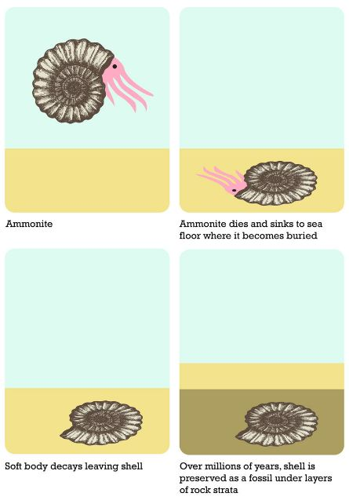
Why aren’t soft
parts of bodies
preserved in fossils?

Slide 6
TYPES OF FOSSILS
TRACE FOSSIL = marking left by an animal (footprint, trail, burrow, etc.)
CAST = when minerals in rocks fill a space left by a decayed organism… makes a cast (replica) of the organism
PETRIFIED FOSSIL = when minerals penetrate and replace the hard parts of an organism (makes copy)

Slide 7
TYPES OF FOSSILS
IMPRINTS = thin object (leaf) falls into sediment and leaves imprint when sediment hardens
AMBER-PRESERVED = organism quickly trapped in tree sap (also frozen in ice)
MOLD = forms when an organism is buried in sediment and decays, leaving an empty space

Slide 8
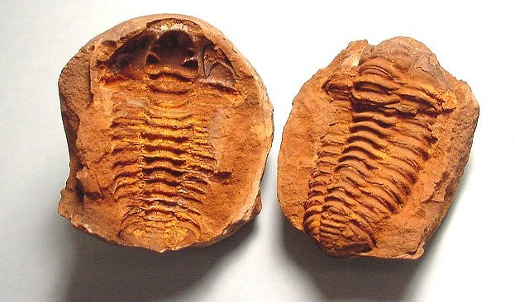
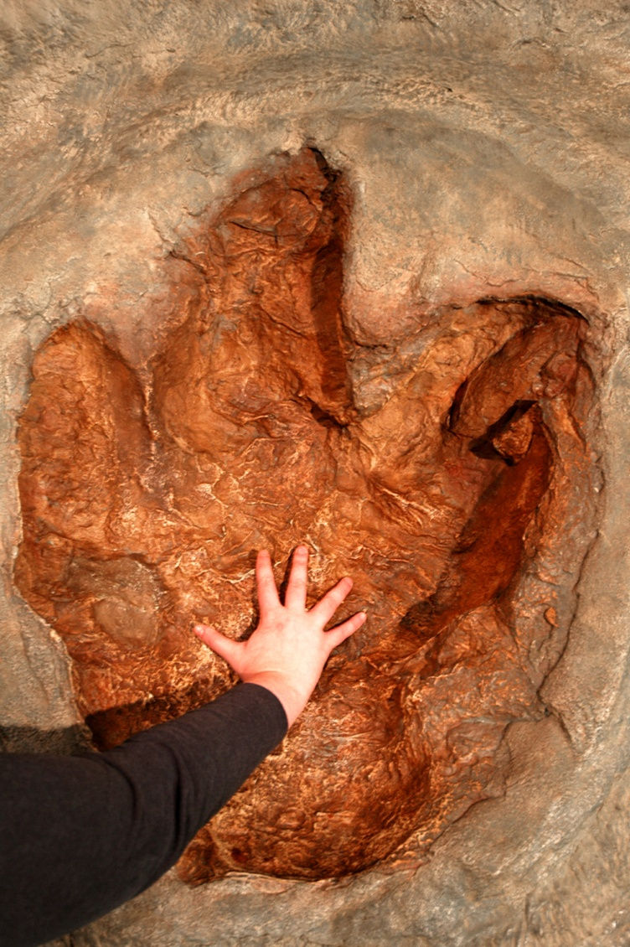
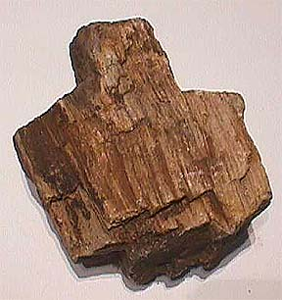
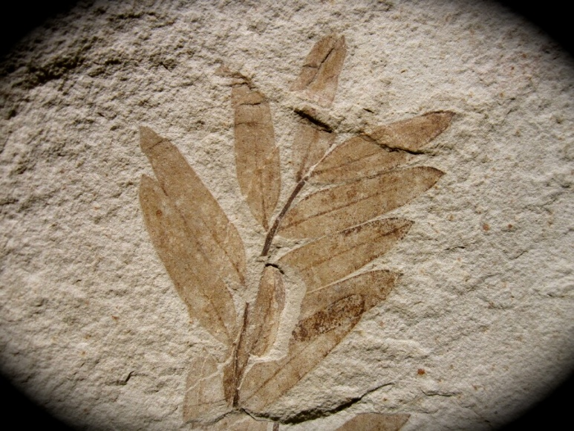
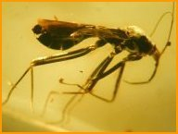
TYPES OF FOSSILS
Trace (T. Rex)
Mold
Cast
Cast
Petrified Wood
Amber
Imprint

Slide 9
THE AGE OF A FOSSIL
1. RADIOMETRIC DATING
determines specific ages of fossils
Radioactive isotopes decay at a measurable rate
As they decay, they turn in to something new
Half-life = time it takes for half of the radioactive isotope to decay and turn in to something new

Slide 10
THE AGE OF A FOSSIL
RADIOMETRIC DATING
RADIOACTIVE ISOTOPE | HALF-LIFE
Potassium-40 | 1.3 billion years
Carbon-14 | 5730 years

Slide 11
THE AGE OF A FOSSIL
A scientist was dating a fossil using carbon-14. If he began with 20 grams, and all that remained were 5 grams, how old is the fossil (hint: the half life of C-14 = 5730 years)

Slide 12
THE AGE OF A FOSSIL
2. RELATIVE DATING
Fossils are found in different layers of rock
Top layers younger
Bottom layers older
Cannot determine the actual age!
younger
older

Slide 13
Review….
How old do scientists believe the Earth is?
What was our Earth originally like?
What gases were present in early Earth’s atmosphere?
Where on Earth do scientists propose life first began?
How do fossils form?
What are the six types of fossils?
What are the two ways we can date/determine the age of a fossil? Which is more accurate?

Slide 14
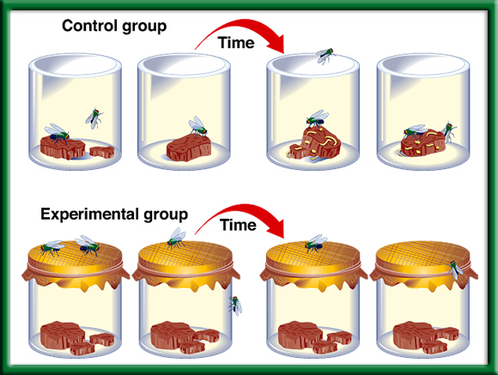
How did life appear?
Used to believe in spontaneous generation-living things came from nonliving things

Slide 15
How did life appear?
In the 1950s, American scientists Miller and Urey conducted experiments to determine if organic molecules could have been created from the harsh environment of early earth
Simulated early atmosphere conditions by filling a flask with hydrogen, methane, ammonia, and water to represent the atmosphere
Passed electric sparks through the mixture to simulate lightning

Slide 16
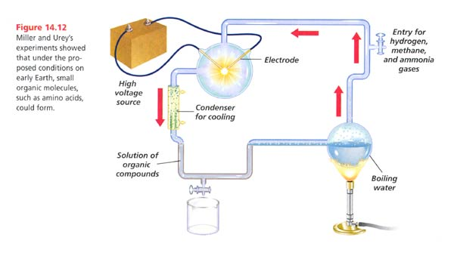
How did life appear?
Amazing results! Over a few days several amino acids began to accumulate!
Recall: What are amino acids?

Slide 17
Evolution of Living Organisms
First Cells = PROKARYOTES!!!
Bacteria
Anaerobic because Earth’s early atmosphere lacked Oxygen
Food = small molecules in the early ocean
If they had to obtain their food, where they heterotrophs or autotrophs???

Slide 18
Evolution of Living Organisms
-Over time fossil evidence shows organisms evolved to survive in the presence of oxygen….but where did oxygen originate from?
-Photosynthetic Prokaryotes!
-make their own food
- product of photosynthesis = oxygen
* formation of the ozone layer
* life comes from the sun

Slide 19
Evolution of Living Organisms
The rise of oxygen in the atmosphere led to the extinction of some life forms, while other life forms evolved new, more efficient metabolic pathways that used oxygen for RESPIRATION
How did eukaryotes develop over time?
Endosymbiotic theory

Slide 20
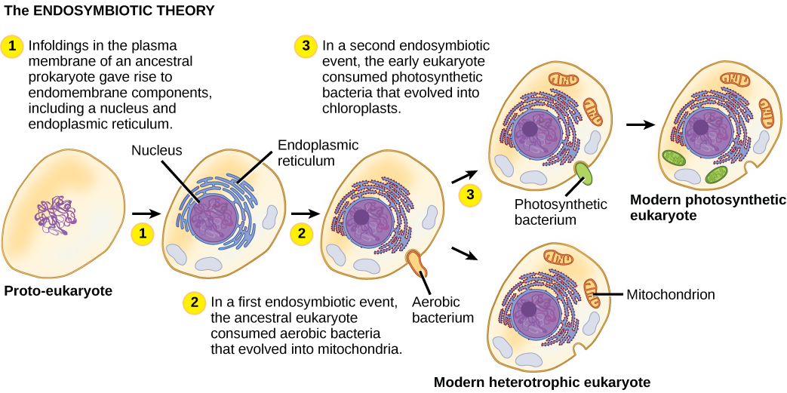
Evolution of Living Organisms
Endosymbiotic theory proposes that eukaryotic cells arose from living communities formed by prokaryotic organisms.

Slide 21
Evidence for Endosymbiotic Theory
1. Mitochondria and choloroplasts contain DNA similar to bacterial DNA
2. Mitochondria and bacteria have ribosomes whose size and structure closely resembles bacteria
3. Mitochondria and bacteria reproduce the same way – binary fission
http://education-portal.com/academy/lesson/the-endosymbiosis-theory-evolution-of-cells.html

Slide 22
Evolution of Living Organisms
Most prokaryotes reproduce asexually
What process do they reproduce by?
Some time after eukaryotes developed, cells began to reproduce sexually
Remember sexual reproduction (meiosis) results in greater genetic diversity and variation
Increasing the number of gene combinations increases the probability that favorable combinations will be produced – favorable combinations greatly increase the chance of evolutionary change in a species

Slide 23
EARLY HISTORY OF EARTH
Are scientists sure that life began this way?
NO
There is no direct evidence of these early years
The oldest rocks that have been found on Earth are only 3.9 billion years old

Slide 24
Review
What is spontaneous generation?
What did Miller and Urey’s experiment prove?
What did the first organisms look like?
From there they were able to make their own food, so they evolved into ________ __________.
Then the organisms developed into ____________ that started to reproduce ____________.
What theory explains how eukaryotes evolved over time?
Finally, ________________ organisms appeared.

