Slide 1
Recall Homeostasis…
Remember that homeostasis is about maintaining a balance between the environment INSIDE your body and the environment OUTSIDE your body
Structural adaptations have evolved to help animals thrive and assume specialized roles (niches) in even the most extreme of environments

Slide 2
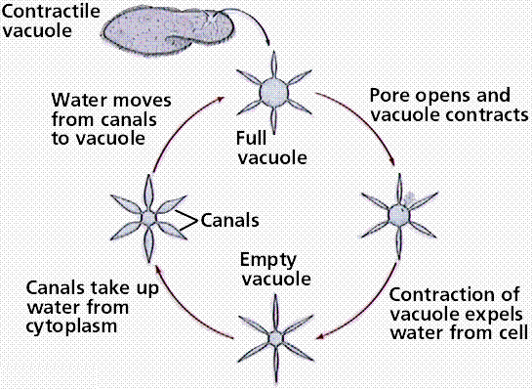
Contractile Vacuoles in Unicellular Organisms
Not all animal cells have vacuoles; some do, and if so they are called contractile vacuoles. Their purpose is to remove excess water build up inside the cell.

Slide 3
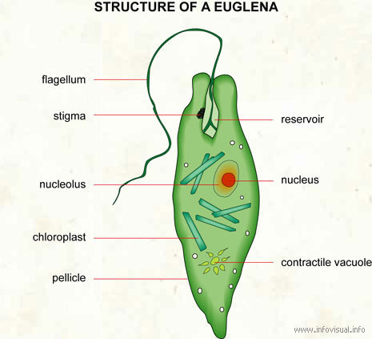
Contractile Vacuoles in Unicellular Organsims

Slide 4
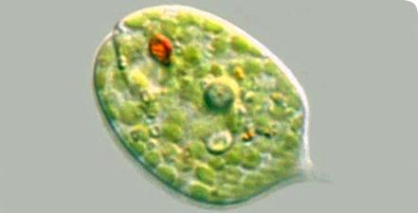
Eyespot in Unicellular Organisms
The eyespot apparatus is a photoreceptive organelle found in the flagellate or (motile) cells of green algae and other unicellular photosynthetic organisms such as euglenids. It allows the cells to sense light direction and intensity and respond to it by swimming either towards the light (positive phototaxis) or away from the light (negative phototaxis).
Red eyespot

Slide 5
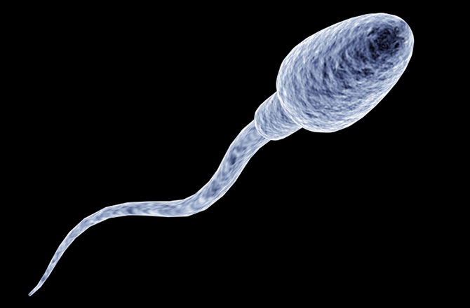
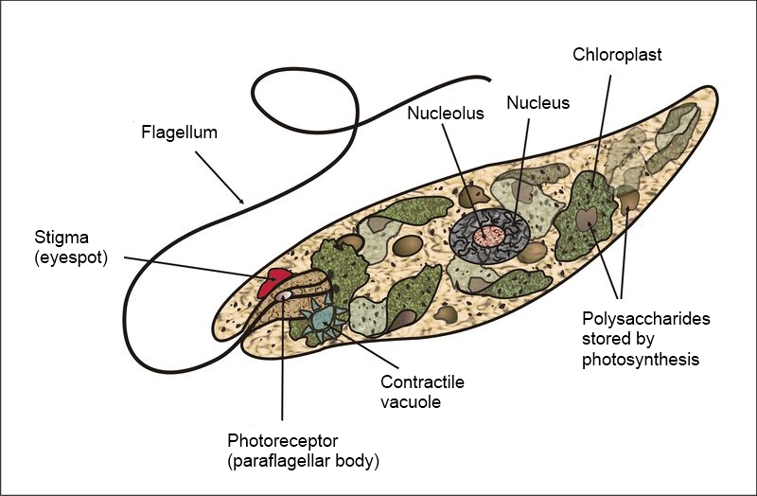
Flagella
Flagella are long whiplike tails used for motion of the cell toward food, away from predators, and for reproduction.

Slide 6
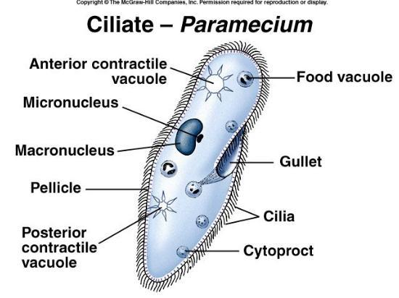
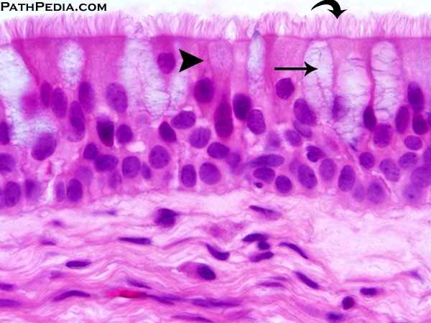
Cilia
Small hairlike projections from the cell membrane used for motion of mucus in respiratory system and movement in unicellular organisms

Slide 7
Cilia
Flagella
Definition | Cilia are short, hair like appendages extending from the surface of a living cell. | Flagella are long, threadlike appendages on the surface of a living cell.
Length | Short | Longer than cilia, can vary
Motion | Rotational, like a motor, very fast moving | Wave-like, undulating, sinusoidal, slow movement compared to cilia
Density | Many (hundreds) per cell | Few (less than 10) per cell
Found in | Eukaryotic cells | Eukaryotic and prokaryotic cells
Etymology | Pronounced as ‘silly-ah’, is the plural of cilium. From Latin word for eyelash. | Pronounced as ‘fla-gel-ah’, is the plural of flagellum. From Latin word for whip.

Slide 8
Chemotaxis
Chemotaxis is the phenomenon whereby bacteria, and other single-cell or multicellular organisms direct their movements according to certain chemicals in their environment. This is important for bacteria to find food (move to the greatest concentration of particles) or to move away from toxins.

Slide 9
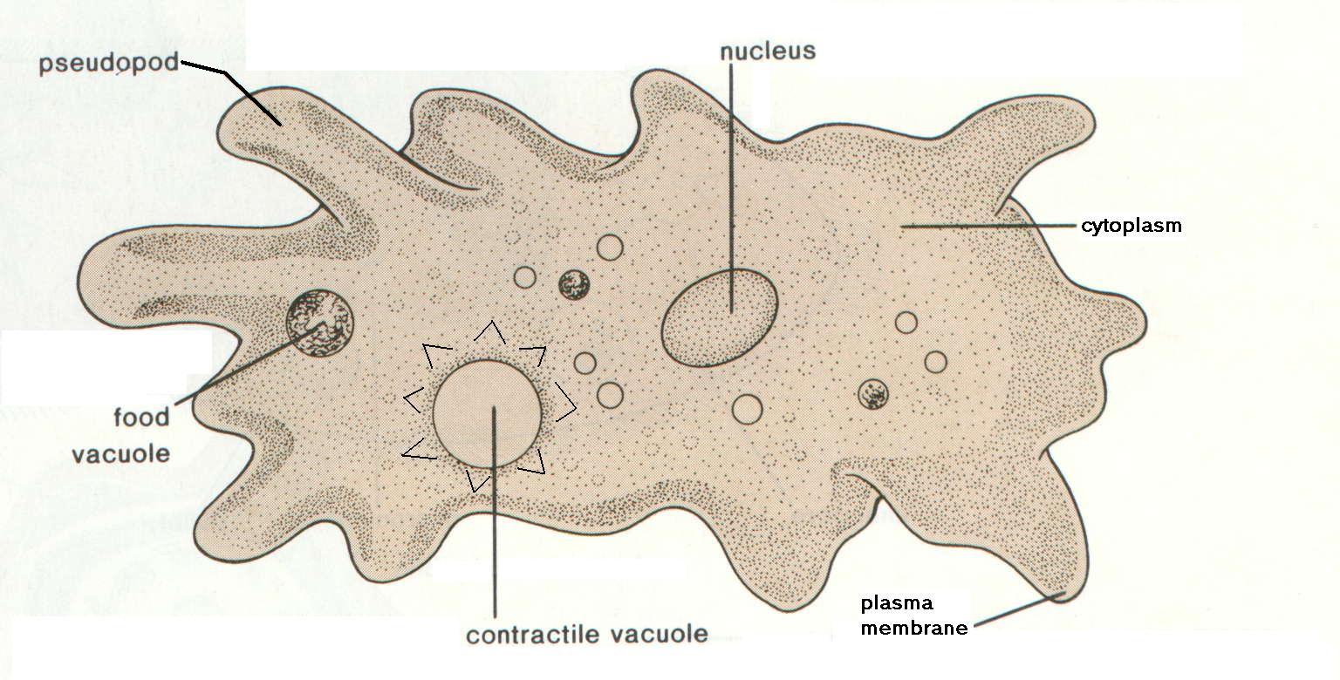
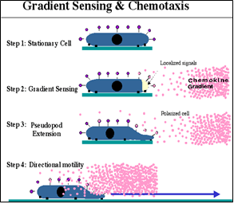
Pseudopod
Amoebas use a pseudopod (fake foot) to
move toward/away from chemicals

Slide 10
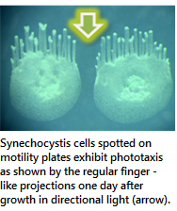
Phototaxis is a kind of taxis, or locomotory movement, that occurs when a whole organism moves in response to the stimulus of light. This is advantageous for phototrophic organisms as they can orient themselves most efficiently to receive light for photosynthesis. Phototaxis is called positive if the movement is in the direction of increasing light intensity and negative if the direction is opposite.

