Slide 1
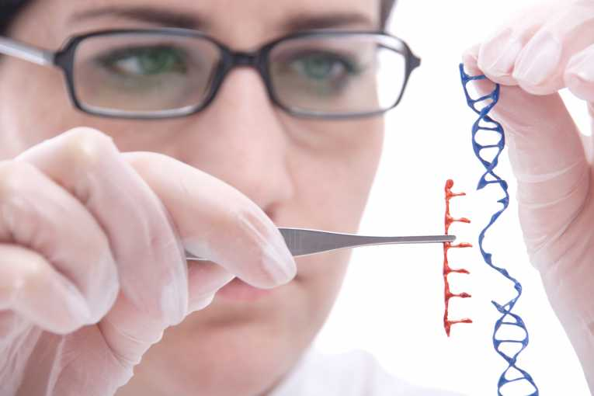
Genetic Engineering

Slide 2
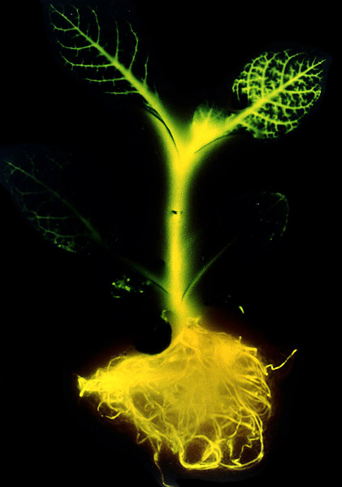
Genetic engineering: Changing the DNA in living organisms to create something new.
These organisms are called Genetically Modified Organisms (GMO), or transgenic organisms; since genes are transferred from one organism to another
Example:
Bacteria that produce human insulin
Tobacco plant with luminescence gene from a firefly

Slide 3
Some genetic engineering techniques include:
1. Artificial selection
A. selective breeding
B. hybridization
C. inbreeding
2. Cloning
3. Gene splicing – Transgenic Organisms
4. Gene Therapy

Slide 4
1. Artificial selection: breeders choose which organism to mate to produce offspring with desired traits.
They cannot control what genes are passed.
When they get offspring with the desired traits, they maintain them by continuing to breed them.
Three types of artificial selection:
A. selective breeding
B. hybridization
C. inbreeding

Slide 5
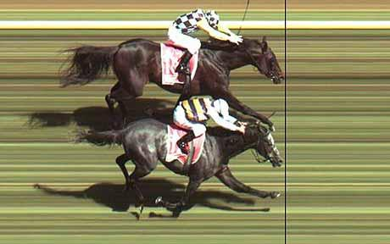
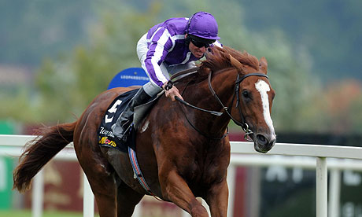
A. Selective breeding: when animals with desired characteristics are mated to produce offspring with those desired traits.
Passing of important genes to next generation.
Example: Champion race horses, cows with tender meat, large juicy oranges on a tree.

Slide 6
People breed dogs for specific purposes.
Dachshunds were once bred to hunt badgers and other burrowing animals.
They had to be small to fit into the animal’s hole in the ground.

Slide 7
Benefits of selective breeding:
Angus cows are bred to increase muscle mass so that we get more meat
Egg-Laying Hen-produces more eggs than the average hen

Slide 8
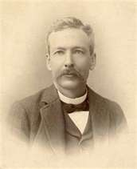
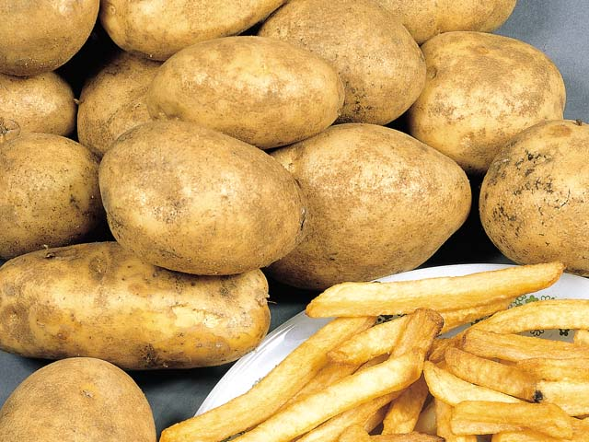
B. Hybridizations: two individuals with unlike characteristics are crossed to produce the best in both organisms.
Example: Luther Burbank created a disease resistant potato called the Burbank potato.
He crossed a disease resistant plant with one that had a large food producing capacity.
Result: disease resistant plant that makes a lot of potatoes.

Slide 9
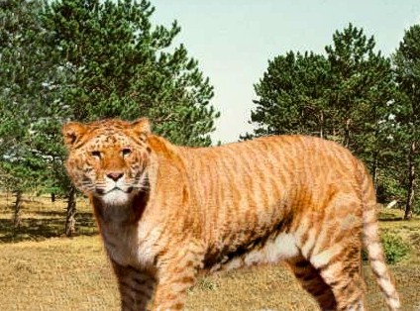
Other Examples of hybridization:
Liger: lion and tiger mix

Slide 10
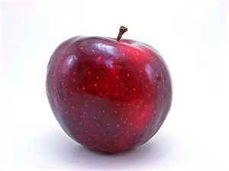
2. Grape + apple= grapple. The fruit tastes like grapes and looks like apple.

Slide 11
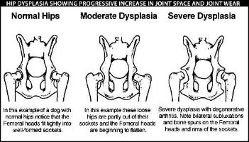
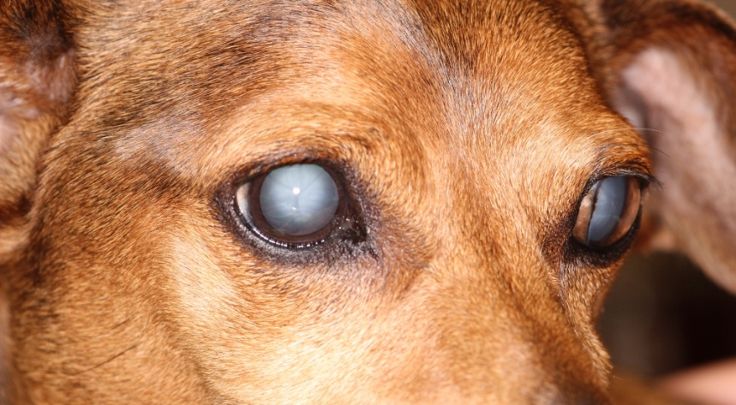
C. Inbreeding - breeding of organisms that are genetically similar to maintain desired traits.
Dog breeds are kept “pure” and unique from other breeds.
Risk: Since both parents have the same genes, the chance that a baby will get a recessive genetic disorder is high.
Risks: cataracts, hip dysplasia (joint deformities)

Slide 12
Variation: difference between individuals of a species. Variation occurs as a result of combinations of different genes in organisms.
Results in: different skin color, hair color, eye color, height, etc
Inbreeding decreases genetic variation because no new genes are introduced.

Slide 13
Cloning: creating an organism that is an exact genetic copy of another.
There are human clones in our school.
identical twins are naturally created clones.
Clone: group of cells or organisms that are genetically identical as a result of asexual reproduction
They will have the same exact DNA as the parent.

Slide 14
How is cloning done?
A single cell is removed from a parent organism.
An entire individual is grown from that cell.
Remember one cell has all the DNA needed to make an entire organism.
Each cell in the body has the same DNA, but cells vary because different genes are turned on in each cell. This is differentiation!

Slide 15
Dolly:
Dolly was the first mammal cloned. (1996)
She had the same exact DNA as her mother and had no father.
Cloning is a form of asexual reproduction, since there is only one genetic parent.
http://content.tutorvista.com/biology_11/content/media/cloning.swf

Slide 16
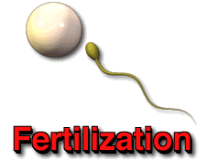
Eggs are haploid
Haploid: half the chromosomes, 23 in humans
Body cells are diploid:
Diploid: two sets of chromosomes, one from mom and one set from dad 46 in humans.

Slide 17
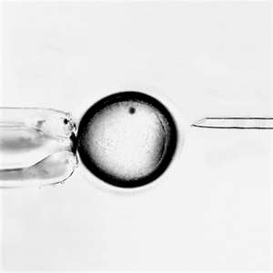
How could you clone a human?
Step 1: An egg is removed from a female human
Eggs are haploid: 23 chromosomes.
The nucleus of the egg is removed and is thrown away.
23
EGG CELL

Slide 18
Step 2: A body cell is removed from another person.
The nucleus of the body cell is removed
Body cells are diploid: 46 chromosomes.
46
Body Cell

Slide 19
Step 3:
The nucleus of the diploid body cell is put into the egg.
This egg no longer needs to be fertilized since it has all 46 chromosomes.
46
EGG CELL

Slide 20
Step 4: The egg is then charged with electricity to start mitosis.
Step 5: Its then put into a surrogate mother so it can grow.
Its going to be genetically identical to the parent of the body cell. But it will be a baby.
Plants and animals can be cloned.

Slide 22
Benefits of cloning:
You can make exact copies of organisms with strong traits.
Increase food supply
Medical purposes: clone organs for transplants.
Bring back or stop species from going extinct.
Saber Tooth Tiger extinct

Slide 23
Risks of cloning:
Decreases genetic diversity
If one of your clones gets a disease, they all get it: same immune system.
Inefficient: high failure rate: 90%+
Expensive

Slide 24
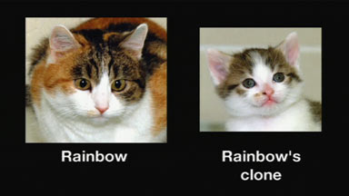
Since Dolly, cats and other organisms have been cloned.
The cat that was cloned had the same exact DNA but different color fur than the mother.
How can this be?

Slide 25
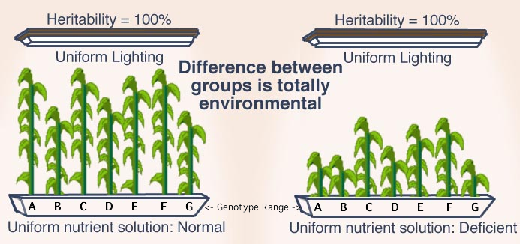
Environment CAN affect how genes are expressed (phenotype)
Identical twin studies: identical twins raised apart in separate homes/environments showed different intelligences

Slide 26
We can change the phenotype (color) of hydrangea blooms by changing the acidity of the soil:
Acidic soil produces pink blooms
Basic soil produces blue blooms

Slide 27
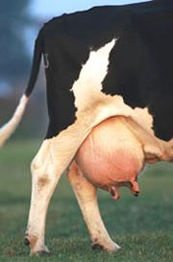
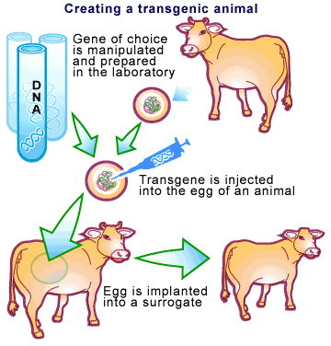
Why make transgenic organisms (animals and plants)?
1. A way to improve amount of food when human population continues to increase! Transgenic cows: gene inserted to increase milk production.

Slide 28
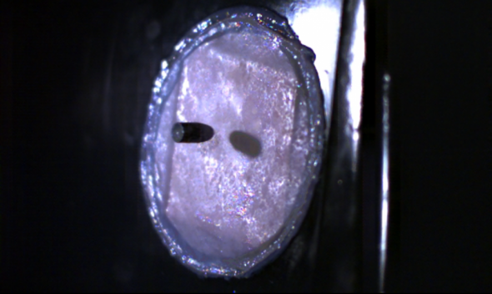
B. Spider goat: gene from spider inserted into goat.
Goats make silk of the spider web in their milk.
Flexible, stronger than steel. Used in bullet proof jackets.

Slide 29
C. Glow-in-the-dark cats
Scientist used a virus to insert DNA from jellyfish
The gene made the cat produce a fluorescent protein in its fur.

Slide 30
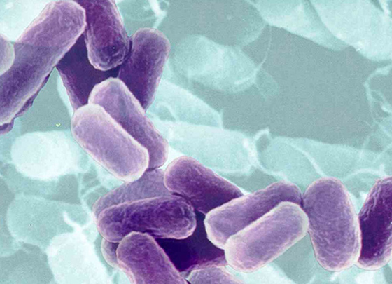
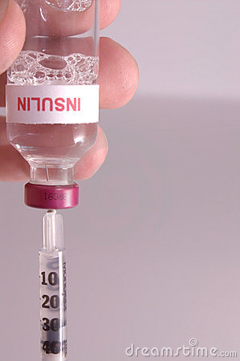
Transgenic bacteria: gene inserted into bacteria so they produce things humans need.
For example: insulin and clotting factors in blood are now made by bacteria.

Slide 31
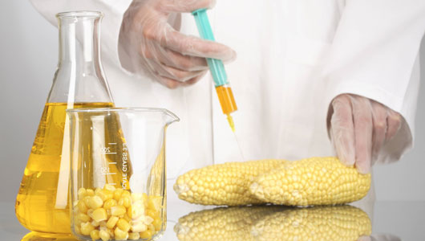
Transgenic plants: plants are given genes so they meet human needs.

Slide 32
a. Venomous cabbage
gene from a scorpion tails inserted into cabbage.
Cabbage now produces that chemical.
Why? Limit pesticide use while still preventing insects from damaging crops.
Corporations state the toxin is modified so it isn’t harmful to humans.

Slide 33
b. Banana vaccines
virus is injected into a banana, the virus DNA becomes part of the plant.
As the plant grows, it produces the virus proteins — but not the disease part of the virus.
When people eat a bite, their immune systems creates antibodies to fight the disease — just like a traditional vaccine
Vaccines for hepatitis and cholera

Slide 34
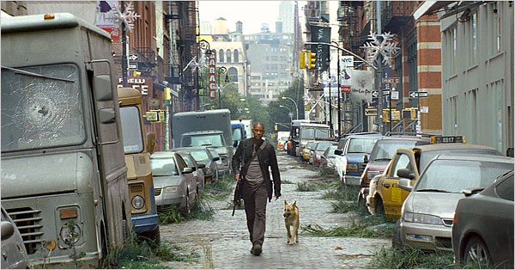
A virus is often used to deliver DNA.
In the movie “I Am Legend,” A healthy gene was inserted into a virus.
The virus invaded the cancer cells and inserts the healthy gene to cure cancer. Worked at first but the virus mutated and became deadly.
This is being attempted in real life right now:
AIDS virus is being used as a vector to help cure cancer.

Slide 35
Gene therapy: When disease causing genes are cut out and good genes are inserted.
Restriction enzymes are used to cut out bad genes.
Viruses (vector) are used to insert good genes.

Slide 36
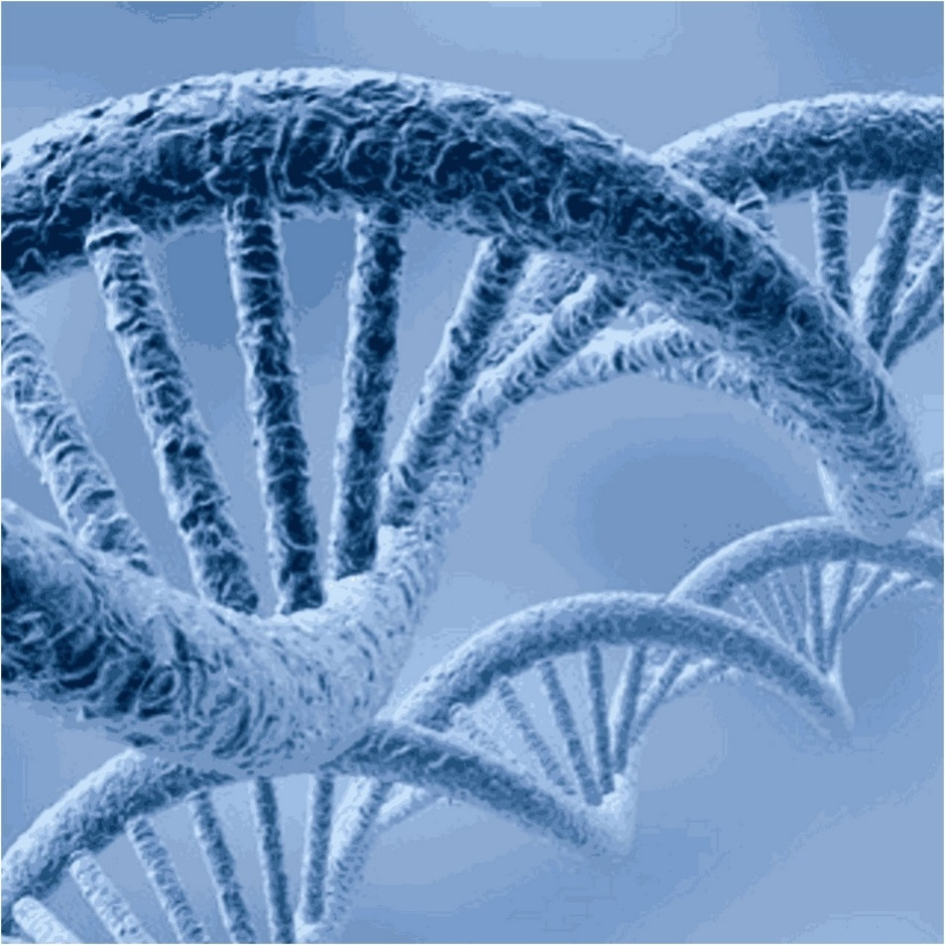
Human Genome Project
Gene therapy could work thanks to the Human Genome Project (2001), a federally funded effort to completely map and sequence the entire human genome.
Approximately 35,000-40,000 genes on 46 chromosomes have been mapped to specific locations on particular chromosomes

Slide 37
Experimental trials for gene therapy are relatively new due to potential lethal side effects.
EX: Cystic fibrosis and Severe Combined Immunodeficiency (SCID)

Slide 38
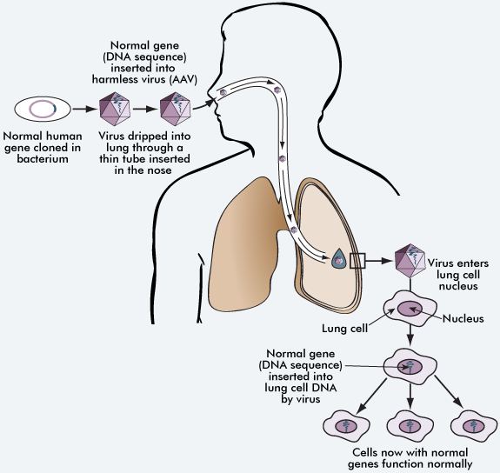
Cystic Fibrosis Gene Therapy

Slide 39
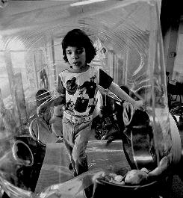
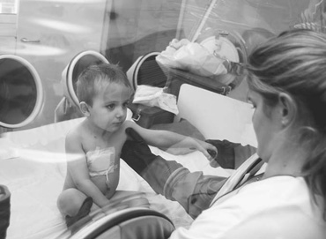
Severe Combined Immunodeficiency
Diagnosed in 40 to 100 babies every year in the US. Results in the inability of the body to fight off infection.
Gene therapy has cured
8 of 10 children with this
disease as of January 2009

