Slide 1
ATP – Energy for LIFE!

Slide 2
Source of Energy
Everything needs energy in order to survive and carry out the basic functions required for life
Energy comes from two sources:
(1) Sun – ultimate source of energy for all living things on our planet
(2) Food – eating food gives us the energy we need to perform functions required for survival

Slide 3
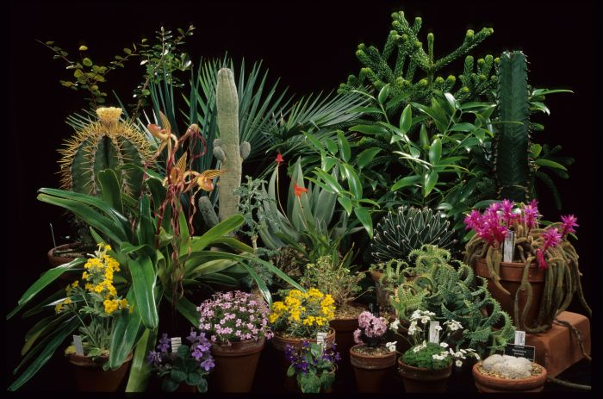
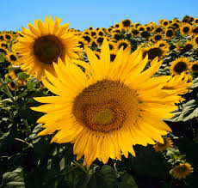
Sun
Sun provides light energy that some organisms can use directly for energy.
Autotrophs are organisms that make their own food
Examples of autotrophs include plants

Slide 4
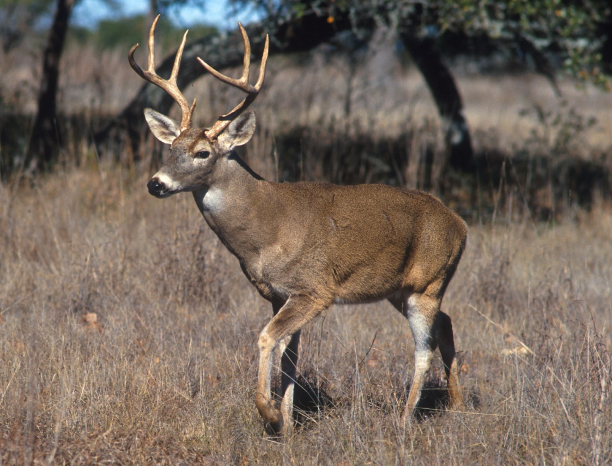
Food
Other organisms cannot use the sun’s energy directly
These organisms, called heterotrophs, obtain energy from the food they eat.
Examples of heterotrophs include lions, deer, mushrooms (get food by decomposing other organisms), people

Slide 5
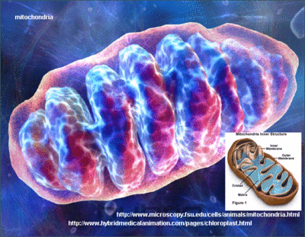
Cell’s Energy
A cell’s energy is supplied by the mitochondria. The energy “currency” produced by the mitochondria is ATP (Adenosine Triphosphate)

Slide 6
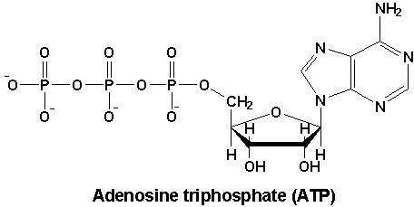
Chemical Fuel - ATP
Cells use Adenosine Triphosphate (ATP) to store and release energy
Made up of adenine, ribose (5 carbon sugar), and three phosphate groups
ENERGY!

Slide 7
Phosphate Bonding
The three phosphate groups that make up ATP have the same charge (negative)
Remember that opposite charges attract, while like charges REPEL
It requires lots of energy to get the phosphate groups to bond because of the repulsion of the like charges

Slide 8
Storing Energy - ADP
There are lots of energy stored in the chemical bonds present between the phosphate groups.

Slide 9
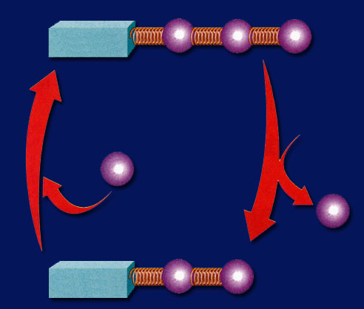
Releasing Energy
The chemical bonds in ATP can be broken, energy is released, and ADP is formed
ADP is free to bind another phosphate group
Unlimited energy as long as phosphate groups are available!
Adenosine Triphosphate (ATP)
Adenosine Diphosphate (ADP)

Slide 10
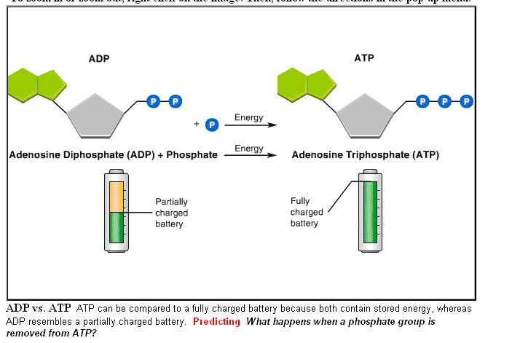

Slide 11
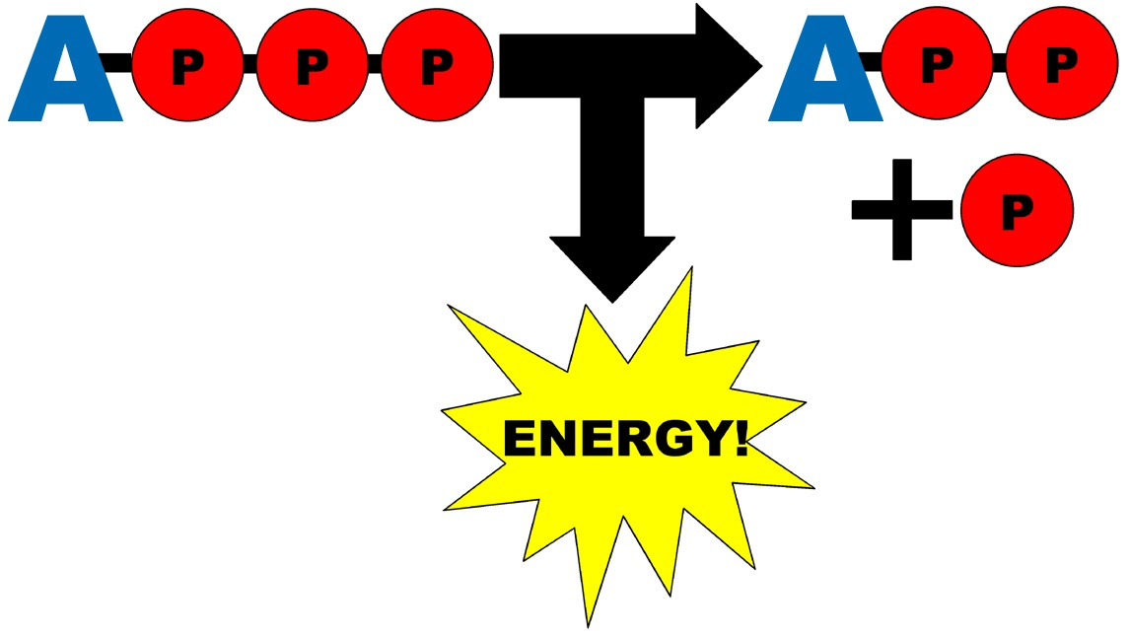
ATP Synthase
The ADP → ATP chemical reaction (recharging the battery) happens with the help of the enzyme ATP synthase , which is found in the inner folds of the mitochondria.

Slide 12
ATP Regeneration
Cells can regenerate ATP from ADP as needed by using foods like glucose
Organisms (like us!) must release the energy associated with glucose and other compounds to perform basic functions required for life

