Slide 1
Behavioral Animal Adaptations
Survival of organisms

Slide 2
ANIMAL BEHAVIOR
BEHAVIOR = anything an animal does in response to a stimulus in its environment
What is a stimulus for bears beginning to hibernate?
What is a stimulus for a dog beginning to bark?

Slide 3
ANIMAL BEHAVIOR
INNATE
INNATE BEHAVIOR = behaviors that animals inherit from parents
These behaviors are typically genetic
Example: toad using tongue to catch prey
Fight or flight response
Herding behavior for protection

Slide 4
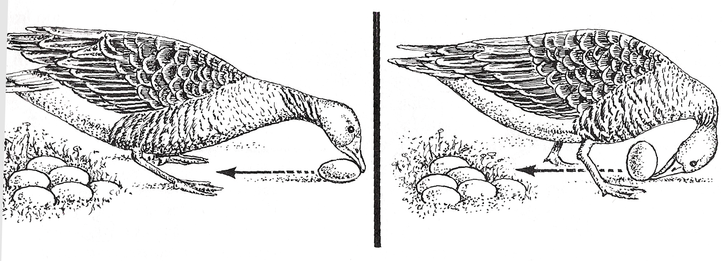
ANIMAL BEHAVIOR
INNATE
Another example: graylag goose retrieving eggs that roll out of the nest

Slide 5
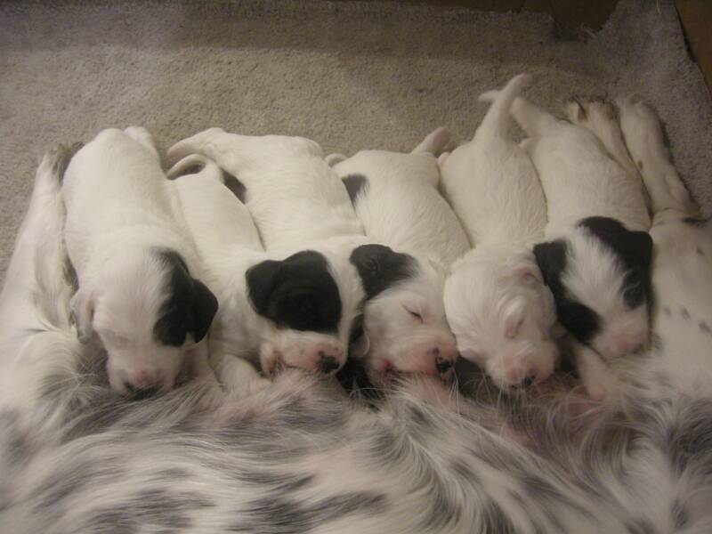
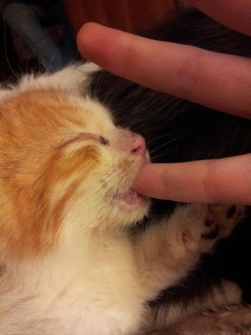
ANIMAL BEHAVIOR
INNATE
Suckling behavior – newborns are able to suckle at nipple to obtain nourishment
This is an innate behavior

Slide 6
ANIMAL BEHAVIOR
INNATE
Also includes:
Courtship behavior
Territoriality
Migration/hibernation/estivation
Pheromones/chemical messages

Slide 7
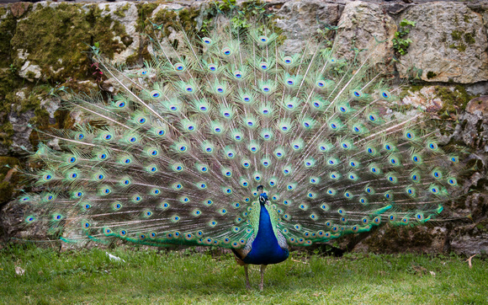
Courtship Behavior
Birds of Paradise are among the many examples of bird species that have elaborate dance/courtship behavior in an effort to attract a mate. They will clean the “performance area” off, and then practice their display
Male peacocks will strut and display plummage as a way to attract a mate

Slide 8
Territorial Defense
A territory is a physical space an animal defends against other members of its species. It may contain the animal’s breeding area, potential mates, feeding area, or all three.
Setting up territories reduces conflict, controls population growth, and provides for efficient use of resources. This means animals don’t compete for the same resources within a small space, and improves chances of survival of the young, and therefore, the species.
EX: Betta fighting fish, three-spined stickleback displays red belly to warn off other males

Slide 9
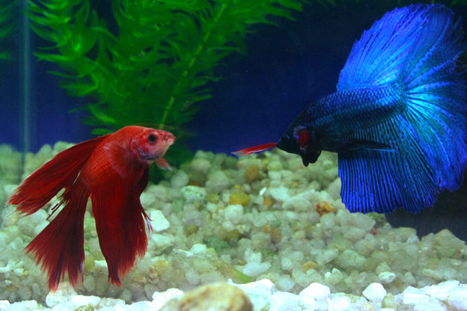
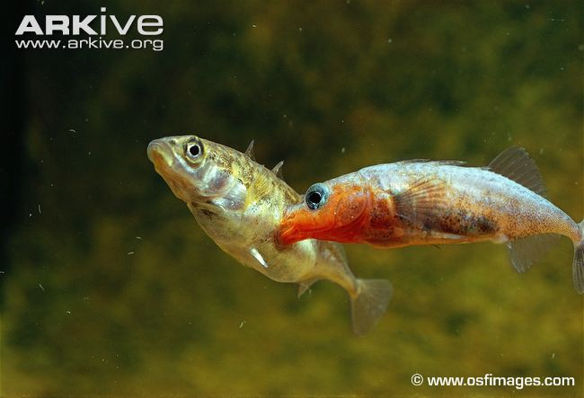
Territorial Defense

Slide 10
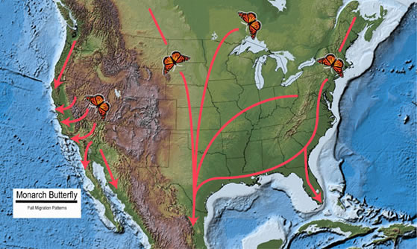
Migration
Cues/stimulus from external environment causes animals to migrate/move to different locations
EX: birds and butterflies migrate south for the winter

Slide 11
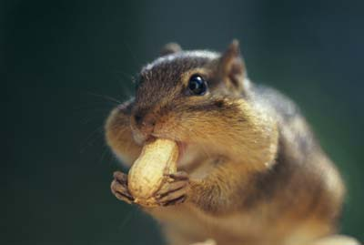
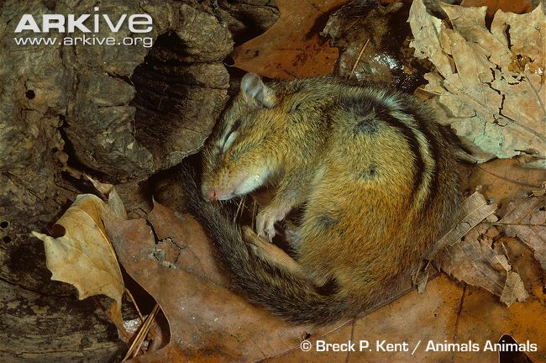
Hibernation
Hibernation is a state where the body temperature drops substantially, oxygen consumption decreases, and breathing rates decline to a few breaths per minute. (Conserve energy)
Animals that go into hibernation to survive the cold winter months when food is scarce usually eat vast amounts food to build up body fat before entering hibernation.
EX: bears, squirrels, bats

Slide 12
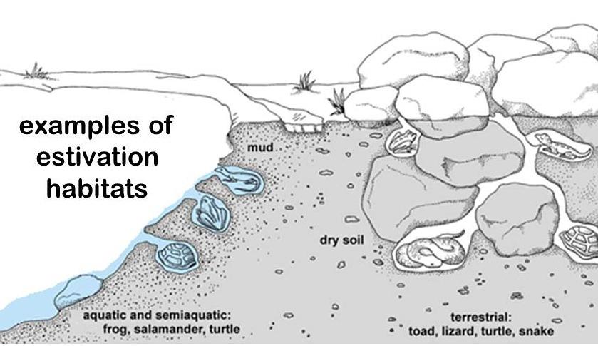
Estivation
Estivation is a state of reduced metabolism that occurs in animals living in conditions of extreme heat.
EX: desert animals may estivate due to lack of food or during periods of drought

Slide 13
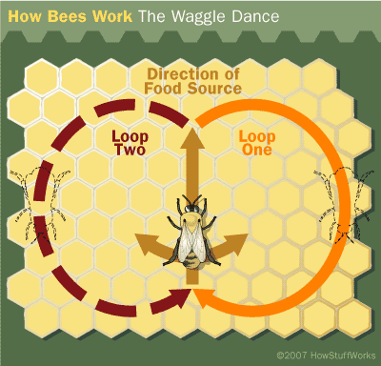
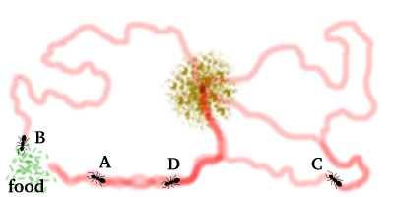
Phermones/Chemical Messaging
Insects such as ants, bees, and termites can communicate with each other by leaving phermones behind
Ants leave chemical trails that are followed by other members of their nest
A honey bee performs a carefully choreographed "waggle" dance that instructs the rest of the hive where to find a food source.

Slide 14
Circadian Rhythm
= 24 hour, sleep/wake cycle of behavior in animals
Controlled by genes, but influenced by environment
Most sleep during night, awake during day
Some sleep during day, awake at night

Slide 15
ANIMAL BEHAVIOR
LEARNED
LEARNED BEHAVIOR = takes place when behavior changes through practice or experience
More common in vertebrates than invertebrates
Learning allows an animal to adjust to change (thus, live longer)

Slide 16
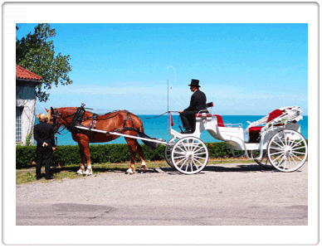
ANIMAL BEHAVIOR
LEARNED
Habituation: getting used to a stimulus (sensory adaptation)
Horses are usually skittish, but horses in a busy city eventually disregard noisy cars and horns. This adaptation is called habituation.

Slide 17
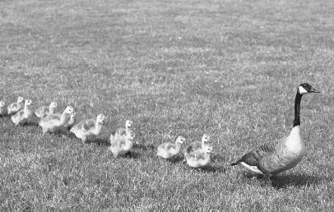
ANIMAL BEHAVIOR
LEARNED
Imprinting: forming an attachment to another object
Ducklings following mother
Happens at a specific time in life
Usually irreversible

Slide 18
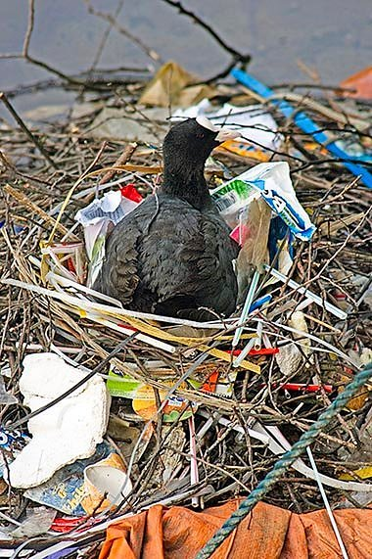
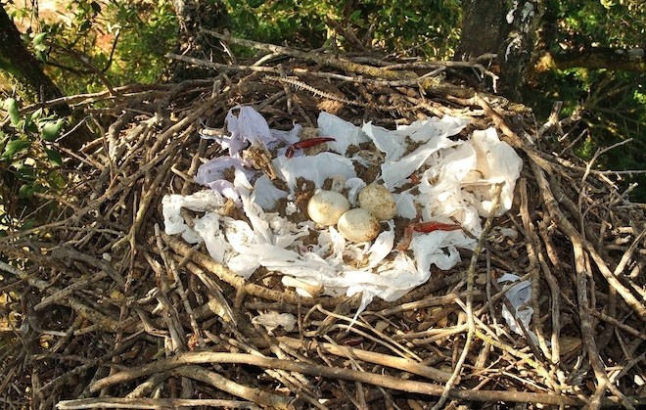
ANIMAL BEHAVIOR
LEARNED
Trial-and-error: learn by mistakes
Birds building nests (coarse vs soft trash)
Animals must have motivation in order to learn!

Slide 19
ANIMAL BEHAVIOR
LEARNED
Classical conditioning is learning by association.
EX: new kitten meows when it smells aroma of food in the can you open. After a few weeks, the sound of the can opener alone attracts the kitten, causing it to meow.
EX: Pavlov’s dogs and salivation

Slide 20
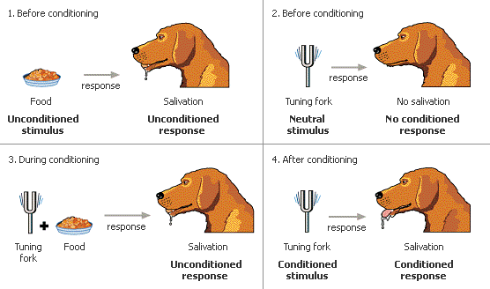
ANIMAL BEHAVIOR
LEARNED
Conditioning:
Learning by association
Pavlov’s dogs
Insight
Most complex type of learning
Using previous experience to learn
Chimpanzees use tools for hunting

Slide 21
Animal Behavior: Taxes/taxis
Chemotaxis is the phenomenon whereby bacteria, and other single-cell or multicellular organisms direct their movements according to certain chemicals in their environment. This is important for bacteria to find food (move to the greatest concentration of particles) or to move away from toxins.

Slide 22
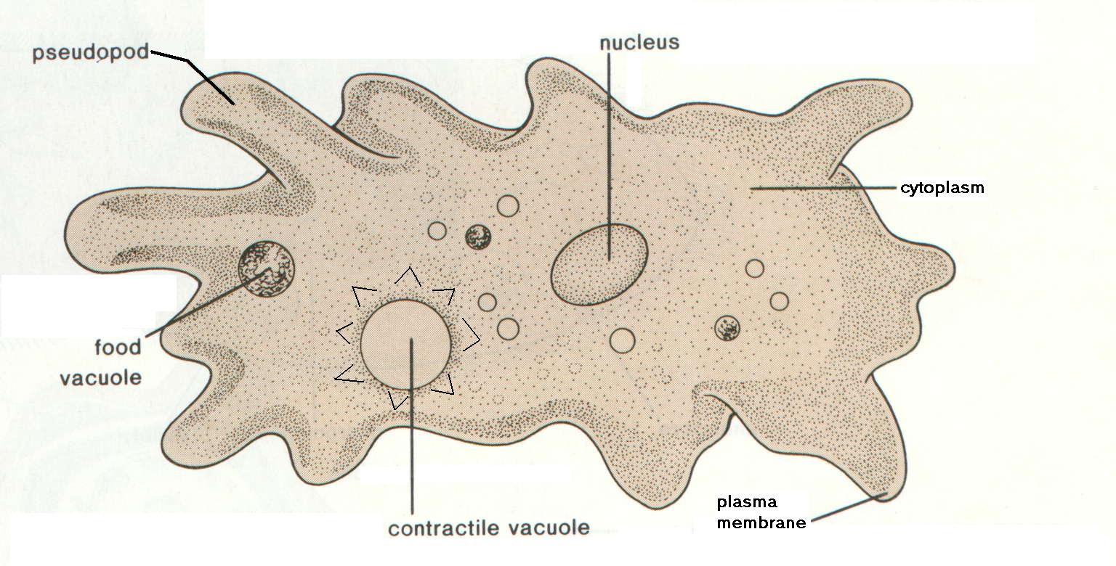
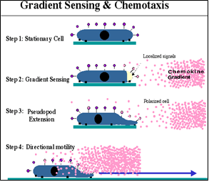
Animal Behavior: Taxes/taxis
Amoebas use a pseudopod (fake foot) to
move toward/away from chemicals

Slide 23
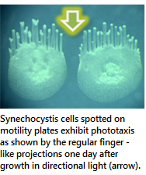
Animal Behavior: Phototaxis
Phototaxis is a kind of taxis, or locomotory movement, that occurs when a whole organism moves in response to the stimulus of light. This is advantageous for phototrophic organisms as they can orient themselves most efficiently to receive light for photosynthesis. Phototaxis is called positive if the movement is in the direction of increasing light intensity and negative if the direction is opposite.

