Slide 1
Blood Typing and sex linked traits

Slide 2
Genetics of Blood Types
Your blood type is established before you are born, by specific GENES inherited from your parents.
You inherit one gene from your MOTHER and one from your FATHER.
These genes determine your blood type by causing proteins called AGGLUTINOGENS to exist on the surface of all of your red blood cells.
Blood types are MULTIPLE ALLELES.
Multiple Alleles – having 3 or more alleles for the same gene in a population, HOWEVER any given individual can have only two of these alleles; Ex: coat color in rabbits and A, B, AB, O blood types

Slide 3
Blood Types
There are three alleles of the gene that control blood type: I^{A}, I^{B}, i. The “I” stands for immunoglobin, or the type of white blood cell that would be triggered to attack. I^{A} and I^{B} are codominant genes, meaning when inherited together, they are both fully expressed, not blended, as in Incomplete Dominance. “ i ” is the recessive form of the allele. Type O blood is a recessive trait, therefore two recessive genes must be inherited to have the O blood type.

Slide 4
What are blood types?
Blood Types
AA or AO = Type A BB or BO = Type B OO = Type O AB = Type AB
There are 3 genes for blood type: A, B, & O. Since we have 2 alleles, there are 6 possible combinations.
PHENOTYPE (blood type) | GENOTYPE | ANTIGEN ON RBC | DONATE TO | RECEIVE BLOOD FROM
A | I^{A}I^{A} or I^{A}i | A | A, AB | A, O
B | I^{B}I^{B} or I^{B}i | B | B, AB | B, O
AB | I^{A}I^{B} | A and B | AB | A, B, AB, and O
O | ii | None | A, B, AB, O | O

Slide 5
How common is your blood type?
46.1%
38.8%
11.1%
3.9%

Slide 6
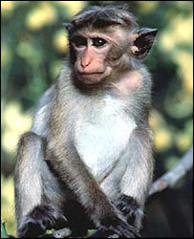
Rh Factors
Scientists sometimes study Rhesus monkeys to learn more about the human anatomy because there are certain similarities between the two species. While studying Rhesus monkeys, a certain blood protein was discovered. This protein is also present in the blood of some people. Other people, however, do not have the protein.
The presence of the protein, or lack of it, is referred to as the Rh (for Rhesus) factor.
If your blood does contain the protein, your blood is said to be Rh positive (Rh+). If your blood does not contain the protein, your blood is said to be Rh negative (Rh-). Rh+ is dominant over Rh-.
A+ A- B+ B- AB+ AB- O+ O-
http://www.fi.edu/biosci/blood/rh.html

Slide 7
Blood Transfusions
A blood transfusion is a procedure in which blood is given to a patient through an intravenous (IV) line in one of the blood vessels. Blood transfusions are done to replace blood lost during surgery or a serious injury. A transfusion also may be done if a person’s body can't make blood properly because of an illness.
Who can give you blood?
People with TYPE O blood are called Universal Donors, because they can give blood to any blood type.
People with TYPE AB blood are called Universal Recipients, because they can receive any blood type.
Rh + → Can receive + or -
Rh - → Can only receive -
Universal Donor
O
A
B
AB
Universal Recipient

Slide 8
Blood Evidence
Blood samples – Can be analyzed to determine blood type and DNA, which can be matched to possible suspects.
Blood droplets – Can be analyzed to give clues to the location of a crime, movement of a victim, and type of weapon.
Blood spatter – Can be analyzed to determine patterns that give investigators clues to how a crime might have happened.

Slide 9
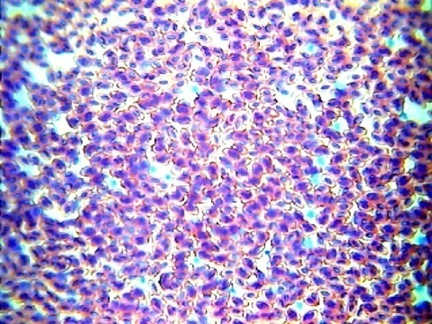
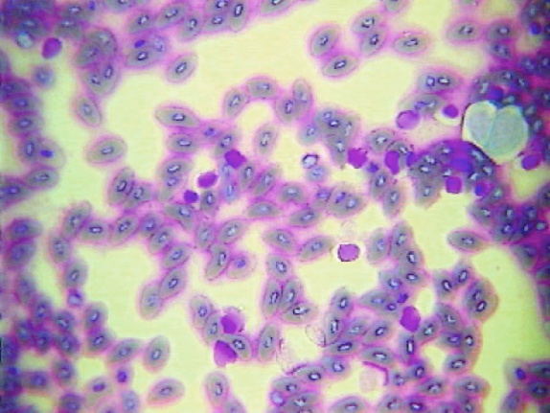
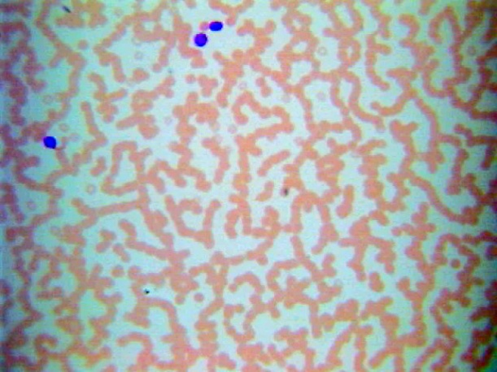
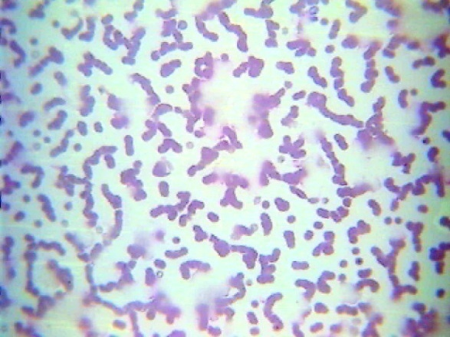
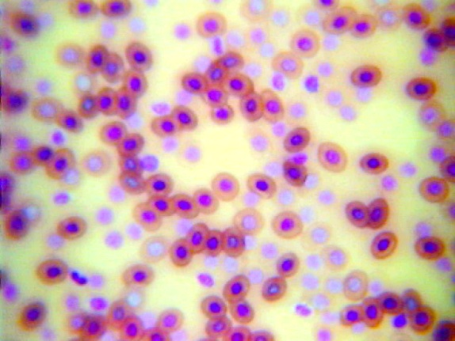
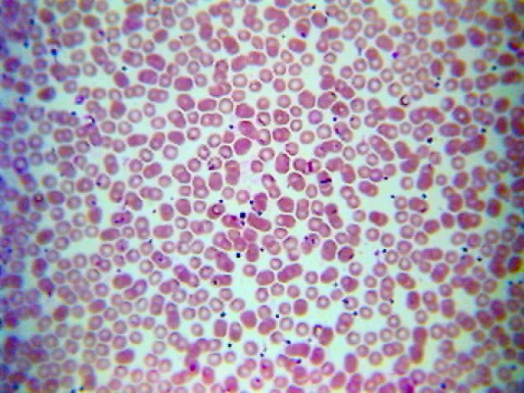
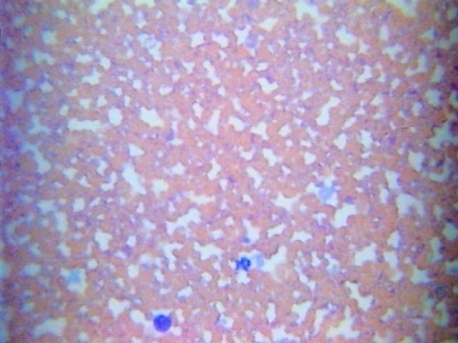
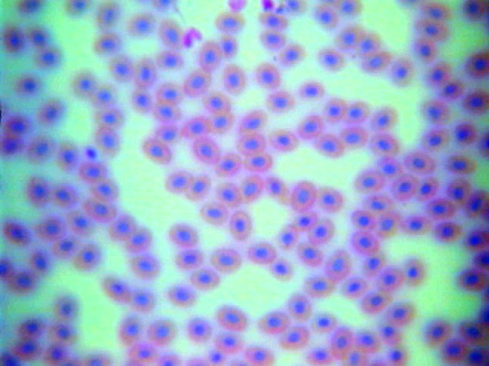
Microscopic Views
Bird Blood
Fish Blood
Horse Blood
Cat Blood
Frog Blood
Human Blood
Dog Blood
Snake Blood

