Slide 1
Carbohydrates

Slide 2
Carbohydrates
Carbohydrates are compounds made of carbon, hydrogen, and oxygen
general formula = CH₂O; 1-2-1 ratio of carbon to hydrogen to oxygen
ribose C₅H₁₀O₅
glucose C₆H₁₂O₆
sucrose C₁₂H₂₂O₁₁
many carbohydrate names end in -ose
Examples of carbohydrates include: sugar, starch, and cellulose

Slide 3
Functions of Carbohydrates
Include:
Energy for metabolism (glucose)
Short term energy storage (glycogen/starch)
Structure: plants – cell wall animals – exoskeleton

Slide 4
Energy for Metabolism
Living things use monosaccharides (simple sugars) as their main source of energy
Breakdown of sugar provides immediate energy for all cell activities
Human blood sugar
Sugar found in milk
Sugar found in fruit

Slide 5
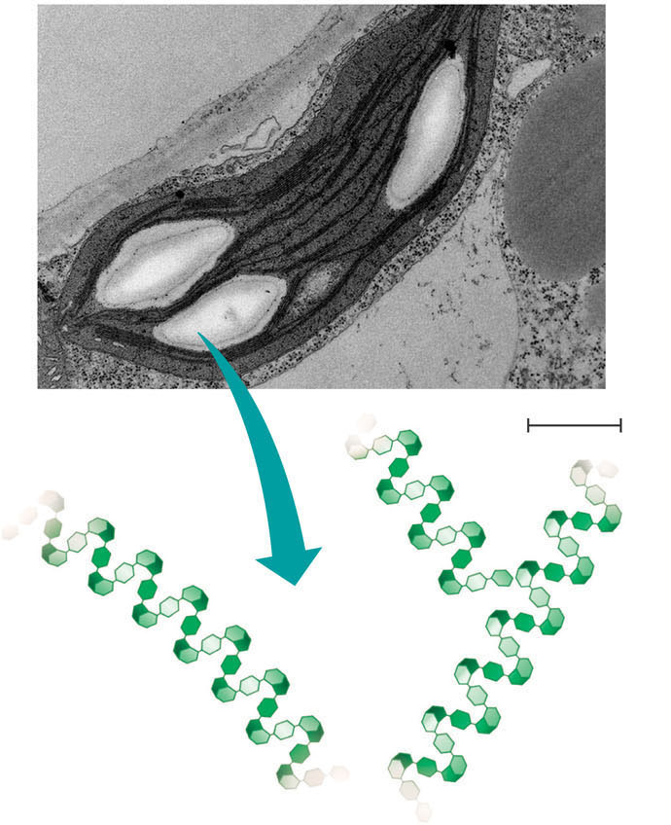
Short Term Energy Storage
Plants store extra sugar as polysaccharides (many sugars) known as starches
The monomers that make up starches are glucose molecules
Examples of foods that contain high amounts of starch include: potatoes, wheat, corn, and rice
Starch: a plant polysaccharide

Slide 6
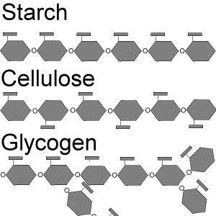
Short Term Energy Storage
Glycogen
Polymer of glucose monomers
Animals store extra sugar called glycogen
Glycogen is stored in liver and muscle
More highly branched than
starch – contains more
stored energy

Slide 7
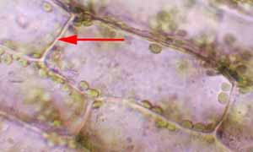
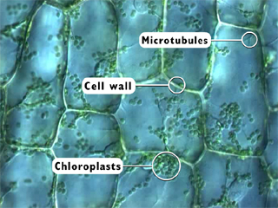
Carbohydrates help form structural units
Cellulose is found in plant cell walls
Tough, flexible cellulose fibers provide the plant with strength and rigidity
Cellulose is composed of glucose monomers
Cellulose is also used in paper and wood

Slide 8
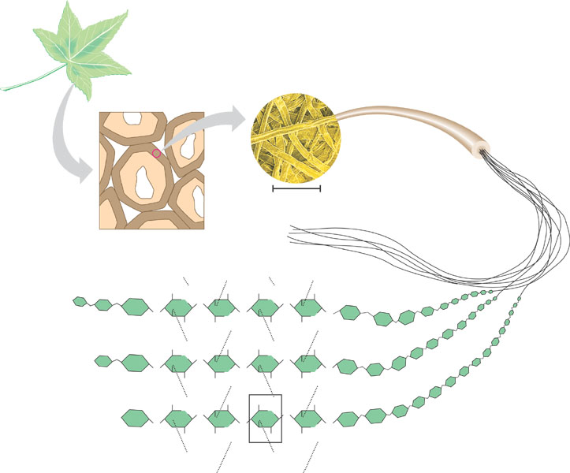
About 80 cellulose
molecules associate
to form a microfibril, the
main architectural unit
of the plant cell wall.
Cellulose microfibrils
in a plant cell wall
Cell walls
Microfibril
∩
0.5 μm
Plant cells
CH₂OH
OH
CH₂OH
OH
O
O
O
O
O
OH
OH
OH
OH
OH
O
O
O
O
CH₂OH
OH
CH₂OH
Cellulose
molecules
CH₂OH
OH
CH₂OH
OH
O
O
O
O
Parallel cellulose molecules are
held together by hydrogen
bonds between hydroxyl
groups attached to carbon
atoms 3 and 6.
O
OH
OH
O
OH
OH
O
OH
O
O
CH₂OH
OH
CH₂OH
CH₂OH
OH
CH₂OH
OH
O
O
O
O
O
OH
OH
O
OH
OH
O
A cellulose molecule
is a straight chain
glucose polymer.
OH
O
O
CH₂OH
OH
CH₂OH
Figure 5.8
Glucose monomer

Slide 9
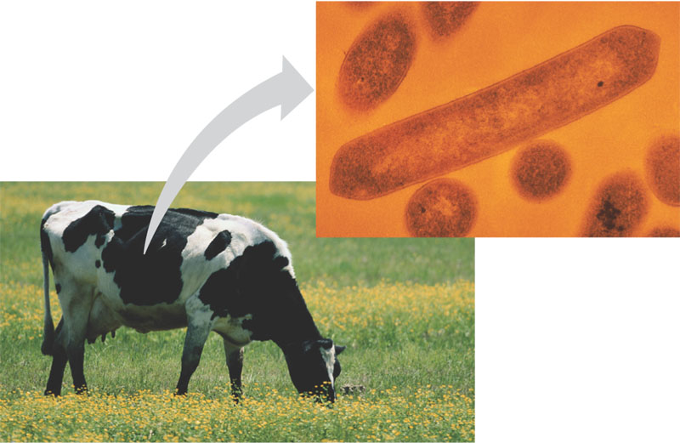
Cellulose is difficult to digest
Animals can’t break the bonds between the glucose molecules –dietary fiber (we can’t digest fiber)
Animals that eat plants have bacteria in their stomachs that can break the bonds of cellulose- allow their hosts to digest plants
Figure 5.9

Slide 10
Animal Structural Units-Chitin
Chitin, another important structural polysaccharide
Is a polymer of a form of glucose
Is found in the exoskeleton of arthropods – gives the “crunch” sound when you step on a cockroach!
CH₂OH
H
H
O
OH
OH
OH
H
H
H
NH
C
O
CH₃
(a) The structure of the
chitin monomer.
(b) Chitin forms the exoskeleton
of arthropods. This cicada
is molting, shedding its old
exoskeleton and emerging
in adult form.
(c) Chitin is used to make a
strong and flexible surgical
thread that decomposes after
the wound or incision heals.
Figure 5.10 A–C

Slide 11
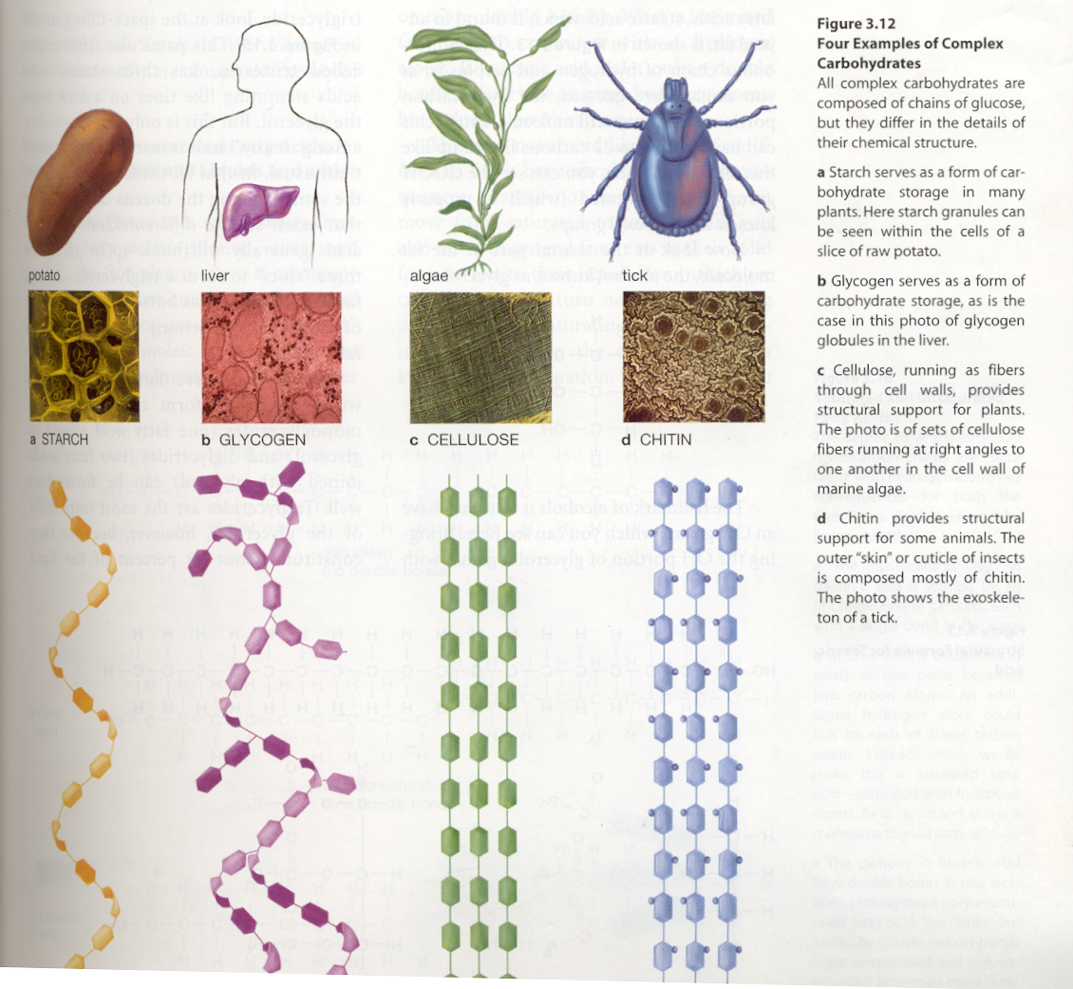
3 Molecules Made From Glucose – What’s the Difference?
Differences in bonding
and shape give the
molecules different
functions

Slide 12
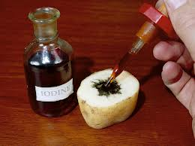
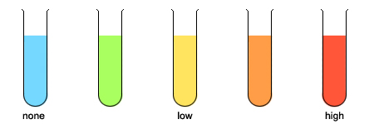
Tests to determine presence
Several tests exist to determine the presence of carbohydrates
(1) Iodine test –used to test for the presence of starch (complex sugar). Iodine reacts with starch to produce a purple-black color
(2) Benedict’s test – used to test for the presence of monosaccharides. Brick red or brown color indicates high glucose content, while blue indicates no glucose
Benedict’s test
Iodine test

Slide 13
Vocabulary to Know and Love
Carbohydrate
Monosaccharide
Glucose
Polysaccharide
Starch
Glycogen
cellulose
Chitin
Additional flashcards
- 5 functions of carbohydrates
- 3 elements found in carbohydrates
- Iodine test- positive test and what molecule it indicates
- Bendict’s test –positive test and what molecule it indicates

