Slide 1
Biological Molecules
Carbon Compounds

Slide 2
Biochemistry
All living things are made up of chemical compounds
The smallest unit of all things is the atom.
Atoms are composed of protons and neutrons found in the nucleus, and electrons found in energy levels around the nucleus

Slide 3
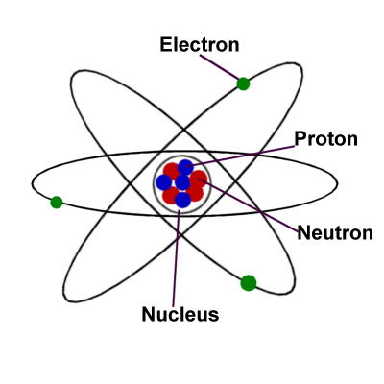
Biochemistry
Electrons in the last, or outermost energy level, are important for forming BONDS between other atoms. A substance consisting of only one type of atom is an ELEMENT. Lots of bonds between different types of atoms are called MOLECULES.

Slide 4
Biochemistry
Elements are pure substances that are made of the same type of atom.
EX: Carbon (C), Hydrogen (H), Oxygen (O), Nitrogen (N), Phosphorus (P)
One of the most important elements to living things is Carbon

Slide 5
Carbon
Carbon is unique! It can:
(1) form 4 bonds with many different elements
(2) Can bond to other carbon atoms, giving it the ability to form chains almost unlimited in length
(3) Can form bonds of different strength (single, double, triple bonds)
(4) Is extremely versatile (can form millions of different large and complex structures)
(5) is abundant – there’s lots of it!

Slide 6
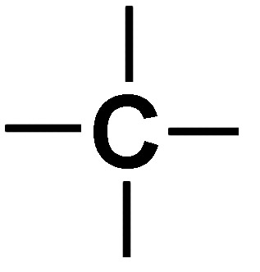
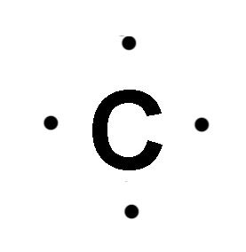
1. Carbon can bond with up to four other atoms
Carbon has 4 (outermost)
electrons that can be shared with other elements
This allows it to bond with 4 other atoms

Slide 7
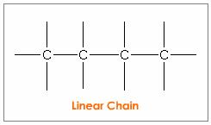
2. Carbon Bonds Readily with Itself
*This allows carbon to be the backbone of large and complex molecules.
Carbon bonds readily with other elements
- in living things: Sulfur, Phosphorus, Oxygen, Nitrogen, & Hydrogen (SPONCH)

Slide 8
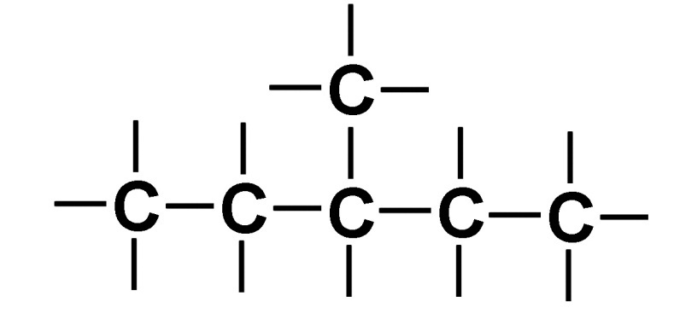
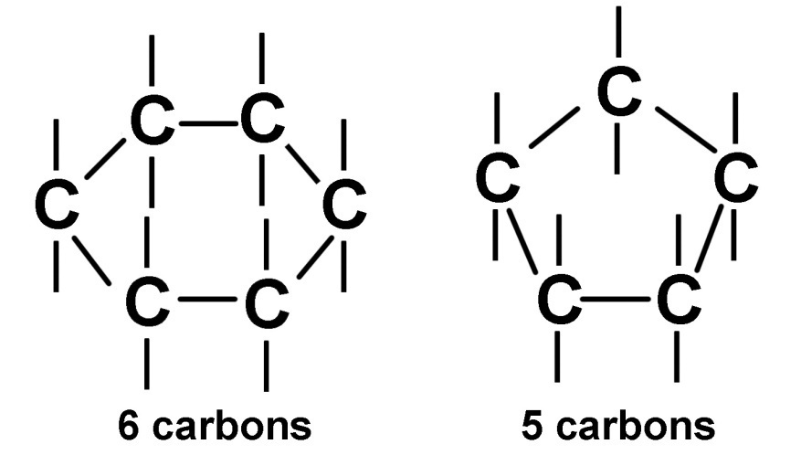
3. Carbon Bonds to Build a Variety of Shapes
Straight chains
Branched chains
Rings

Slide 9
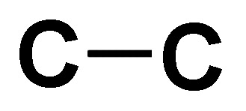
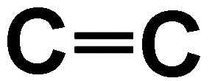
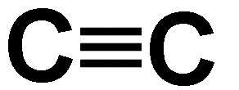
4. Carbon Forms Bonds of Different Strengths
Single Bonds
Double Bonds
Triple Bonds

Slide 10
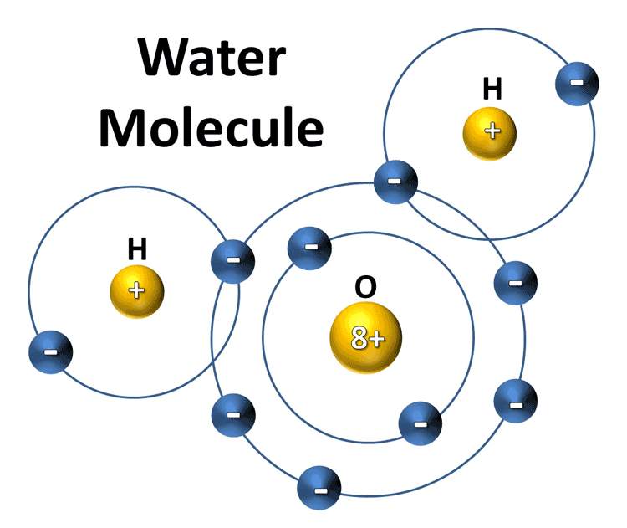
Biochemistry
Molecules are substances made up of different elements
EX: Water (H₂O), Glucose (C₆H₁₂O₆, Carbon Dioxide (CO₂)
Shared electrons between Hydrogen and Oxygen

Slide 11
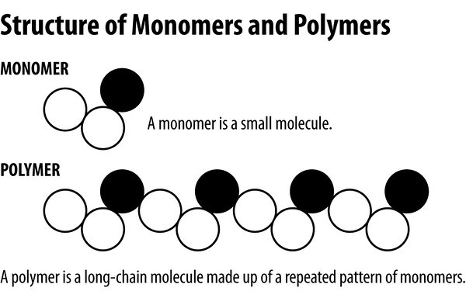
Monomers
Molecules are examples of monomers, single building blocks that are joined together to make polymers.

Slide 12
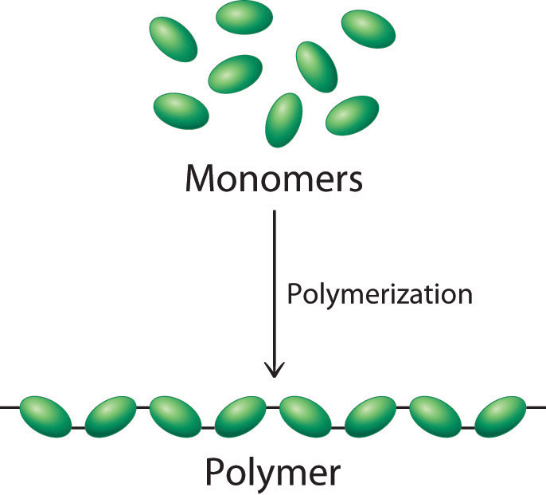
Biomolecules are macromolecules
Macromolecules – “giant molecules”
Made from thousands or hundreds of thousands of smaller molecules
Formed through a process called polymerization
Smaller units (monomers) join together to make larger, longer units (polymers)

Slide 13
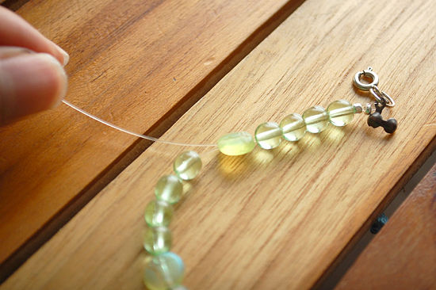
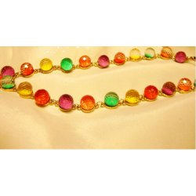
Biomolecules are macromolecules
Polymerization is similar to stringing beads on a necklace
Beads = monomers
Necklace = polymer
Monomers can be the same, or different
Same
monomers
Different
monomers

Slide 14
Biomolecules
Four types of biomolecules:
(1) Carbohydrates – sugars and starches
(2) Lipids – fats and oils
(3) Proteins – enzymes
(4) Nucleic Acids – DNA, RNA, ATP, ADP

Slide 15
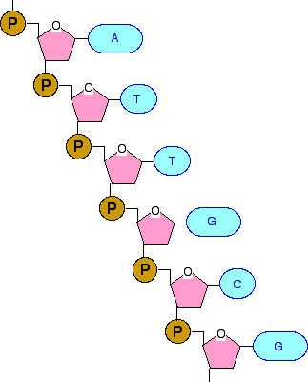
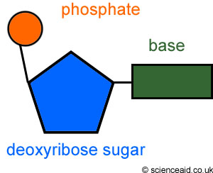
The Polymer:
Nucleic Acid
Monomer: nucleotide that makes up

Slide 16
Biomolecules
Each type of biomolecule has its own monomer unit
Biomolecule (polymer) Monomer
Carbohydrate Monosaccharide
Lipid Fatty Acid and Glycerol
Protein Amino Acid
Nucleic Acid Nucleotide
Polymer

