Slide 1
Cell Differentiation

Slide 2
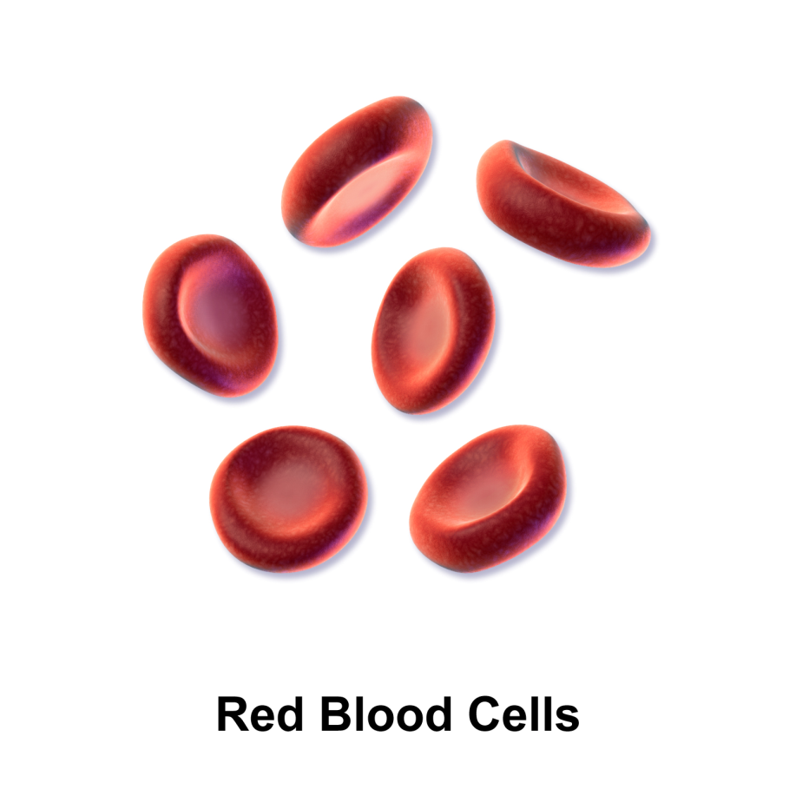
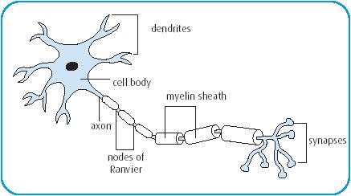
Do all Eukaryotic cells look the same?
No! Cells can DIFFERENTIATE to perform different functions!
Nerve Cell

Slide 3
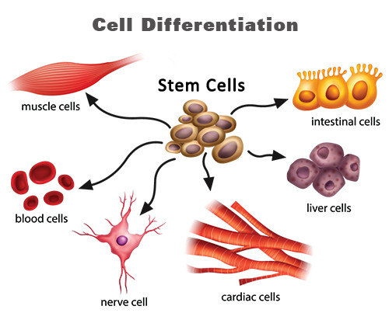
Cell Differentiation
Differentiation is the process of a cell changing from a less specialized type becoming a more specialized type.

Slide 4
Cell Differentiation
Although each somatic (body) cell has the same DNA, only specific parts of the DNA are activated. The parts of the DNA that are activated determine the function and specialized structure of a cell.

Slide 5
Cell Differentiation
Because all cells contain the same DNA, all cells initially have the potential to become any type of cell; however; once a cell differentiates, the process cannot be reversed.

Slide 6
Red Blood Cells
Red blood cells function to transport oxygen and remove carbon dioxide and waste products from cells.

Slide 7
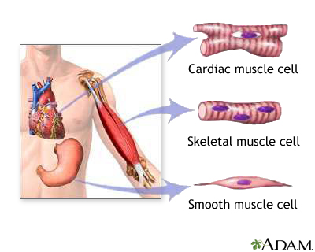
Muscle Cells
Muscle cells function to allow motion to occur.

Slide 8
Nerve Cell
Nerve cells have the ability to conduct electrical impulses to maintain homeostasis in the body.

Slide 9
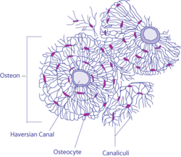
Bone Cell
Bones function to provide support and movement.

