Slide 1
Cell Structure

Slide 2
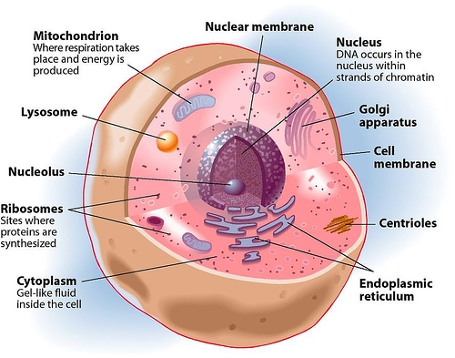
Eukaryotic Cell Structure
Many structures in eukaryotic cells act like specialized organs, and are called organelles “little organs”
Two major divisions: nucleus and cytoplasm

Slide 3
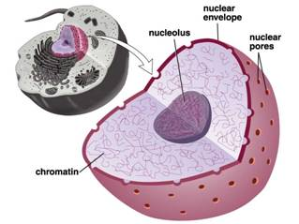
Nucleus
The nucleus contains genetic information (DNA) and with it the coded instructions for making proteins and other important molecules.

Slide 4
Nucleus
Also contains chromatin, the granular material you can see in the nucleus. Chromatin is composed of DNA bound to protein. When it is time for the cell to divide (reproduce), chromatin condenses to form chromosomes. Chromosomes are thread-like genetic material that is passed from one generation of cells to the next.

Slide 5
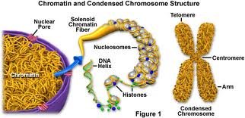
Chromatin and Chromosomes

Slide 6
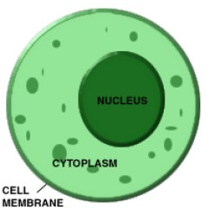
Cytoplasm
The cytoplasm is the portion of the cell outside the nucleus. The organelles are found embedded in the cytoplasm. The function of the cytoplasm is to transport materials within the cell and into and out from the cell.

Slide 7
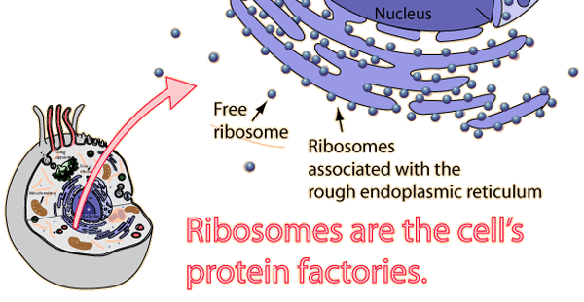
Ribosomes
Ribosomes are small particles of RNA and protein found throughout the cytoplasm. They function to produce proteins by following a set of instructions received from the nucleus.

Slide 8
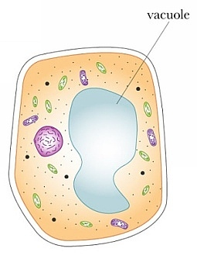
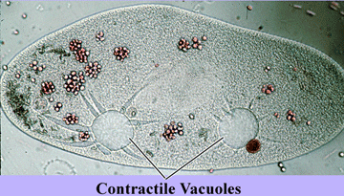
Vacuoles
Plant Cell
Vacuoles are saclike structures used to store materials like water, salts, proteins, and carbohydrates. They are most common in plant cells, where the pressure of the vacuole makes it possible to support leaves and flowers. In some animals, the vacuole is used to pump excess water out from the cell. They are called contractile vacuoles.
Animal Cell

Slide 9
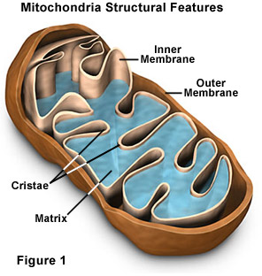
Mitochondria in Animal Cells
Mitochondria function to provide energy for the cell. They convert chemical energy stored in food (glucose) into a form that the cell can use. Inherited from mother only! Mitochondria are often found in muscle cells, and contain their own DNA.
Notice the increased number of
folds (cristae) found inside the
mitochondria. This increases the
surface area available for converting
“food” into energy the cell uses.

Slide 10
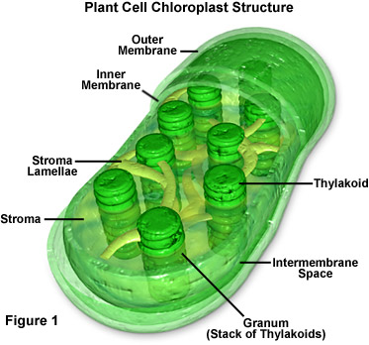
Chloroplast in Plant Cells
In plant cells, chloroplasts use light energy to perform photosynthesis. Chloroplasts also contain their own DNA. Chloroplasts contain green pigment called chlorophyll that gives plants their green color.

Slide 11
Animal Cell | Plant Cell
1. Cell Membrane surrounds cell | 1. Cell wall made of cellulose surrounds the cell membrane
2. Cytoplasm occupies most of the space in the cell. | 2. Cytoplasm is pushed to the sides of the cell.
3. Rarely contains vacuoles. If so, they are small and temporary. | 3. Vacuole takes up majority of space of the cell.
4. Stores reserve energy in form of glycogen. | 4. Stores reserve energy in form of starch.

Slide 12
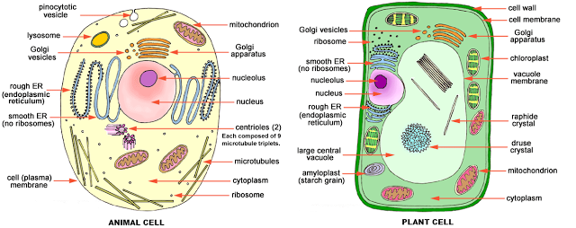
Eukaryotic Cell Structure
Remember eukaryotic cells include animals AND plant cells!
Animal and plant cells contain a cell membrane that controls what enters and leaves the cell. Only plant cells have a rigid cell wall made of cellulose to protect the cell from harm and provide rigid support of leaf and stem structures.

