Slide 1
Cell Transport

Slide 2
Cell Membrane
Recall that the cell membrane controls what enters and what leaves the cell
Also provides protection and support

Slide 3
Composition of the Cell Membrane
Also called the “Fluid Mosaic Model”
Outer membrane is a lipid bilayer (FLUID -movement) two layers of fat. Lipids provide a flexible structure and barrier between the cell and its surroundings.
Also have proteins embedded in membrane (MOSAIC – multiple molecules) to act as channels to bring substances into and out from the cell.

Slide 4
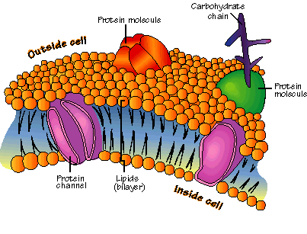
Composition of Cell Membrane
Hydrophilic heads
“Water loving”
Hydrophobic tails
“Water fearing”

Slide 5
Cell Transport
All cells must remain in a state of homeostasis. Cells must constantly bring substances into and out of the cell to maintain a dynamic equilibrium with the environment they live in!!
If a substance can pass through the membrane, it is said to be PERMEABLE
If a substance cannot pass through the membrane, it is said to be IMPERMEABLE
Most biological membranes are SELECTIVELY PERMEABLE, this means some substances can pass through and some cannot

Slide 6
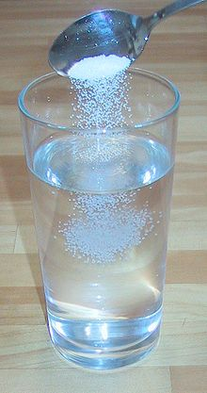
Solute versus Solvent
Solution is a mixture of two or more substances
Solvent is the substance doing the dissolving (present in the greater amount)
Solute is the substance being dissolved (substance present in the smaller amount)
When we say something is concentrated, we are talking about how much solute is dissolved in a given amount of solution
One of the most important functions of cells is to regulate how dissolved molecules get into and out of the cell through the membrane.
What is the solute? What is
the solvent?

Slide 7
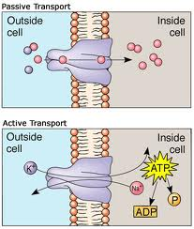
Cell Transport
There are two main ways that cells can transport substances:
(1) Passive transport – this type of transport allows molecules to come into and out of the cell without requiring energy to bring them in and out
(2) Active transport – cell must use energy to bring the molecule inside or out

Slide 8
Cell Transport: Diffusion
In a solution particles are constantly moving. They collide with each other and spread out randomly.
Diffusion is when the particles move from a more concentrated area to less concentrated area.
EX: spray perfume in one part of the room, eventually you will smell the perfume in all parts of the room; it diffuses throughout
When the concentration of the solute is the same throughout a system, the system has reach equilibrium

Slide 9
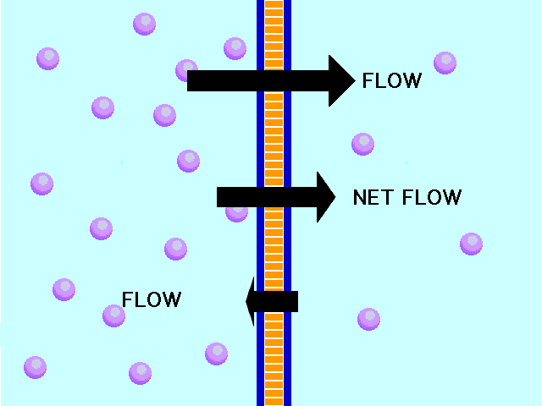
Cell Transport: Diffusion
Since diffusion depends on random particle movements, substances can travel through the membrane without requiring the cell to use energy
Even when equilibrium is reached, particles will continue to flow back and forth across the membrane to maintain equilibrium
Because almost equal numbers of particles move
in each direction, there is no further change in the
concentration of the solution

Slide 10
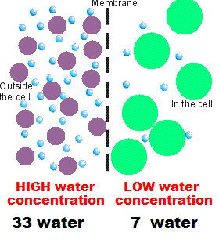
Cell Transport: Osmosis
Osmosis is the diffusion of water through the membrane
The movement of water is controlled by a concentration gradient. In biology, a gradient results from an unequal distribution of ions (charged particles) across the cell membrane. When this happens, solutes move along a concentration gradient from the area of greatest concentration to the area of least concentration.
Diffusion works when solute particles move with the gradient from high to low concentration
Osmosis occurs when water moves from an area of high water concentration to an area of low water concentration

Slide 11
Solutions
We can predict where water will move in three types of solutions:
(1) hypertonic solution
(2) hypotonic solution
(3) isotonic solution

Slide 12
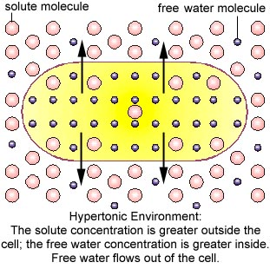
HYPeRTONIC Solution
Cell Shrinks When Placed in this solution
A hypertonic solution occurs when the concentration of the solution is greater than the concentration inside the cell
Because the concentration gradient is greater outside the cell (more solute than water), water will move out of the cell and the cell will SHRINK
REMEMBER: SALT AND SUGAR SUCK!

Slide 13
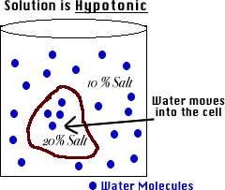
hypOtonic Solution – hypO is LOW
Cell swells when placed in this solution.
A hypotonic solution occurs when the concentration of solution is lower than the concentration of the cell
Because the concentration gradient is lower outside the cell (less solute than water), water will move into the cell and the cell will SWELL
Remember: hypO is low, the cell swells like an O

Slide 14
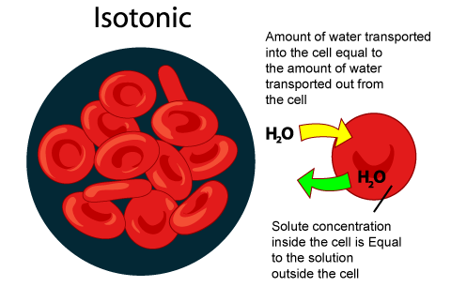
Isotonic Solution
When the concentration of the solution is EQUAL to the concentration of the cell
Osmosis does occur, but the cell DOES NOT change shape

Slide 15
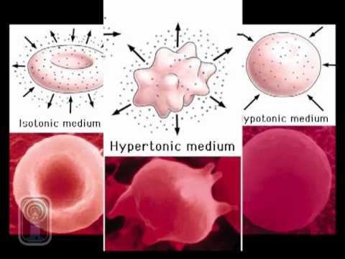
Summary of Solutions

Slide 16
You Practice!
Predict what happens when:
(1) A salt water plant is placed in a gallon bucket of freshwater. What will happen to the plant cell?
(2) A person is stranded out at sea. Thirsty, she drinks ocean water that has a high salt concentration. What will happen to her cells?
(3) A cell contains 5% solute and is placed in a 17% solution. What will happen to the cell?

Slide 17
Passive Transport
There are three types of passive transport:
1. Simple Diffusion
2. Osmosis
3. Facilitated Diffusion
All move substances WITH the gradient from HIGH to LOW concentration WITHOUT USING ENERGY!

Slide 18
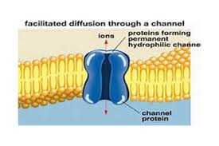
Passive Transport: Facilitated Diffusion
Some larger molecules, like sugar, cannot diffuse through the membrane because of their size. These molecules pass through protein channels that facilitate (help) specific molecules pass into and out of the cell.
This process, called facilitated diffusion, and will not occur if there is not a high concentration of specific molecules on one side than on the other side.

Slide 19
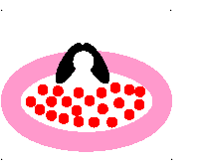
Active Transport
Sometimes cells need to move substances AGAINST a concentration gradient. This process requires energy, and is called active transport. Active transport occurs when carrier proteins embedded in the membrane bind to a SPECIFIC substance, change shape, and bring the substance into/out of the cell.

Slide 20
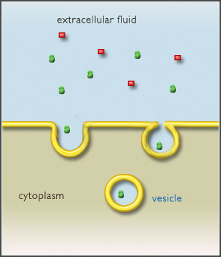
Active Transport
Cells can also bring substances in/out through the use of the cell membrane
Endocytosis is the process of taking material into the cell by folding the cell membrane into a vesicle (pocket). The pocket breaks loose from the membrane and forms a vacuole inside the cell.

Slide 21
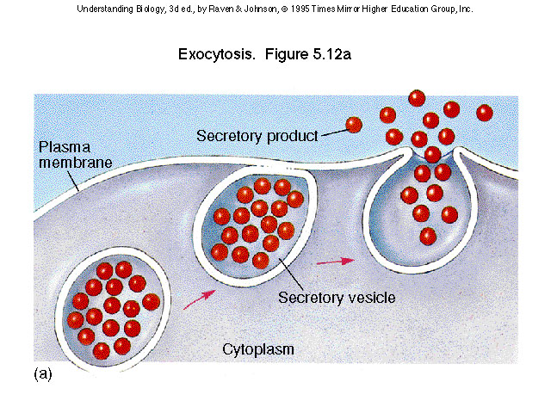
Exocytosis
Cells also excrete and release large amounts of material from the cell in a process known as exocytosis. The membrane of the vacuole fuses with the cell membrane and forces the contents out of the cell.

Slide 22
Sodium-Potassium Pump
The human nerve cell sends messages throughout the body using the sodium (Na⁺) –potassium (K⁺) pump.
Four Step Process:
1. There is more sodium outside the cell than inside the cell. It requires energy for the cell to pump sodium out AGAINST the gradient. Sodium binds to carrier protein.
2. Energy is required to change the protein’s shape and release sodium outside of the cell.
3. Potassium binds to carrier protein.
4. Energy is required to change the protein’s shape and bring potassium into the cell.

Slide 23
Summary of Cell Transport

