Slide 1
Darwin and Natural Selection

Slide 2
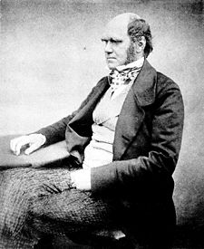
Charles Darwin
1809-1882
English Scientist
Developed the Theory of Evolution by Natural Selection

Slide 3
Influences of Darwin
Numerous ideas helped to shape Darwin’s theory
(1) Thomas Malthus – economist who predicted the human population would grow faster than the space and resources required to sustain it (Influenced competition for limited resources)
(2) James Hutton – proposed Earth was much older than scientists currently believed (gave time for evolution to occur)

Slide 4
Influences of Darwin
3. Charles Lyell – geologist who stressed that processes occurring now have shaped Earth’s geological features over long periods of time (made Darwin ask, if the Earth could change over time, could life change as well?)
4. Jean-Baptiste Lamarck – first to propose a mechanism to explain how organisms change over time (inheritance of acquired traits/behavior)

Slide 5
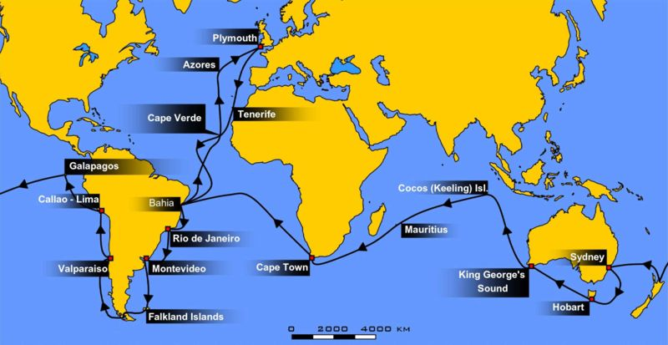
At 22, Darwin sailed around the world on a ship called the HMS Beagle
Studied for a long time on the Galapagos Islands off the coast of S. America

Slide 6
The Theory of Evolution by Natural Selection
Evolution = change in a species over time
Natural Selection = process by which individuals that are better suited to their environment survive and reproduce at a higher rate

Slide 7
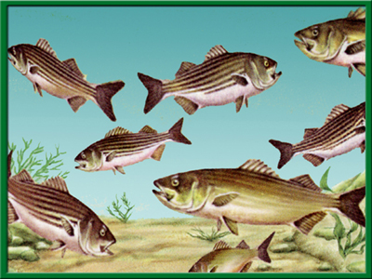
How Natural Selection Works
Organisms tend to over produce offspring, and have the potential to increase in numbers exponentially.

Slide 8
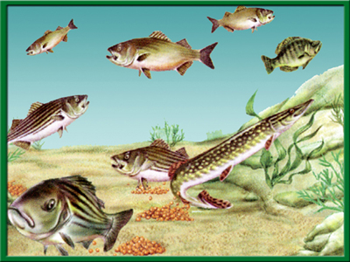
How Natural Selection Works
2. Populations are genetically variable due to mutations and genetic recombination (crossover)

Slide 9
How Natural Selection Works
3. There is a finite supply of resources required for life.

Slide 10
How Natural Selection Works
4. Changing environments select for specific genetic phenotypes.

Slide 11
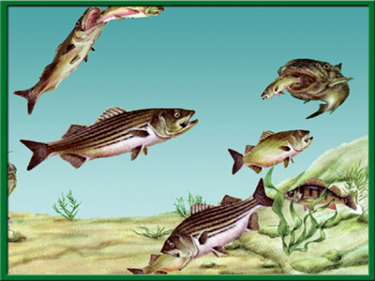
How Natural Selection Works
5. Favorable variations out-compete, survive and reproduce to pass on their alleles.

Slide 12
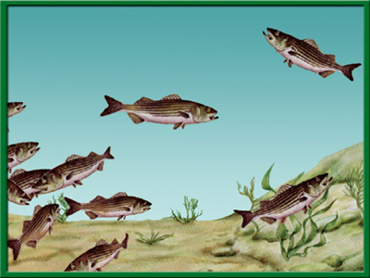
How Natural Selections Works
6. The accumulation and change in favored alleles leads to changes in species over time.

Slide 13
Evidence of Evolution
1. Biogeography:
Geographical distribution of species.
2. Fossil Record:
Fossils and the order in which they appear in layers of sedimentary rock (strongest evidence).

Slide 14
Evidence of Evolution
3. Taxonomy:
Classification of life forms.
4. Homologous structures:
Structures that are similar because of common ancestry (comparative anatomy)

Slide 15
Evidence of Evolution
5. Comparative embryology:
Study of structures that appear during embryonic development.
6. Molecular biology:
DNA and proteins (amino acids)

Slide 16
Evidence of Evolution
What is the best evidence of evolution?
Fossil Record

Slide 17
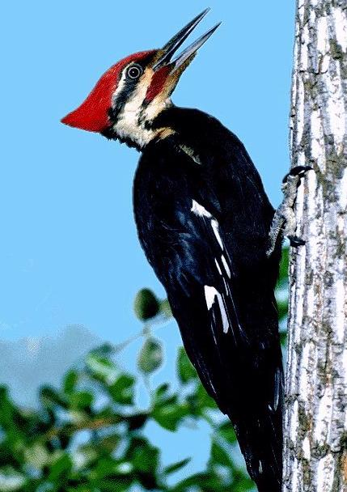
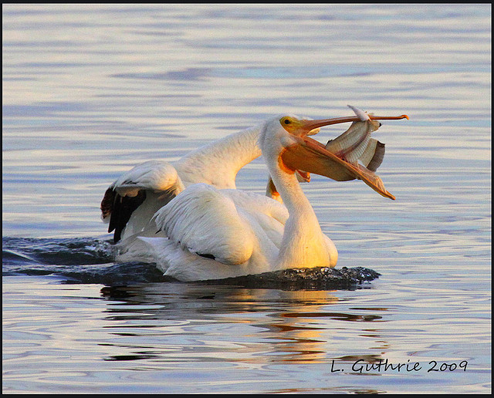
Evidence of Evolution
Examples of natural selection include:
(1) Birds with specialized beaks for food.
EX: Woodpeckers are adapted for eating insects
Waterbirds are adapted for eating fish

Slide 18
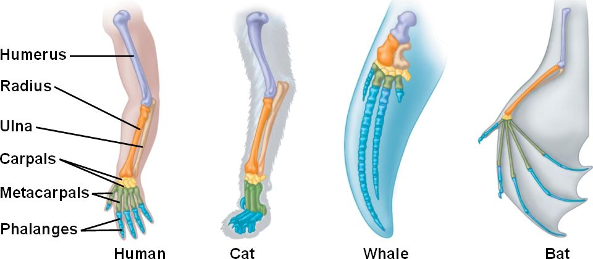
Evidence of Evolution
Anatomy – Homologous Structures may have a common evolutionary origin
Example: forelimb in humans, cat, whale, and bat

Slide 19
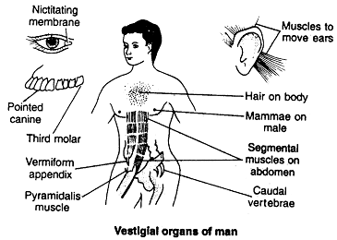
Evidence of Evolution
Some homologous structures appear to have no function. These structures are so reduced in size that they are vestiges, or traces, of homologous organs. These are called vestigial organs.
Translucent 3rd eyelid
Absent in about
20% of humans

Slide 20
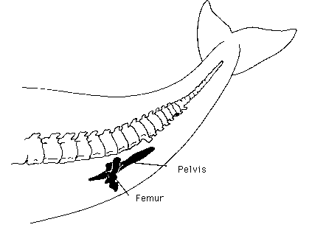
Evidence of Evolution
Why do we still have traces of these organs if they serve no purpose? If the organ doesn’t affect an organism’s ability to survive and reproduce, natural selection will not cause the organ to be eliminated.
The presence of a pelvis and femurs are still found in the skeleton of the whale

Slide 21
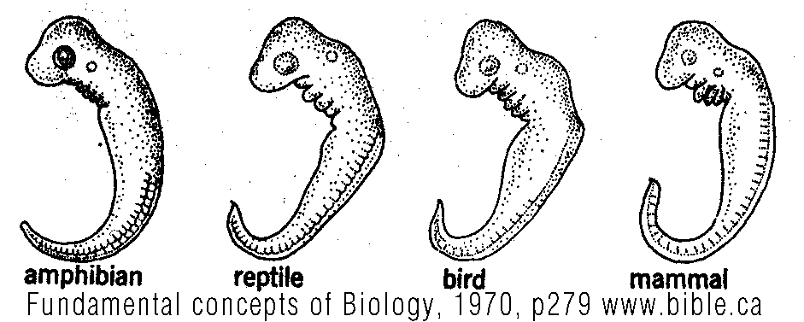
Evidence of Evolution
Similarities in the early stages of vertebrate embryos during development
The same groups of embryonic cells develop in the same order and in similar patterns to produce the tissues and organs of all vertebrates

Slide 22
Evidence of Evolution
Biochemistry - Comparing organic molecules between different species. Similar organic molecules are seen across all species.
Examples:
20% of human DNA identical to mouse DNA
98% of human DNA identical to chimp DNA

Slide 23
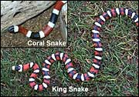
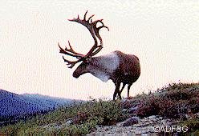
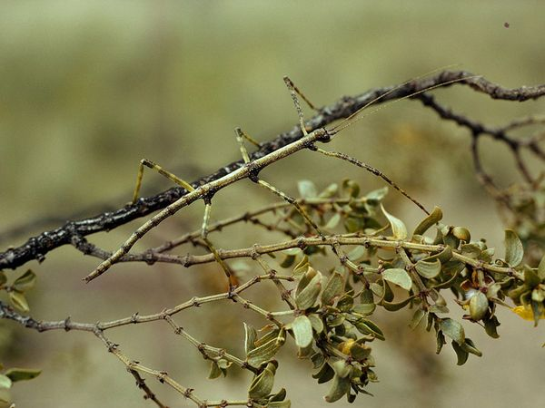
Adaptations: inherited trait that helps organism survive in environment
Structural: any physical form or part, such as beak shape for a bird, or mimicry
Mimicry- similarity of one species to another which protects one or both

Slide 24
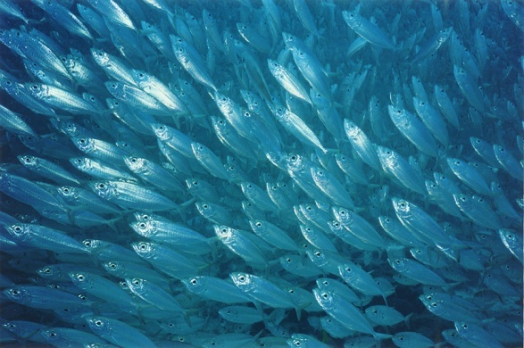
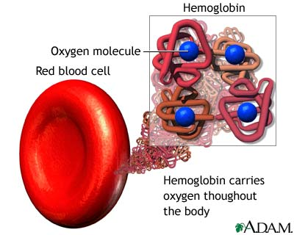
Adaptations
Behavioral: any genetically-controlled action; herding, growling
Physiological: any body process; oxygen binding of hemoglobin

Slide 25
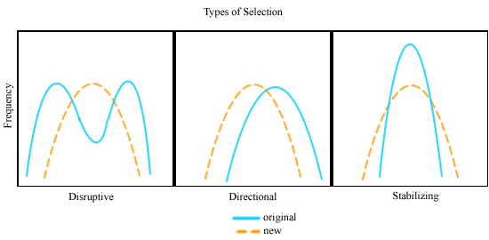
Modes of Action
Natural selection has three modes of action:
1. Stabilizing selection
2. Directional selection
3. Diversifying selection

Slide 26
1. Stabilizing Selection
Acts upon extremes and favors the intermediate.
Number
of
Individuals
Small Large
Size of individuals

Slide 27
2. Directional Selection
Favors variants of one extreme.
Number
of
Individuals
Small Large
Size of individuals

Slide 28
3. Diversifying Selection
Favors variants of opposite extremes.
Number
of
Individuals
Small Large
Size of individuals

Slide 29
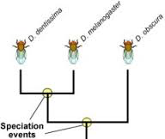
Speciation
The evolution of new species.

Slide 30
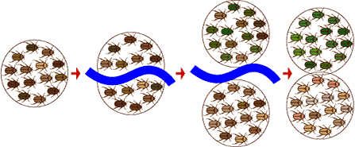
Allopatric Speciation
Induced when the ancestral population becomes separated by a geographical barrier.
Example:
Grand Canyon and ground squirrels

Slide 31
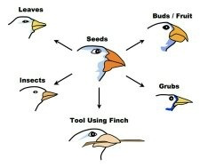
Adaptive Radiation
Emergence of numerous species from a common ancestor introduced to new and diverse environments.
Example:
Darwin’s Finches

Slide 32
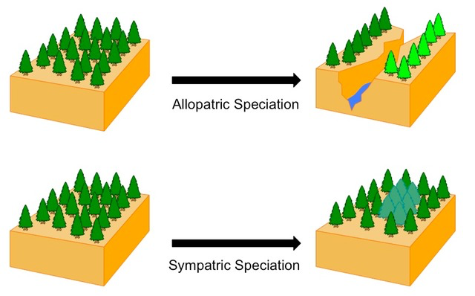
Sympatric Speciation
When a new species is formed from an existing species while living in the same geographic region (more rare than allopatric speciation).

Slide 33
Convergent Evolution
Species from different evolutionary branches may come to resemble one another if they live in very similar environments.
Example:
1. Ostrich (Africa) and Emu (Australia).
2. Sidewinder (Mojave Desert) and
Horned Viper (Middle East Desert)

Slide 34
Coevolution
Evolutionary change, in which one species act as a selective force on a second species, inducing adaptations that in turn act as selective force on the first species.
Example:
1. Acacia ants and acacia trees
2. Humming birds and plants with flowers with long tubes

