Slide 1
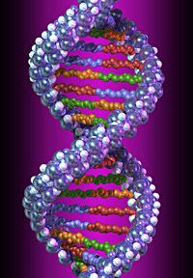
DNA

Slide 2
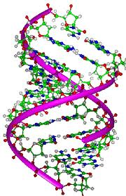
DNA =
A molecule, Deoxyribonucleic Acid, that holds the master copy of an organism’s genetic code

Slide 3
DNA: The Molecule of Heredity
Genetic information in DNA determines traits
DNA contains the instruction to make proteins
Enzymes (proteins) control chemical reactions needed for life
DNA contains the instructions for life - the complete code for manufacturing all the proteins for an organism

Slide 4
DNA: The Molecule of Heredity
STRUCTURE
Monomer of DNA is the nucleotide
DNA is a Nucleic Acid
NUCLEOTIDE consists of:
Simple sugar (deoxyribose)
Phosphate group
Nitrogen base

Slide 5
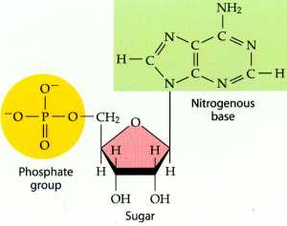

Slide 6
DNA: The Molecule of Heredity
STRUCTURE
Nucleotides join to form long chains
Deoxyribose sugar & phosphate group bond to form the backbone
Nitrogenous bases stick out like teeth on a zipper
Bases hold sides of DNA together with weak hydrogen bonds

Slide 7
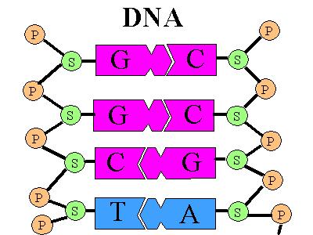
DNA: The Molecule of Heredity
STRUCTURE

Slide 8
DNA: The Molecule of Heredity
<>
PAIRED BASES
The nitrogenous bases pair up with each other as follows:
A pairs with T
T pairs with A
C pairs with G
G pairs with C

Slide 9
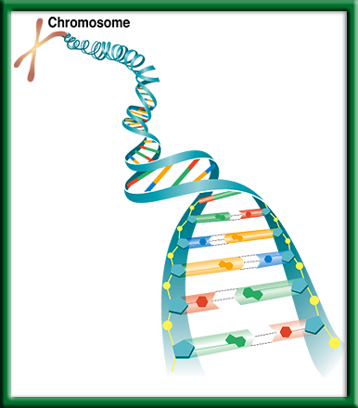
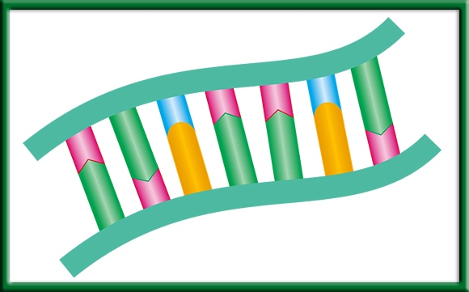
DNA: The Molecule of Heredity
Each DNA strand is connected to a complementary strand
DNA - DNA

Slide 10
DNA: The Molecule of Heredity
<>
STRUCTURE
Because DNA is composed of 2 strands twisted together, its shape is called a double helix

Slide 11
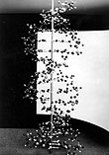
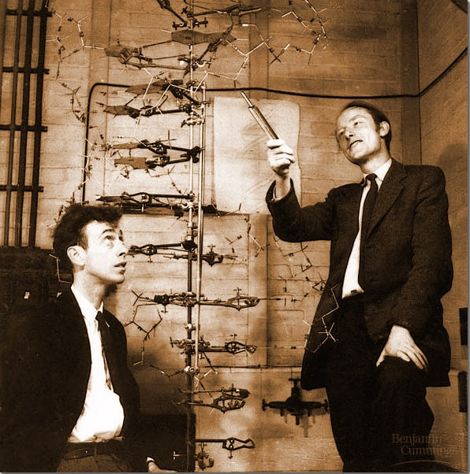
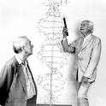
Brief History of Unraveling the DNA Structure Mystery
Watson and Crick used stick-and-ball models to test their ideas on the possible structure of DNA
Watson and Crick win Nobel Prize for determining DNA’s double helix structure

Slide 12
DNA: The Molecule of Heredity
STRUCTURE
How can organisms be so different from each other if their genetic material is made of the same 4 nucleotides?
Difference = sequence of 4 different nucleotides along DNA strands

Slide 13
DNA: The Molecule of Heredity
STRUCTURE
For example:
A-T-T-G-A-C is different from
T-C-C-A-A-G
The closer the relationship between 2 organisms, the greater the similarity in the order of DNA nucleotides

Slide 14
DNA: The Molecule of Heredity
STRUCTURE
Is the DNA of a chimpanzee more similar to a gorilla or a pea plant?

Slide 15
Quick Review
1. Describe the shape of the DNA molecule.
Double helix
2. DNA is made of a double chain of what monomer?
nucleotides
3. DNA nucleotides are made up of ___, ____, and ____.
ribose sugar, a phosphate, and a nitrogen base

Slide 16
Quick Review
4. How do DNA bases pair?
A – T T – A C – G G – C
5. Describe the bond between base pairs.
Weak hydrogen bonds
6. DNA codes for building what organic molecules?
proteins
7. Who is credited with discovering the shape of the DNA molecule?
Watson and Crick

Slide 17
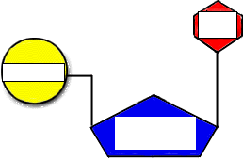
NUCLEOTIDE OF DNA

Slide 18
Making Models of DNA
Cut out the parts of the DNA molecule.
Paste them onto a piece of paper to show the structure of DNA.
Cut out 12 P, 12 D, 6 A, 6 T, 6 G and 6 C.
The sequence of the bases determines which protein is coded for.
KEY:
D - deoxyribose sugar P - phosphate
A – adenine T - thymine
G - guanine C - cytosine

Slide 19
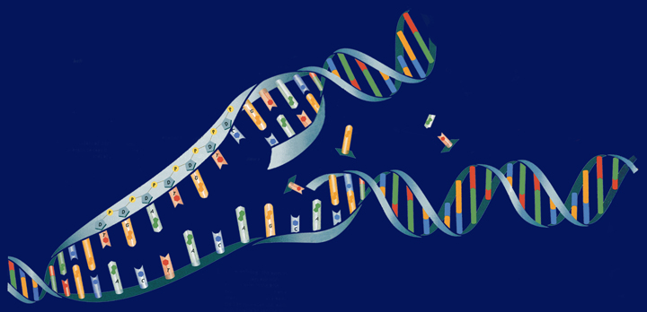
DNA - Replication

Slide 20
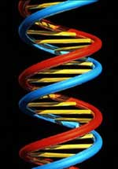
Making a Copy
To “replicate” something is to make a replica or a copy
DNA Replication = DNA is copied
Happens every time a cell divides
Mitosis and Meiosis

Slide 21
Why does DNA Need to replicate?
So that when the cell divides, the daughter cells will have the correct number of chromosomes
All organisms undergo DNA replication

Slide 22
Sequence of Replication
Separation of DNA Strands
Enzymes break hydrogen bonds between nucleotides
Double helix untwists and the 2 strands move apart
DNA is unzipped

Slide 23
Sequence of Replication
2. Base pairing:
- free nucleotides pair with exposed nucleotides

Slide 24
Sequence of Replication
3. Bonding of two strands
- one DNA strand has become 2
- the two strands are identical
double helix

Slide 25
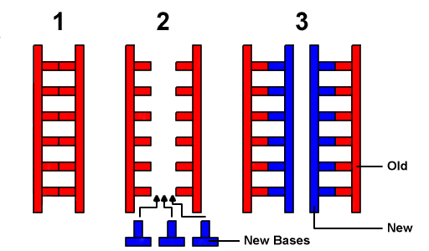
Sequence of Replication
Replication is semiconservative –
Two new helices: one old strand & one new strand

Slide 26
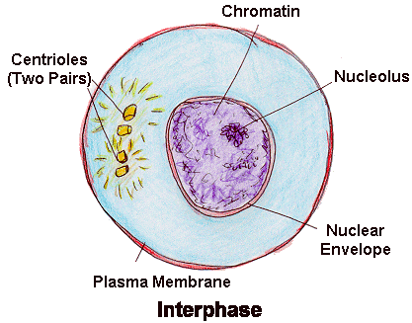
When in the cell cycle does DNA replication occur?
INTERPHASE!!!

Slide 27
Where in the cell does DNA replication occur?
THE NUCLEUS!

Slide 28
Replicate the following DNA:
AAATCG
TTTAGC

