Slide 1
DNA FINGERPRINTING Gel Electrophoresis

Slide 2
DNA Fingerprinting
A way to compare the DNA from one organism with DNA of other organisms
(for paternity, crime-solving):
Step 1
Cut DNA into fragments
Step 2
Separate the fragments
Step 3
Compare the fragments

Slide 3
RESTRICTION ENZYME CLEAVES DNA
Step 1: Cut DNA into fragments using restriction enzymes
RESTRICTION ENZYMES are bacterial proteins that have the ability to cut both strands of the DNA molecule at a specific nucleotide sequence

Slide 4
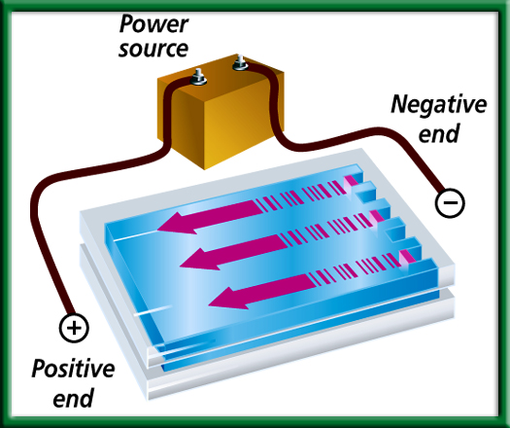
Step 2
Separate the DNA fragments according to size (length) using a procedure called gel electrophoresis.

Slide 5
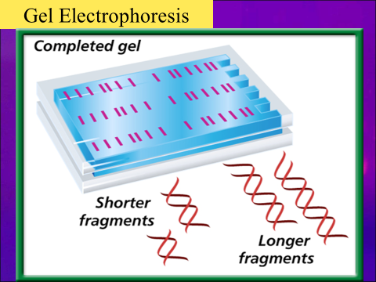
Gel Electrophoresis
DNA fragments are separated by running electrical current through the gel.
Larger fragments take a longer time to move through the gel and don’t move as far as the smaller fragments.

Slide 6
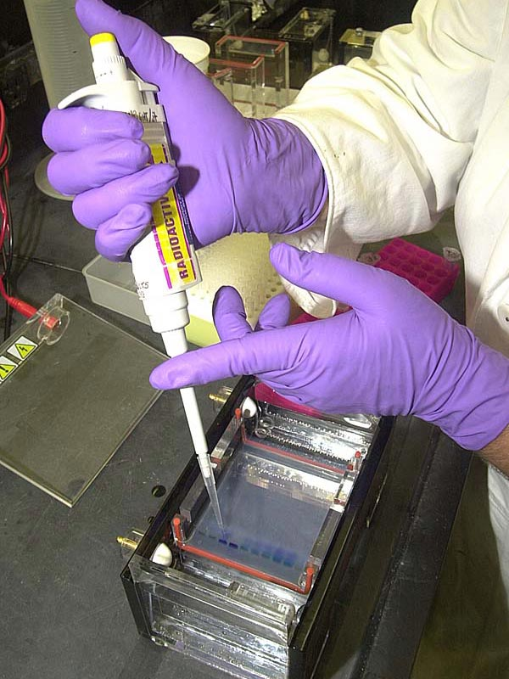
Sample of DNA put into well at one end of the gel

Slide 7
DNA Fingerprint
Uses non-coding DNA sequences – “Junk” DNA
WHY?
Within coding DNA little variation (3%)
Within noncoding DNA (97%) – much more variation
Individuals, even though they possess many common genes, differ widely in their noncoding DNA
More related → more similarity of DNA

Slide 8
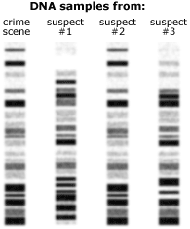
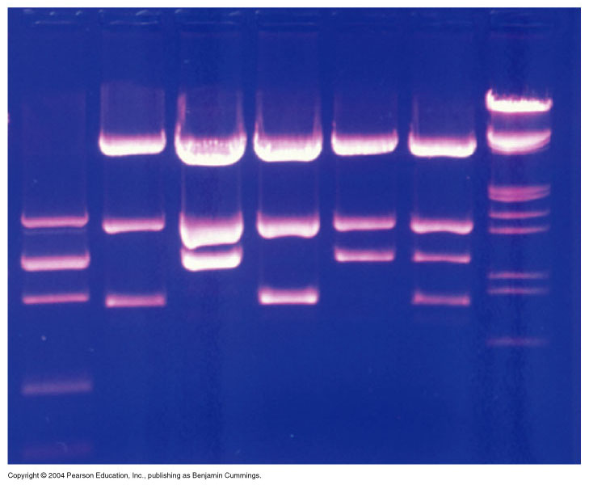
DNA Fingerprint
Result: individual “DNA Fingerprint”
NOT an actual print of a finger, but DNA fragments

Slide 9
Step 3
Compare the fragments
Recall that half of an organism’s DNA comes from the Mom, half comes from the Dad

Slide 10
Are any 2 fingerprints the same?
What causes differences in fingerprints?
Each person’s non-coding DNA has variation creating a unique DNA sequence

Slide 11
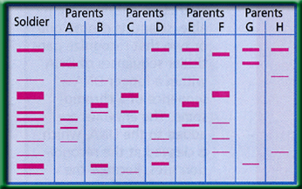
Problem-Solving Lab on page 353
Who are the soldier’s parents?

Slide 12
Examine each fragment of the soldier, one at a time
Top fragment: had to come from Mom or Dad
Where did it come from?
Not A or B, but other parents are possible
Rule out parents A&B

Slide 13
Next fragment
Came from C, E, or H
Next fragment
Came from C or F
Rule out parents G & H
Next fragment
Had to come from Parent C

Slide 14
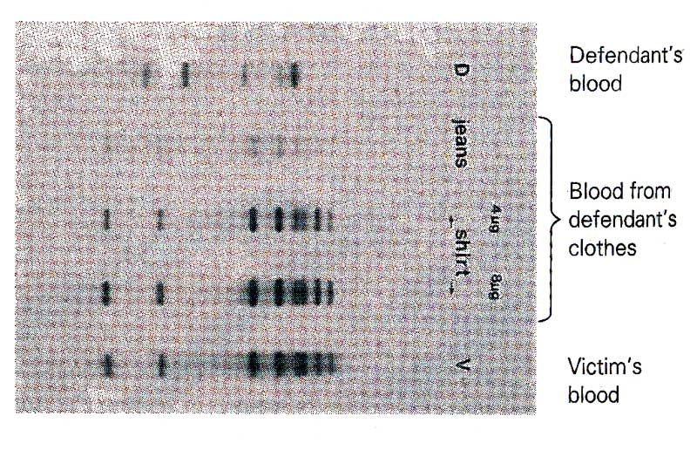
Blood on defendant’s clothes – is it defendant’s blood or victim’s blood?

