Slide 1
Std 1 & 2 Review

Slide 2
What three things do plant cells have that animal cells do not?

Slide 3
Cell wall
Chloroplast
Larger vacuole for water storage

Slide 4
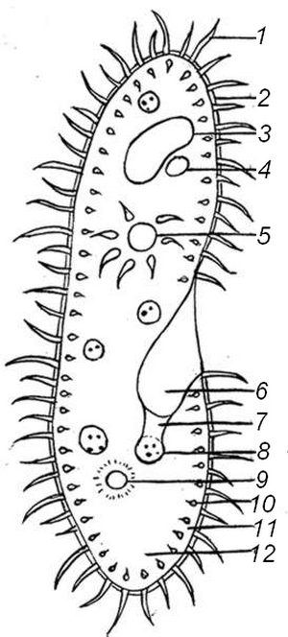
Identify the organism. What would happen if structure #1 was damaged or did not function properly?

Slide 5
It is a Paramecium, and structure #1 is cilia. If this structure did not function, the organism would be unable to move to catch food or flee from predators.

Slide 6
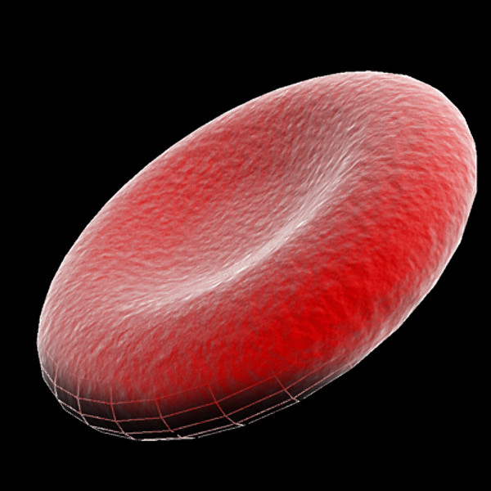
Identify the type of cell present below. What is its function?

Slide 7
Red blood cell
Purpose is to transport oxygen throughout the body and pick up wastes

Slide 8
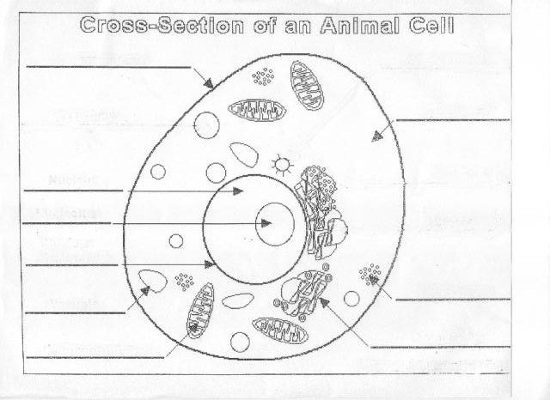
Identify the structures on the cell below. Is this a plant or animal cell? How do you know?

Slide 9
Animal Cell;
Plasma membrane only, no cell wall present

Slide 10
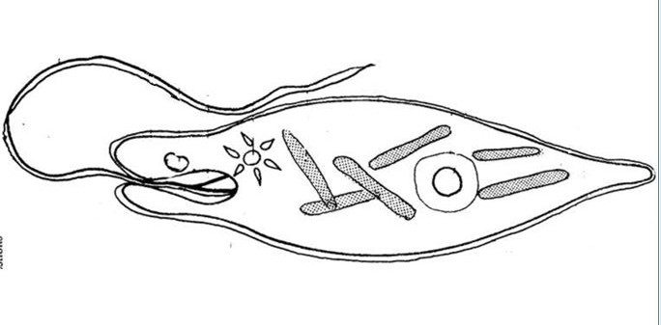
What is the organism below, and what is the purpose of structure #2?
#2
#1

Slide 11
Euglena
Eyespot designed to detect light

Slide 12
All cells contain _____ DNA. All cells start out as _______ cells.

Slide 13
All cells contain identical DNA. All cells start out as stem cells.

Slide 14
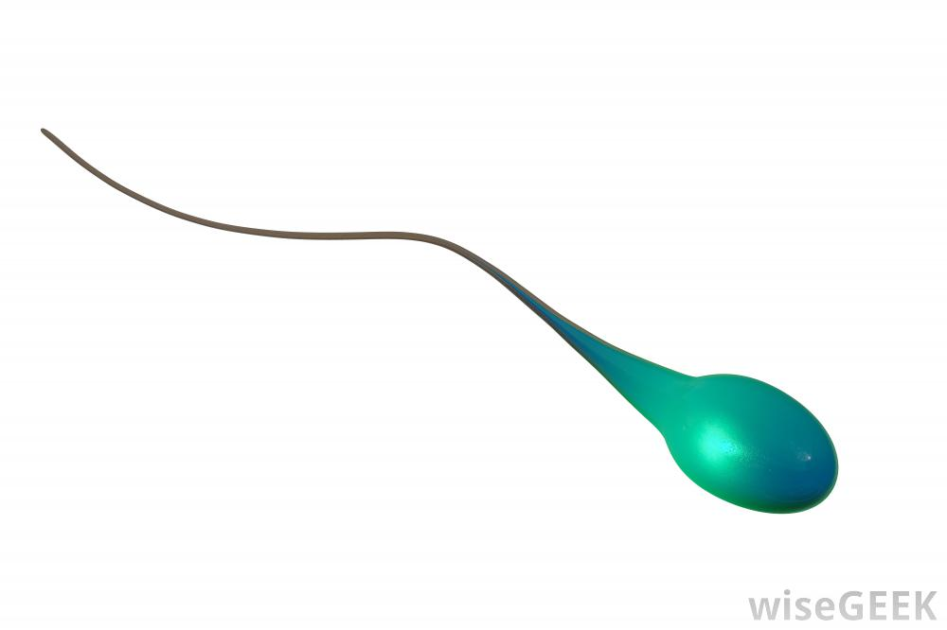
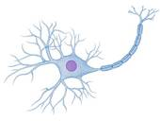
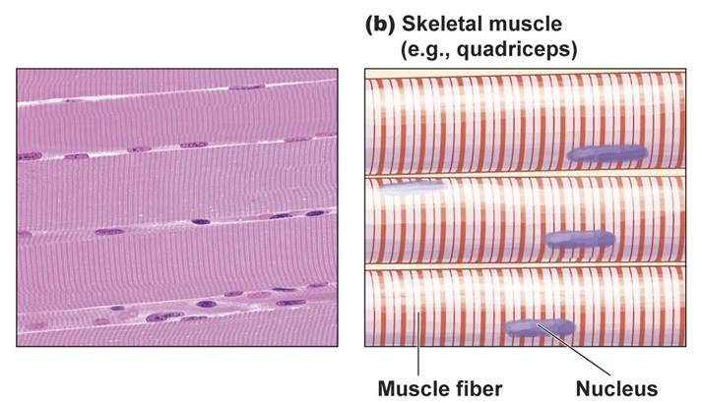
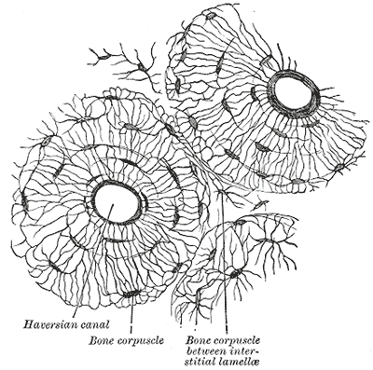
What causes the creation of the cells below?

Slide 15
Differentiation

Slide 16
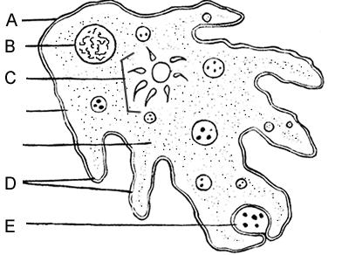
What is the name of the organism below, and what would happen if structure D did not function properly?

Slide 17
This is an Amoeba, and if structure D did not function properly the Amoeba would be unable to move to catch food. Structure D is a pseudopod.

Slide 18
What structure(s) do eukaryotes contain that prokaryotes do not?

Slide 19
A nucleus
Membrane bound organelles
Larger size
Complex internal structure

Slide 20
In which of these ways are prokaryotic and eukaryotic cells similar?
A. They both contain DNA.
B. They both contain a nucleus.
C. They are both highly complex.
D. They are both enclosed by a cell wall.

Slide 21
In which of these ways are prokaryotic and eukaryotic cells similar?
A. They both contain DNA.
B. They both contain a nucleus.
C. They are both highly complex.
D. They are both enclosed by a cell wall.

Slide 22
A single muscle cell is isolated observed. Which organelle would you expect to be abundant in the cell?
A. ribosomes
B. mitochondria
C. Golgi bodies
D. lysosomes

Slide 23
A single muscle cell is isolated observed. Which organelle would you expect to be abundant in the cell?
A. ribosomes
B. mitochondria
C. Golgi bodies
D. lysosomes

Slide 24
How do buffers help maintain homeostasis within a cell?
By regulating pH levels
By regulating water levels
By regulating temperature
By regulating glucose levels

Slide 25
How do buffers help maintain homeostasis within a cell?
By regulating pH levels
By regulating water levels
By regulating temperature
By regulating glucose levels

Slide 26
Which best summarizes the purpose of mitosis in multicellular organisms?
A. enabling growth
B. increasing variation
C. producing gametes
D. encouraging mutations

Slide 27
Which best summarizes the purpose of mitosis in multicellular organisms?
A. enabling growth
B. increasing variation
C. producing gametes
D. encouraging mutations

Slide 28
Which statement best describes mutations?
A. All mutations are harmful.
B. All mutations can be reversed.
C. All mutations change a cell’s DNA.
D. All mutations are caused by radiation.

Slide 29
Which statement best describes mutations?
A. All mutations are harmful.
B. All mutations can be reversed.
C. All mutations change a cell’s DNA.
D. All mutations are caused by radiation.

Slide 30
What happens if we place a red blood cell in a salt water solution?

Slide 31
What happens if we place a red blood cell in a salt water solution?
Water moves out of the cell and shrinks, causing crenation.

Slide 32
How many and what type of cell are created after mitosis occurs?

Slide 33
How many and what type of cell are created after mitosis occurs?
2 cells genetically identical to the parent cell

Slide 34
What type of reproduction and cell division would mammals go through?

Slide 35
What type of reproduction and cell division would mammals go through?
Sexual reproduction, meiosis

Slide 36
A saltwater plant is placed in a freshwater bucket of water. What will happen to the cell?

Slide 37
A saltwater plant is placed in a freshwater bucket of water. What will happen to the cell?
Water will move into the saltwater plant cell, causing it to swell; hypotonic solution

Slide 38
Which of these describes mutations that cause skin cancer and lung cancer?
A. They are somatic mutations and are passed from parent to offspring.
B. They are somatic mutations and are not passed from parent to offspring.
C. They are germ mutations and are passed from parent to offspring.
D. They are germ mutations and are not passed from parent to offspring.

Slide 39
Which of these describes mutations that cause skin cancer and lung cancer?
A. They are somatic mutations and are passed from parent to offspring.
B. They are somatic mutations and are not passed from parent to offspring.
C. They are germ mutations and are passed from parent to offspring.
D. They are germ mutations and are not passed from parent to offspring.

Slide 40
Giant sequoia trees are some of the largest living organisms. These massive trees can reach a height of more than 76 meters. Which structural adaptation makes it possible for leaf cells at the top of a giant sequoia to receive water from the ground?

Slide 41
Xylem

Slide 42
Which function would an algal cell not be able to perform if its chloroplasts were removed?
A. cellular respiration
B. protein synthesis
C. storage and transport
D. photosynthesis

Slide 43
Which function would an algal cell not be able to perform if its chloroplasts were removed?
A. cellular respiration
B. protein synthesis
C. storage and transport
D. photosynthesis

Slide 44
What is the meaning of the phrase “a gene is turned on”?
The protein the gene codes for is produced.
mRNA releases the gene into the cytoplasm
The corresponding section of DNA is replicated.
DNA transcription and replication are complete.

Slide 45
What is the meaning of the phrase “a gene is turned on”?
The protein the gene codes for is produced.
mRNA releases the gene into the cytoplasm
The corresponding section of DNA is replicated.
DNA transcription and replication are complete.

Slide 46
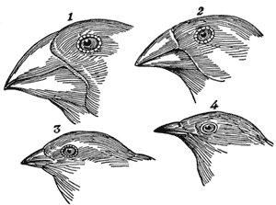
The picture below shows four different beak shapes in finches. A comparison of these four beak shapes would most likely be the focus of what type of study in finches?
A. a study of feeding adaptations
B. a study of digestive adaptations
C. a study of camouflage adaptations
D. a study of reproductive adaptations

Slide 47
The picture below shows four different beak shapes in finches. A comparison of these four beak shapes would most likely be the focus of what type of study in finches?
A. a study of feeding adaptations
B. a study of digestive adaptations
C. a study of camouflage adaptations
D. a study of reproductive adaptations

Slide 48
Which group of organisms is responsible for nitrogen fixation and denitrification?
A. fungi
B. plants
C. bacteria
D. humans

Slide 49
Which group of organisms is responsible for nitrogen fixation and denitrification?
A. fungi
B. plants
C. bacteria
D. humans

Slide 50
Barnacles are small crustaceans that attach themselves to the bodies of whales without harming or benefiting them. The barnacles travel with the whales. Which term best describes the relationship between the whales and the barnacles?
A. predation
B. mutualism
C. parasitism
D. commensualism

Slide 51
Barnacles are small crustaceans that attach themselves to the bodies of whales without harming or benefiting them. The barnacles travel with the whales. Which term best describes the relationship between the whales and the barnacles?
A. predation
B. mutualism
C. parasitism
D. commensualism

Slide 52
An energy pyramid is a model used to show the flow of energy between trophic levels in an ecosystem. Which statement describes the relationship between biomass and energy pyramids?
Biomass is lowest at the producer level
Biomass is lowest at the highest trophic level
Biomass is equally distributed among the trophic levels
Biomass continuously cycles between the trophic levels.

Slide 53
An energy pyramid is a model used to show the flow of energy between trophic levels in an ecosystem. Which statement describes the relationship between biomass and energy pyramids?
Biomass is lowest at the producer level
Biomass is lowest at the highest trophic level
Biomass is equally distributed among the trophic levels
Biomass continuously cycles between the trophic levels.

Slide 54
In an ecosystem, each trophic level receives energy from the level below it. What is the source of energy for the first trophic level?
A. Energy is recycled to the first trophic level from all the higher levels.
B. The first trophic level receives a continuous supply of radiant energy from the sun.
C. The first trophic level produces energy without any input from the environment.
D. The first trophic level converts nutrients in soil into energy.

Slide 55
In an ecosystem, each trophic level receives energy from the level below it. What is the source of energy for the first trophic level?
A. Energy is recycled to the first trophic level from all the higher levels.
B. The first trophic level receives a continuous supply of radiant energy from the sun.
C. The first trophic level produces energy without any input from the environment.
D. The first trophic level converts nutrients in soil into energy.

Slide 56
Which interaction is the best example of mutualism?
A. Tapeworms consume nutrients available in the host’s intestines, weakening the host
B. Wolves hunt rabbits and prevent the rabbit population from increasing past the carrying capacity of the ecosystem.
C. Bacteria in the digestive system of termites break down the cellulose in the wood that the termites eat.
D. Lions and hyenas both hunt the same zebra population. If lions catch more zebras, hyenas will catch fewer zebras.

Slide 57
Which interaction is the best example of mutualism?
A. Tapeworms consume nutrients available in the host’s intestines, weakening the host
B. Wolves hunt rabbits and prevent the rabbit population from increasing past the carrying capacity of the ecosystem.
C. Bacteria in the digestive system of termites break down the cellulose in the wood that the termites eat.
D. Lions and hyenas both hunt the same zebra population. If lions catch more zebras, hyenas will catch fewer zebras.

Slide 58
Which environmental impact is most associated with the overuse of pesticides?
A. biomagnification
B. eutrophication
C. acid rain
D. deforestation

Slide 59
Which environmental impact is most associated with the overuse of pesticides?
A. biomagnification
B. eutrophication
C. acid rain
D. deforestation

Slide 60
Which of the following is the most serious environmental issue that can result when humans introduce a nonnative species of bird?
A. Nonnative birds may outcompete native birds for habitat and food.
B. Nonnative birds may breed with native birds.
C. Native birds may prey on nonnative birds.
D. Native birds may introduce diseases and parasites to nonnative birds.

Slide 61
Which of the following is the most serious environmental issue that can result when humans introduce a nonnative species of bird?
A. Nonnative birds may outcompete native birds for habitat and food.
B. Nonnative birds may breed with native birds.
C. Native birds may prey on nonnative birds.
D. Native birds may introduce diseases and parasites to nonnative birds.

Slide 62
A population of elephants in a savannah ecosystem has reached its carrying capacity. Which statement best describes the population of elephants?
A. The population has become too dense for the ecosystem to support.
B. The population will remain stable even if the ecosystem undergoes severe changes.
C. The population has grown to the largest size the ecosystem can support.
D. The population has decreased so much that it is in danger of not surviving.

Slide 63
A population of elephants in a savannah ecosystem has reached its carrying capacity. Which statement best describes the population of elephants?
A. The population has become too dense for the ecosystem to support.
B. The population will remain stable even if the ecosystem undergoes severe changes.
C. The population has grown to the largest size the ecosystem can support.
D. The population has decreased so much that it is in danger of not surviving.

Slide 64
A certain office has decided to protect the environment by using less paper. How will this most likely benefit the environment?
A. It will help increase biodiversity.
B. It will help conserve forests and save energy.
C. It will help protect the soil.
D. It will help reduce acid rain.

Slide 65
A certain office has decided to protect the environment by using less paper. How will this most likely benefit the environment?
A. It will help increase biodiversity.
B. It will help conserve forests and save energy.
C. It will help protect the soil.
D. It will help reduce acid rain.

Slide 66
Some plants, such as cultivated banana plants, reproduce asexually. What is the most likely result in plants that reproduce asexually instead of sexually?
A. Most of the offspring are genetically identical.
B. The offspring are genetically diverse.
C. Few offspring are produced.
D. The offspring have varied phenotypes.

Slide 67
Some plants, such as cultivated banana plants, reproduce asexually. What is the most likely result in plants that reproduce asexually instead of sexually?
A. Most of the offspring are genetically identical.
B. The offspring are genetically diverse.
C. Few offspring are produced.
D. The offspring have varied phenotypes.

Slide 68
A scientist examines an unknown cell to determine whether the cell is prokaryotic or eukaryotic. If the cell is prokaryotic, which list includes the only structures that the scientist will observe?
A. cell wall, plasma membrane, mitochondria
B. central vacuole, cell wall, lysosomes
C. cell wall, plasmid, ribosomes
D. plasma membrane, nucleus, mitochondria

Slide 69
A scientist examines an unknown cell to determine whether the cell is prokaryotic or eukaryotic. If the cell is prokaryotic, which list includes the only structures that the scientist will observe?
A. cell wall, plasma membrane, mitochondria
B. central vacuole, cell wall, lysosomes
C. cell wall, plasmid, ribosomes
D. plasma membrane, nucleus, mitochondria

Slide 70
In multicellular organisms such as humans, the excretory system removes excess water. Which structures do protists such as paramecia use to remove excess water?
A. cilia
B. flagella
C. psuedopods
D. contractile vacuoles

Slide 71
In multicellular organisms such as humans, the excretory system removes excess water. Which structures do protists such as paramecia use to remove excess water?
A. cilia
B. flagella
C. psuedopods
D. contractile vacuoles

Slide 72
Humans, like other multicellular organisms, are made up of different types of cells that perform different functions. One of these cell types is the nerve cell. From which cells do nerve cells develop?
A. muscle cells
B. stem cells
C. sperm cells
D. white blood cells

Slide 73
Humans, like other multicellular organisms, are made up of different types of cells that perform different functions. One of these cell types is the nerve cell. From which cells do nerve cells develop?
A. muscle cells
B. stem cells
C. sperm cells
D. white blood cells

Slide 74
In a cell, what does a buffer help maintain?
A. a constant temperature
B. a low temperature
C. a constant pH
D. a low pH

Slide 75
In a cell, what does a buffer help maintain?
A. a constant temperature
B. a low temperature
C. a constant pH
D. a low pH

Slide 76
Which of the following statements best describes the cell cycle?
A. Interphase is the reproductive phase; mitosis is the growth phase
B. Interphase is the growth phase; mitosis is the reproductive phase
C. Cytokinesis is the growth phase; the S phase is the reproductive phase
D. Cytokinesis is the reproductive phase; the S phase is the growth phase

Slide 77
Which of the following statements best describes the cell cycle?
A. Interphase is the reproductive phase; mitosis is the growth phase
B. Interphase is the growth phase; mitosis is the reproductive phase
C. Cytokinesis is the growth phase; the S phase is the reproductive phase
D. Cytokinesis is the reproductive phase; the S phase is the growth phase

Slide 78
Which process of the carbon cycle removes carbon dioxide from the atmosphere?
A. photosynthesis
B. cellular respiration
C. combustion of fossil fuels
D. death and decomposition of organisms

Slide 79
Which process of the carbon cycle removes carbon dioxide from the atmosphere?
A. photosynthesis
B. cellular respiration
C. combustion of fossil fuels
D. death and decomposition of organisms

Slide 80
In very hot or dry conditions, land snails may enter a state of inactivity and lowered metabolism. Which adaptation does this best demonstrate?
A. hibernation
B. estivation
C. imprinting
D. migration

Slide 81
In very hot or dry conditions, land snails may enter a state of inactivity and lowered metabolism. Which adaptation does this best demonstrate?
A. hibernation
B. estivation
C. imprinting
D. migration

Slide 82
Which method would be most helpful in preventing eutrophication of lakes and waterways?
A. recycling aluminum
B. conserving fossil fuels
C. reducing runoff from farms
D. using less pesticide

Slide 83
Which method would be most helpful in preventing eutrophication of lakes and waterways?
A. recycling aluminum
B. conserving fossil fuels
C. reducing runoff from farms
D. using less pesticide

Slide 84
The organelles within a cell work together to help the cell function. Which statement best describes a relationship between mitochondria and ribosomes?
A. Ribosomes contain waste produced by mitochondria.
B. Ribosomes and mitochondria perform the same function.
C. Mitochondria generate energy using enzymes made by ribosomes.
D. Mitochondria produce the RNA molecules used by ribosomes to synthesize proteins.

Slide 85
The organelles within a cell work together to help the cell function. Which statement best describes a relationship between mitochondria and ribosomes?
A. Ribosomes contain waste produced by mitochondria.
B. Ribosomes and mitochondria perform the same function.
C. Mitochondria generate energy using enzymes made by ribosomes.
D. Mitochondria produce the RNA molecules used by ribosomes to synthesize proteins.

Slide 86
In which cells would the gene be expressed that codes for the production of hemoglobin?
A. liver cells
B. stomach cells
C. red blood cells
D. pancreas cells

Slide 87
In which cells would the gene be expressed that codes for the production of hemoglobin?
A. liver cells
B. stomach cells
C. red blood cells
D. pancreas cells

Slide 88
Which individual parts of the cell cycle make up Interphase?
A. M phase and S phase
B. G1 phase and M phase
C. G1 phase, S phase, and M phase
D. G1 phase, G2 phase, and S phase

Slide 89
Which individual parts of the cell cycle make up Interphase?
A. M phase and S phase
B. G1 phase and M phase
C. G1 phase, S phase, and M phase
D. G1 phase, G2 phase, and S phase

