Slide 1
Std 3 part 1

Slide 2
The inheritance of color-blindness is an X-linked, recessive trait. If a woman who carries the trait and a man without the trait have children, what would be the most likely result?
All of their sons would be colorblind, and half of their daughters would be carriers.
Half of their sons would be colorblind, and half of their daughters would be carriers.
Half of their sons would be colorblind, and all of their daughters would be a carriers.
None of their sons would be colorblind, and all of their daughters would be carriers.

Slide 3
The inheritance of color-blindness is an X-linked, recessive trait. If a woman who carries the trait and a man without the trait have children, what would be the most likely result?
All of their sons would be colorblind, and half of their daughters would be carriers.
Half of their sons would be colorblind, and half of their daughters would be carriers.
Half of their sons would be colorblind, and all of their daughters would be a carriers.
None of their sons would be colorblind, and all of their daughters would be carriers.

Slide 4
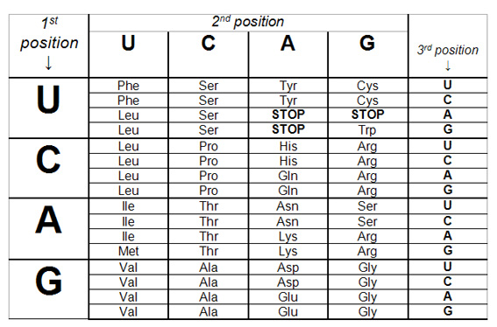
Which amino acids are coded for by an mRNA segment that reads GUA CAC?
Lysine and Alanine
Valine and Histidine
Valine and Glycine
Glycine and Serine

Slide 5
Which amino acids are coded for by an mRNA segment that reads GUA CAC?
Lysine and Alanine
Valine and Histidine
Valine and Glycine
Glycine and Serine

Slide 6
How does crossing-over during meiosis lead to genetic variation?
It increases the number of gametes produced.
It adds additional genes to the parent chromosome.
It doubles the number of chromosomes in the gametes.
It increase the number of possible genetic combinations in the offspring.

Slide 7
How does crossing-over during meiosis lead to genetic variation?
It increases the number of gametes produced.
It adds additional genes to the parent chromosome.
It doubles the number of chromosomes in the gametes.
It increase the number of possible genetic combinations in the offspring.

Slide 8
Which of the following is evidence that the environment influences the expression of genetic traits?
A child with two recessive genes for cystic fibrosis will have the disease
The son of hemophiliac parents will also have hemophilia
A child needs only one gene for Huntington disease to develop the disease
a healthful diet can help a person with genetic predisposition for type 2 diabetes avoid the disease

Slide 9
Which of the following is evidence that the environment influences the expression of genetic traits?
A child with two recessive genes for cystic fibrosis will have the disease
The son of hemophiliac parents will also have hemophilia
A child needs only one gene for Huntington disease to develop the disease
a healthful diet can help a person with genetic predisposition for type 2 diabetes avoid the disease

Slide 10
A father with blood type AB and a mother with blood type O give birth to a son with blood type B and a daughter with blood type A. Which term best describes this scenario?
Codominance
Polygenic traits
Multiple alleles
Incomplete dominance

Slide 11
A father with blood type AB and a mother with blood type O give birth to a son with blood type B and a daughter with blood type A. Which term best describes this scenario?
Codominance
Polygenic traits
Multiple alleles
Incomplete dominance

Slide 12
Which of the following groups of terms is associated with engineering transgenic organism?
Meiosis, zygotes, fertilization
Crossing-over, genetic variation, haploid cells
Recombinant DNA, plasmids, restriction enzymes
Incomplete dominance, multiple alleles, mutations

Slide 13
Which of the following groups of terms is associated with engineering transgenic organism?
Meiosis, zygotes, fertilization
Crossing-over, genetic variation, haploid cells
Recombinant DNA, plasmids, restriction enzymes
Incomplete dominance, multiple alleles, mutations

Slide 14
Which of these is one way that growing and buying organic food affects our environment?
Competition between native species is reduced
The level of pollution in groundwater is reduced
The demand for fossil fuels is reduced
The risk of oil spills is reduced

Slide 15
Which of these is one way that growing and buying organic food affects our environment?
Competition between native species is reduced
The level of pollution in groundwater is reduced
The demand for fossil fuels is reduced
The risk of oil spills is reduced

Slide 16
In the process of DNA replication, the DNA molecule is unzipped down the middle, forming two complementary halves. During which phase of the cell cycle does this occur?
S phase
G1 phase
Anaphase
Metaphase

Slide 17
In the process of DNA replication, the DNA molecule is unzipped down the middle, forming two complementary halves. During which phase of the cell cycle does this occur?
S phase
G1 phase
Anaphase
Metaphase

Slide 18
In pea plants, the allele for purple flowers(P) is dominant over the allele for white flowers (p). The punnett square shown below represents a cross between two pea plants with purple flowers.
P
p
P
p
What will be the phenotypic ratios for this cross?
One-half Pp, one-half pp
One-fourth PP, one-half Pp, one-fourth pp
One-half purple, one-half white
Three-fourths purple, one-fourth white

Slide 19
In pea plants, the allele for purple flowers(P) is dominant over the allele for white flowers (p). The punnett square shown below represents a cross between two pea plants with purple flowers.
P
p
PP | Pp
PP | pp
P
p
What will be the phenotypic ratios for this cross?
One-half Pp, one-half pp
One-fourth PP, one-half Pp, one-fourth pp
One-half purple, one-half white
Three-fourths purple, one-fourth white

Slide 20
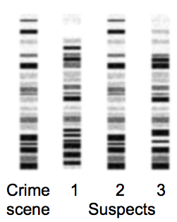
This diagram show DNA fingerprints made from a hair found at a crime scene and for hairs from four suspects, labeled W to Z.
Which suspect is most likely the source of the hair at the crime scene?
1
2
3
None of the above

Slide 21
This diagram show DNA fingerprints made from a hair found at a crime scene and for hairs from four suspects, labeled W to Z.
Which suspect is most likely the source of the hair at the crime scene?
1
2
3
None of the above

Slide 22
What phrase best summarizes the end result of meiosis?
Haploid cells, each with a unique set of chromosomes
Diploid cells, each with a unique set of chromosomes
Haploid cells, each identical to the parent cell
Diploid cells, each identical to the parent cell

Slide 23
What phrase best summarizes the end result of meiosis?
Haploid cells, each with a unique set of chromosomes
Diploid cells, each with a unique set of chromosomes
Haploid cells, each identical to the parent cell
Diploid cells, each identical to the parent cell

Slide 24
How did the research of miller and urey and of oro contribute to the hypotheses about the origins of life on earth?
Their experiments reproduced the transformation of DNA into RNA
Their experiments successfully created the first prokaryotic cell in a lab setting
Their experiments showed that amino acids could form from chemicals present in earth’s early environment
Their experiments demonstrated the transition for anaerobic prokaryotic cells to photosynthetic prokaryotic cells

Slide 25
How did the research of miller and urey and of oro contribute to the hypotheses about the origins of life on earth?
Their experiments reproduced the transformation of DNA into RNA
Their experiments successfully created the first prokaryotic cell in a lab setting
Their experiments showed that amino acids could form from chemicals present in earth’s early environment
Their experiments demonstrated the transition for anaerobic prokaryotic cells to photosynthetic prokaryotic cells

Slide 26
The diagram shows a cladogram of ten vertebrates
According to the cladogram, which of the following pairs are the most closely related?
Shark and dimetrodon
Tyrannosaurus and bird
Dimetrodon and human
Tyrannosaurs and triceratops
Shark trout frog dimetrodon human whale crocodile tyrannosaurs bird triceratops

Slide 27
The diagram shows a cladogram of ten vertebrates
According to the cladogram, which of the following pairs are the most closely related?
Shark and dimetrodon
Tyrannosaurus and bird
Dimetrodon and human
Tyrannosaurs and triceratops
Shark trout frog dimetrodon human whale crocodile tyrannosaurs bird triceratops

Slide 28
Pesticides are used to kill aedes aegypti, the mosquito that carries yellow fever. Over time, the type of pesticides being used comes ineffective and has to be replaced. Which is the best explanation for this?
The mosquitoes that are not killed by the pesticides continue to reproduce, passing their resistance on to their offspring. Over time, the mosquito population becomes resistant.
The mosquitoes that are not killed by the pesticide migrate from the area. Over time, new strains of mosquito replace them.
The mosquitoes become weakened by the pesticides, but they develop an ability to survive. Over time, their offspring learn that same ability.
The mosquitoes become weakened by the pesticide, but they produce antibodies against it. Over time, the entire population develops these antibodies.

Slide 29
Pesticides are used to kill aedes aegypti, the mosquito that carries yellow fever. Over time, the type of pesticides being used comes ineffective and has to be replaced. Which is the best explanation for this?
The mosquitoes that are not killed by the pesticides continue to reproduce, passing their resistance on to their offspring. Over time, the mosquito population becomes resistant.
The mosquitoes that are not killed by the pesticide migrate from the area. Over time, new strains of mosquito replace them.
The mosquitoes become weakened by the pesticides, but they develop an ability to survive. Over time, their offspring learn that same ability.
The mosquitoes become weakened by the pesticide, but they produce antibodies against it. Over time, the entire population develops these antibodies.

Slide 30
Which sequence shows the stages of interphase in the correct order?
G1 stage→G2 stage → S stage
S stage → G1 stage → G2 stage
G1 stage→ S stage→ G2 stage
G2 stage→ S stage→ G1 stage

Slide 31
Which sequence shows the stages of interphase in the correct order?
G1 stage→G2 stage → S stage
S stage → G1 stage → G2 stage
G1 stage→ S stage→ G2 stage
G2 stage→ S stage→ G1 stage

Slide 32
Which of the following scientific inventions and discoveries led to the inclusion of microorganisms in the taxonomy of living things?
X-rays
Antibiotics
Microscopes
The structure of DNA

Slide 33
Which of the following scientific inventions and discoveries led to the inclusion of microorganisms in the taxonomy of living things?
X-rays
Antibiotics
Microscopes
The structure of DNA

Slide 34
Gene therapy involves replacing a defective or missing gene in a person’s genome. Which of the following aspects of gene therapy would most likely spark an ethical debate over this area of DNA technology
Finding the genetic defect that causes a disease
Developing the replacement gene
Identifying the defective gene in a person’s genome
Using weakened viruses to transport replacement genes

Slide 35
Gene therapy involves replacing a defective or missing gene in a person’s genome. Which of the following aspects of gene therapy would most likely spark an ethical debate over this area of DNA technology
Finding the genetic defect that causes a disease
Developing the replacement gene
Identifying the defective gene in a person’s genome
Using weakened viruses to transport replacement genes

Slide 36
In which scenario would natural selection most likely lead to the evolution of a new species?
A canyon separates two populations of a lizard species, so they cannot interbreed.
A population of foxes lives in a forest that remains stable over a long period of time
A small population of corn plants with few variation is infected with a new type of fungus.
Two populations of a finch species move into the same area and mate with each other.

Slide 37
In which scenario would natural selection most likely lead to the evolution of a new species?
A canyon separates two populations of a lizard species, so they cannot interbreed.
A population of foxes lives in a forest that remains stable over a long period of time
A small population of corn plants with few variation is infected with a new type of fungus.
Two populations of a finch species move into the same area and mate with each other.

Slide 38
which of the following describes part of the process of protein synthesis in eukaryotic and prokaryotic organisms?
DNA unzips, and each strand is replicated
tRNA transcribes the DNA nucleotide sequence
Nucleotide codons are used to construct amino acids
mRNA carries genetic instruction from the nucleus to the cytoplasm

Slide 39
which of the following describes part of the process of protein synthesis in eukaryotic and prokaryotic organisms?
DNA unzips, and each strand is replicated
tRNA transcribes the DNA nucleotide sequence
Nucleotide codons are used to construct amino acids
mRNA carries genetic instruction from the nucleus to the cytoplasm

Slide 40
Which statement best describes the fossil record?
The fossil record contains evidence of all species that have ever lived on earth
The fossil record is incomplete but contains evidence of species changing over time
Because the fossil record is incomplete, it cannot show that species have changed over time
The fossil record shows that species changed in the past but are no longer evolving

Slide 41
Which statement best describes the fossil record?
The fossil record contains evidence of all species that have ever lived on earth
The fossil record is incomplete but contains evidence of species changing over time
Because the fossil record is incomplete, it cannot show that species have changed over time
The fossil record shows that species changed in the past but are no longer evolving

Slide 42
Which of the following is a way that transgenic organisms are used to benefit society.
Modified goats produce a protein that is used to treat people whose blood clots too easily
Gel electrophoresis is used to separate DNA into individual fragment
A defective gene in a organism's genome is replaced
DNA fingerprints are used to math DNA from skin samples to a crime suspect.

Slide 43
Which of the following is a way that transgenic organisms are used to benefit society.
Modified goats produce a protein that is used to treat people whose blood clots too easily
Gel electrophoresis is used to separate DNA into individual fragment
A defective gene in a organism's genome is replaced
DNA fingerprints are used to math DNA from skin samples to a crime suspect.

Slide 44
Which of these is an example of passive immunity?
A child who is given a vaccine for polio becomes immune to the disease
A person who becomes ill with flu produces antibodies to the disease
A person who becomes ill with tuberculosis is cured with an antibiotic
A newborn baby receives antibodies from its mother’s milk

Slide 45
Which of these is an example of passive immunity?
A child who is given a vaccine for polio becomes immune to the disease
A person who becomes ill with flu produces antibodies to the disease
A person who becomes ill with tuberculosis is cured with an antibiotic
A newborn baby receives antibodies from its mother’s milk

Slide 46
What is one way that natural selection affects some population of bacteria and viruses?
They generate fewer mutations
They reproduce at a slower rate
They develop resistance to drugs and vaccines
They produce offspring with unfavorable adaptation

Slide 47
What is one way that natural selection affects some population of bacteria and viruses?
They generate fewer mutations
They reproduce at a slower rate
They develop resistance to drugs and vaccines
They produce offspring with unfavorable adaptation

Slide 48
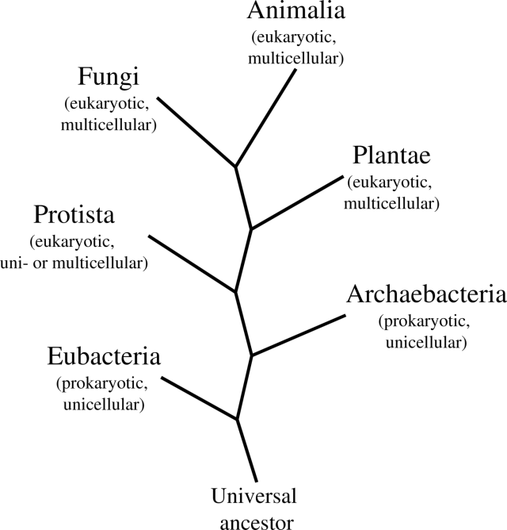
The diagrams shows the modern organization of domain and kingdoms.
Archaea are now classified in their own domain. With which organisms were Archaea classified prior to the creation of this domain?
Bacteria
Animals
Plants
Fungi

Slide 49
The diagrams shows the modern organization of domain and kingdoms.
Archaea are now classified in their own domain. With which organisms were Archaea classified prior to the creation of this domain?
Bacteria
Animals
Plants
Fungi

