Slide 1
Std 3 part 2

Slide 2
Which of the following is an ethical concern associated with using genetically engineered crop varieties?
Genetically engineered varieties are unable to reproduce
The use of genetically engineered seeds might educe genetic variation
Genetically engineered crops required more water than regular crops
The short-term effects of eating genetically engineered foods are unknown.

Slide 3
Which of the following is an ethical concern associated with using genetically engineered crop varieties?
Genetically engineered varieties are unable to reproduce
The use of genetically engineered seeds might educe genetic variation
Genetically engineered crops required more water than regular crops
The short-term effects of eating genetically engineered foods are unknown.

Slide 4
a strand of DNA has these bases: TGA CGG ATC GAT
What is the complementary DNA strand?
CUG UAA GCU AGC
CTG TAA GCT AGC
ACU GCC UAG CUA
ACT GCC TAG CTA

Slide 5
a strand of DNA has these bases: TGA CGG ATC GAT
What is the complementary DNA strand?
CUG UAA GCU AGC
CTG TAA GCT AGC
ACU GCC UAG CUA
ACT GCC TAG CTA

Slide 6
An error occurs in transcribing a strand of mRNA and an extra base is inserted into the sequence of bases. What is the most likely result of this error?
The addition of only one base will not cause a change in the overall structure of the resulting protein
The peptide chain will probably contain one incorrect amino acid, which may change the entire protein
The entire peptide chain beginning with that location with be altered, changing the entire protein
The number of chromosomes will be changed in the organism

Slide 7
An error occurs in transcribing a strand of mRNA and an extra base is inserted into the sequence of bases. What is the most likely result of this error?
The addition of only one base will not cause a change in the overall structure of the resulting protein
The peptide chain will probably contain one incorrect amino acid, which may change the entire protein
The entire peptide chain beginning with that location with be altered, changing the entire protein
The number of chromosomes will be changed in the organism

Slide 8
The inheritance of the disorder cystic fibrosis is autosomal recessive, meaning that a homozygous recessive individual will have the disorder. Which would most likely result if both parents in a family are heterozygous for this trait?
All of their children have cystic fibrosis
Three-fourths of their children will have cystic fibrosis
Half of their children will have cystic fibrosis
One-fourth of their children will have cystic fibrosis

Slide 9
The inheritance of the disorder cystic fibrosis is autosomal recessive, meaning that a homozygous recessive individual will have the disorder. Which would most likely result if both parents in a family are heterozygous for this trait?
All of their children have cystic fibrosis
Three-fourths of their children will have cystic fibrosis
Half of their children will have cystic fibrosis
One-fourth of their children will have cystic fibrosis

Slide 10
Which of these genetic disorders is most likely to be influenced by environmental factors?
Color blindness
Sickle cell disease
Lung cancer
Hemophilia

Slide 11
Which of these genetic disorders is most likely to be influenced by environmental factors?
Color blindness
Sickle cell disease
Lung cancer
Hemophilia

Slide 12
Which statement best describes DNA fingerprints?
The more similar the patterns in two DNA fingerprints, the closer the relationship between the organisms
Any difference between the patterns in two DNA fingerprints suggests that the organisms are not related
The only use for DNA fingerprints is investigation of crimes
Scientists always use DNA for skin cells to develop DNA fingerprints

Slide 13
Which statement best describes DNA fingerprints?
The more similar the patterns in two DNA fingerprints, the closer the relationship between the organisms
Any difference between the patterns in two DNA fingerprints suggests that the organisms are not related
The only use for DNA fingerprints is investigation of crimes
Scientists always use DNA for skin cells to develop DNA fingerprints

Slide 14
In the past, diabetics relied on insulin produced in cows and pigs to manage blood sugar. Today, transgenic bacteria produce greater amounts of insulin in large laboratory cultures. How do biologist engineer transgenic bacteria?
The gene for producing human insulin is inserted into the DNA of a bacterium. When the bacterium reproduces, all the offspring contain that gene.
An entire plasmid of a bacterium is replaced with human insulin producing genes. When the bacterium reproduces, all the offspring contain those genes.
Bacteria with a naturally occurring ability to produce human insulin are cultivated in large vats
Bacteria with a naturally occurring ability to produce human insulin are bred together and their offspring are cultivated in large vats

Slide 15
In the past, diabetics relied on insulin produced in cows and pigs to manage blood sugar. Today, transgenic bacteria produce greater amounts of insulin in large laboratory cultures. How do biologist engineer transgenic bacteria?
The gene for producing human insulin is inserted into the DNA of a bacterium. When the bacterium reproduces, all the offspring contain that gene.
An entire plasmid of a bacterium is replaced with human insulin producing genes. When the bacterium reproduces, all the offspring contain those genes.
Bacteria with a naturally occurring ability to produce human insulin are cultivated in large vats
Bacteria with a naturally occurring ability to produce human insulin are bred together and their offspring are cultivated in large vats

Slide 16
All the plants grown from a given type of genetically engineered seed are genetically identical. On the one hand, uniformity can make it easier for a farmer to manage the crops. Which is the best reason why the loss of genetic variation is an environmental concern?
Crops with less variation need more pesticide
Crops with less variation are more vulnerable to disease
Crops with less variation are less nutritious
Crops with less variation required larger areas to grow

Slide 17
All the plants grown from a given type of genetically engineered seed are genetically identical. On the one hand, uniformity can make it easier for a farmer to manage the crops. Which is the best reason why the loss of genetic variation is an environmental concern?
Crops with less variation need more pesticide
Crops with less variation are more vulnerable to disease
Crops with less variation are less nutritious
Crops with less variation required larger areas to grow

Slide 18
According to the endosymbiont theory, how did the mitochondria and chloroplasts in eukaryotic cells evolve?
From mutation in the DNA of ancient prokaryotes
From bacteria engulfed, or taken in, by other prokaryotes
From mutations in the DNA of ancient eukaryotes
From the ribosomes of ancient bacteria

Slide 19
According to the endosymbiont theory, how did the mitochondria and chloroplasts in eukaryotic cells evolve?
From mutation in the DNA of ancient prokaryotes
From bacteria engulfed, or taken in, by other prokaryotes
From mutations in the DNA of ancient eukaryotes
From the ribosomes of ancient bacteria

Slide 20
Natural selection has sometimes been described as survival of the fittest. In this sense what is meant by the fitness of an organism?
The strength of an organism
The intelligence of the organism
The ability to survive and reproduce
The tendency to grow larger than others

Slide 21
Natural selection has sometimes been described as survival of the fittest. In this sense what is meant by the fitness of an organism?
The strength of an organism
The intelligence of the organism
The ability to survive and reproduce
The tendency to grow larger than others

Slide 22
What is the system for naming organisms that was developed by carolus linnaeus and is still used today?
Phylogeny
Binomial nomenclature
Taxonomy
Cladogram

Slide 23
What is the system for naming organisms that was developed by carolus linnaeus and is still used today?
Phylogeny
Binomial nomenclature
Taxonomy
Cladogram

Slide 24
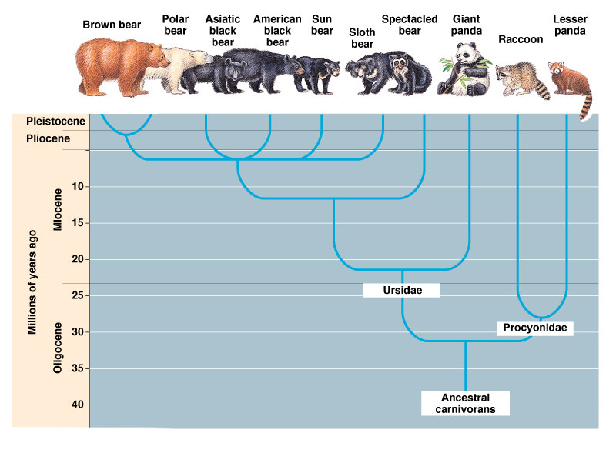
This diagram shows a phylogenetic tree of the bears family according to the diagram, approximately when did the common ancestor of giant pandas and spectacled bears exist?
5-10mya
10-15mya
15-20mya
20-25mya

Slide 25
This diagram shows a phylogenetic tree of the bears family according to the diagram, approximately when did the common ancestor of giant pandas and spectacled bears exist?
5-10mya
10-15mya
15-20mya
20-25mya

Slide 26
Which statement best describes how the use of antibiotics on certain bacteria affects natural selection?
Natural selection is altered because bacteria are killed
The rate of selection is decreased because the antibiotics kill only young bacteria
Antibiotics alter natural selection by causing bacterial DNA to mutate
The rate of selection is increased because antibiotics do not kill the bacteria that are naturally resistant to them

Slide 27
Which statement best describes how the use of antibiotics on certain bacteria affects natural selection?
Natural selection is altered because bacteria are killed
The rate of selection is decreased because the antibiotics kill only young bacteria
Antibiotics alter natural selection by causing bacterial DNA to mutate
The rate of selection is increased because antibiotics do not kill the bacteria that are naturally resistant to them

Slide 28
A DNA molecule is made up of two strands of nucleotides, joined to form a double helix. Which statement describes how the strands are linked?
Each sugar in one strand is paired with a complementary base in the other strand
Each sugar in one strand is paired with a complementary phosphate in the other strand
Each phosphate in one strand is paired with a complementary phosphate in the other strand
Each base in one strand is paired with a complementary base in the other strand

Slide 29
A DNA molecule is made up of two strands of nucleotides, joined to form a double helix. Which statement describes how the strands are linked?
Each sugar in one strand is paired with a complementary base in the other strand
Each sugar in one strand is paired with a complementary phosphate in the other strand
Each phosphate in one strand is paired with a complementary phosphate in the other strand
Each base in one strand is paired with a complementary base in the other strand

Slide 30
In protein synthesis, which carries the individual amino acids that join to form a peptide chain?
mRNA
tRNA
rRNA
DNA

Slide 31
In protein synthesis, which carries the individual amino acids that join to form a peptide chain?
mRNA
tRNA
rRNA
DNA

Slide 32
In what way does crossing-over influence the genetic variation of offspring?
Genes from both parents are interchanged, which increase the number of possible combination that the offspring can receive
Chromosomes from both parents are interchanged, which increase the number of possible combination that the offspring can receive
Genes from both parents are kept separate, which reduces the number of possible combination that the offspring can receive
Chromosomes from both parents are kept separate, which reduces the number of possible combination that the offspring can receive

Slide 33
In what way does crossing-over influence the genetic variation of offspring?
Genes from both parents are interchanged, which increase the number of possible combination that the offspring can receive
Chromosomes from both parents are interchanged, which increase the number of possible combination that the offspring can receive
Genes from both parents are kept separate, which reduces the number of possible combination that the offspring can receive
Chromosomes from both parents are kept separate, which reduces the number of possible combination that the offspring can receive

Slide 34
One parent is heterozygous for type B blood. The other parent has type AB blood. Which fraction of their children will have type O blood.
Three-fourths of their children will have type O blood
Half of their children will have type O blood
One-fourth of their children will have type O blood
None of their children will have type O blood

Slide 35
One parent is heterozygous for type B blood. The other parent has type AB blood. Which fraction of their children will have type O blood.
Three-fourths of their children will have type O blood
Half of their children will have type O blood
One-fourth of their children will have type O blood
None of their children will have type O blood

Slide 36
Some cotton plants have been genetically engineered to contain a gene that protects them from certain insects. Which is a way in which these genetically engineered cotton plants can benefit society?
Faster production of cotton
Less soil erosion
Increased genetic variation
Less need for pesticides

Slide 37
Some cotton plants have been genetically engineered to contain a gene that protects them from certain insects. Which is a way in which these genetically engineered cotton plants can benefit society?
Faster production of cotton
Less soil erosion
Increased genetic variation
Less need for pesticides

Slide 38
Which represent the most significant ethical issue regarding research and medical treatments using stem cells ?
The use of adult stem cell tissue
The use of embryonic stem cell tissue
The loss of genetic variation
The patenting of human genes

Slide 39
Which represent the most significant ethical issue regarding research and medical treatments using stem cells ?
The use of adult stem cell tissue
The use of embryonic stem cell tissue
The loss of genetic variation
The patenting of human genes

Slide 40
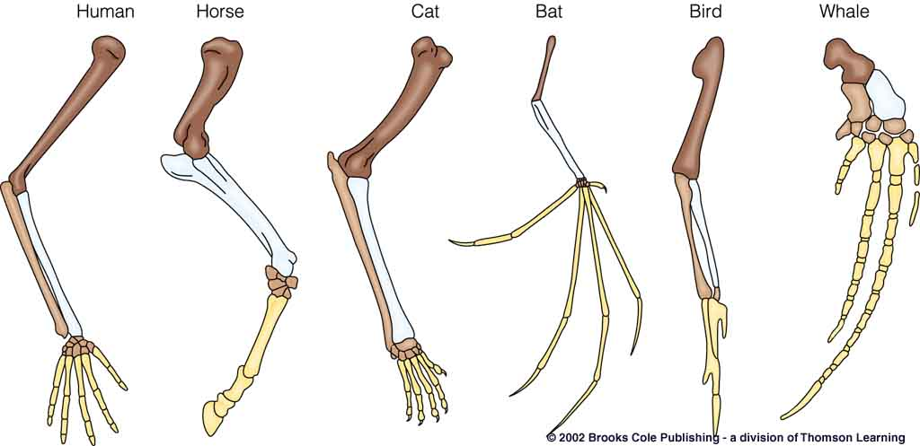
this diagram shows the bones of a human arm, a bird wing, a dog’s front leg, and a whale’s flipper. Together, these structures indicate that the four organisms share a common ancestor. What are these types of structures called?
Embryological structures
Vestigial structures
Homologous structures
Analogous structures

Slide 41
this diagram shows the bones of a human arm, a bird wing, a dog’s front leg, and a whale’s flipper. Together, these structures indicate that the four organisms share a common ancestor. What are these types of structures called?
Embryological structures
Vestigial structures
Homologous structures
Analogous structures

Slide 42
Which statement best describes how the biological classification system has changed since it was developed by carolous linnaeus?
Advances in technology and knowledge have confirmed the original system. It has not change over time
The system developed by Linnaeus have been combined with Aristotle's system of grouping plants and animals
As technology has advanced and knowledge has increased, the system developed by Linnaeus have undergone many changes
As technology have advanced and knowledge have increased, the system developed by Linnaeus have been completely discarded.

Slide 43
Which statement best describes how the biological classification system has changed since it was developed by carolous linnaeus?
Advances in technology and knowledge have confirmed the original system. It has not change over time
The system developed by Linnaeus have been combined with Aristotle's system of grouping plants and animals
As technology has advanced and knowledge has increased, the system developed by Linnaeus have undergone many changes
As technology have advanced and knowledge have increased, the system developed by Linnaeus have been completely discarded.

Slide 44
How does genetic variation affect natural selection?
A variety of physical traits makes it more likely that some members will survive and reproduce under different situations
A variety of genes results in more mutations
Increasing genetic variety results in overproduction of offspring
Genetic variation leads to more competition within a particular population

Slide 45
How does genetic variation affect natural selection?
A variety of physical traits makes it more likely that some members will survive and reproduce under different situations
A variety of genes results in more mutations
Increasing genetic variety results in overproduction of offspring
Genetic variation leads to more competition within a particular population

Slide 46
What is the largest taxonomic grouping?
Kingdom
Phylum
Domain
Genus

Slide 47
What is the largest taxonomic grouping?
Kingdom
Phylum
Domain
Genus

Slide 48
Which organisms rely on DNA for protein synthesis?
All life forms
Only eukarotes
Only multicellular organisms
Only vertebrates

Slide 49
Which organisms rely on DNA for protein synthesis?
All life forms
Only eukarotes
Only multicellular organisms
Only vertebrates

Slide 50
Lactase is an enzyme that is involved in breaking down lactose, the sugar in milk. Which term best describes the role of lactase in the digestion of milk?
Substrate
Reactant
Product
Catalyst

Slide 51
Lactase is an enzyme that is involved in breaking down lactose, the sugar in milk. Which term best describes the role of lactase in the digestion of milk?
Substrate
Reactant
Product
Catalyst

Slide 52
A complementary strand of RNA is made from a section of DNA during which process?
Replication
Transcription
Translation
Synthesis

Slide 53
A complementary strand of RNA is made from a section of DNA during which process?
Replication
Transcription
Translation
Synthesis

