Slide 1
Std 4 Review!

Slide 2
Cells use the sequence of nucleotides in the DNA molecules as a set of instructions for making proteins. What parts make up a single nucleotide?
A phospholipid chain and a nitrogenous base
A phosphate molecule and three glucose molecules
A sugar molecule, an amino acid, and a variable group
A nitrogenous base, a sugar molecule, and a phosphate molecule

Slide 3
Cells use the sequence of nucleotides in the DNA molecules as a set of instructions for making proteins. What parts make up a single nucleotide?
A phospholipids chain and a nitrogenous base
A phosphate molecule and three glucose molecules
A sugar molecule, an amino acid, and a variable group
A nitrogenous base, a sugar molecule, and a phosphate molecule

Slide 4
Which three of the four main kinds of macromolecules are used by living thing for energy?
Proteins, lipids, nucleic acids
Proteins, carbohydrates, lipids
Carbohydrates, lipids, nucleic acids
Proteins, nucleic acids, carbohydrates

Slide 5
Which three of the four main kinds of macromolecules are used by living thing for energy?
Proteins, lipids, nucleic acids
Proteins, carbohydrates, lipids
Carbohydrates, lipids, nucleic acids
Proteins, nucleic acids, carbohydrates

Slide 6
Which is an example of how cells use active transport to maintain homeostasis?
Water diffuses across selectively permeable membrane.
Energy from ATP is used to move sodium and potassium ions against a concentration gradient
Particles move passively across the cell membrane in response to a concentration gradient
Protein channels embedded in the cell membrane help specific molecules move across the cell membrane

Slide 7
Which is an example of how cells use active transport to maintain homeostasis?
Water diffuses across selectively permeable membrane.
Energy from ATP is used to move sodium and potassium ions against a concentration gradient
Particles move passively across the cell membrane in response to a concentration gradient
Protein channels embedded in the cell membrane help specific molecules move across the cell membrane

Slide 8
Which would be the best evidence that a cell is using active transport to move a substance across its cell membrane?
ATP is being consumed at a high rate near the cell membrane
Water molecules are moving across the cell membrane at a rapid rate
Glucose molecules are moving through channels in the cell membrane
Calcium ions are moving from high to low concentrations across the cell membrane

Slide 9
Which would be the best evidence that a cell is using active transport to move a substance across its cell membrane?
ATP is being consumed at a high rate near the cell membrane
Water molecules are moving across the cell membrane at a rapid rate
Glucose molecules are moving through channels in the cell membrane
Calcium ions are moving from high to low concentrations across the cell membrane

Slide 10
Which of the following compounds are proteins?
DNA and RNA
Glucose and cellulose
Waxes and cholesterol
Hemoglobin and collagen

Slide 11
Which of the following compounds are proteins?
DNA and RNA
Glucose and cellulose
Waxes and cholesterol
Hemoglobin and collagen

Slide 12
In biological reactions, the reactants and enzyme fit together like a lock and key. This complementary attachment speeds up the reaction. What is the attachment site on the enzyme called?
Active site
Reactant site
Catalytic site
Substrate site

Slide 13
In biological reactions, the reactants and enzyme fit together like a lock and key. This complementary attachment speeds up the reaction. What is the attachment site on the enzyme called?
Active site
Reactant site
Catalytic site
Substrate site

Slide 14
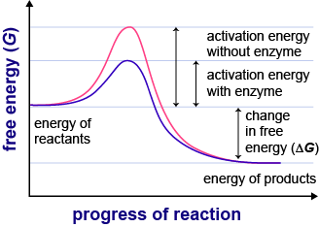
The graph shows the activation energy required for a biochemical reaction under two different conditions.
What does the peak of the blue line MOST LIKELY represent?

Slide 15
What does the peak of the blue line MOST LIKELY represent?
The activation energy required for cellular respiration
The activation energy required for photosynthesis
The activation energy required with an enzyme
The activation energy required without an enzyme

Slide 16
What does the peak of the blue line MOST LIKELY represent?
The activation energy required for cellular respiration
The activation energy required for photosynthesis
The activation energy required with an enzyme
The activation energy required without an enzyme

Slide 17
Read the following four statements. 1. glucose and oxygen are the reactants 2. glucose and oxygen are the products 3.carbon dioxide and water are reactants 4.carbon dioxide and water are products
What statement summarizes the process of cellular respiration?
2 and 4
1 and 3
2 and 3
1 and 4

Slide 18
Read the following four statements. 1. glucose and oxygen are the reactants 2. glucose and oxygen are the products 3.carbon dioxide and water are reactants 4.carbon dioxide and water are products
What statement summarizes the process of cellular respiration?
2 and 4
1 and 3
2 and 3
1 and 4

Slide 19
In all cells, how is the sequence of nucleotides in DNA used?
As instructions for making antibodies
As instruction for making proteins
As instructions for making a new nucleus
As instructions for making glucose chains

Slide 20
In all cells, how is the sequence of nucleotides in DNA used?
As instructions for making antibodies
As instruction for making proteins
As instructions for making a new nucleus
As instructions for making glucose chains

Slide 21
Which best describes the relationship between cellular respiration and photosynthesis?
Photosynthesis required oxygen; cellular respiration required carbon dioxide
Photosynthesis traps sunlight; cellular respiration traps ATP
Photosynthesis uses energy from sunlight to make food; cellular respiration used food to release energy
Photosynthesis is used by plants to get energy from food; cellular respiration is used by animals to get energy from food.

Slide 22
Which best describes the relationship between cellular respiration and photosynthesis?
Photosynthesis required oxygen; cellular respiration required carbon dioxide
Photosynthesis traps sunlight; cellular respiration traps ATP
Photosynthesis uses energy from sunlight to make food; cellular respiration used food to release energy
Photosynthesis is used by plants to get energy from food; cellular respiration is used by animals to get energy from food.

Slide 23
Which statement summarizes the relationship between photosynthesis and cellular respiration?
Photosynthesis and cellular respiration have the same reactants but different products
The reactants of photosynthesis are the products of cellular respiration
Photosynthesis releases energy, and cellular respiration stores energy
Photosynthesis releases energy, and cellular respiration uses energy

Slide 24
Which statement summarizes the relationship between photosynthesis and cellular respiration?
Photosynthesis and cellular respiration have the same reactants but different products
The reactants of photosynthesis are the products of cellular respiration
Photosynthesis releases energy, and cellular respiration stores energy
Photosynthesis releases energy, and cellular respiration uses energy

Slide 25
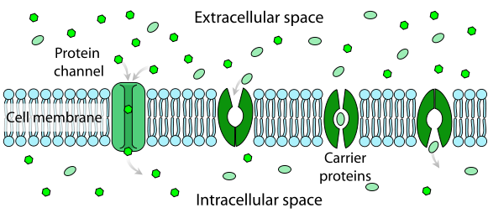
Certain large molecules, such as glucose, can flow through the kind of structure labeled X in the diagram. These molecules move because of differences in concentration between the two sides of the plasma membrane. Which process occurs through the structures labeled X?
Facilitated diffusion
Active transport
Respiration
Osmosis

Slide 26
Certain large molecules, such as glucose, can flow through the kind of structure labeled X in the diagram. These molecules move because of differences in concentration between the two sides of the plasma membrane. Which process occurs through the structures labeled X?
Facilitated diffusion
Active transport
Respiration
Osmosis

Slide 27
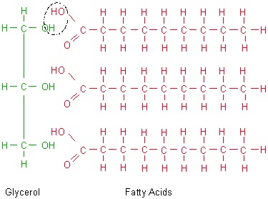
Which is a function of this molecule in organisms?
Storage of genetic information
Structure and support
Short-term energy storage
Long-term energy storage

Slide 28
Which is a function of this molecule in organisms?
Storage of genetic information
Structure and support
Short-term energy storage
Long-term energy storage

Slide 29
Which factor determines the shape and function of a protein?
The density of ribosome in the cell
The peptide bonds between the amino acids
The order of the amino acids in the peptide chain
The sequence of phosphate molecules in DNA

Slide 30
Which factor determines the shape and function of a protein?
The density of ribosome in the cell
The peptide bonds between the amino acids
The order of the amino acids in the peptide chain
The sequence of phosphate molecules in DNA

Slide 31
Which best describes the function of enzymes?
They speed up chemical reactions in cells
To produce cellular energy
To produce proteins
To speed up cell division

Slide 32
Which best describes the function of enzymes?
They speed up chemical reactions in cells
To produce cellular energy
To produce proteins
To speed up cell division

Slide 33
What are the products of photosynthesis?
Glucose and oxygen
Glucose and carbon dioxide
Glucose and water
Water, carbon dioxide, and energy

Slide 34
What are the products of photosynthesis?
Glucose and oxygen
Glucose and carbon dioxide
Glucose and water
Water, carbon dioxide, and energy

Slide 35
Which process uses ATP to move material through the plasma membrane against the concentration gradient?
Passive transport
Active transport
Facilitated diffusion
Osmosis

Slide 36
Which process uses ATP to move material through the plasma membrane against the concentration gradient?
Passive transport
Active transport
Facilitated diffusion
Osmosis

Slide 37
One way cells maintain homeostasis is by regulating water balance inside and outside the cell. The movement of water into or out of a cell is called osmosis. What drives the process of osmosis?
The concentration gradient of a solute
The concentration gradient of water
The temperature of the cytoplasm
The temperature outside the cell

Slide 38
One way cells maintain homeostasis is by regulating water balance inside and outside the cell. The movement of water into or out of a cell is called osmosis. What drives the process of osmosis?
The concentration gradient of a solute
The concentration gradient of water
The temperature of the cytoplasm
The temperature outside the cell

Slide 39
After strenuous exercise, the process of cellular respiration in muscle cells uses up much of the available oxygen. How does cellular respiration change at this point?
Cellular respiration stops
Aerobic respiration begins
Anaerobic respiration begins
Cellular respiration starts producing oxygen

Slide 40
After strenuous exercise, the process of cellular respiration in muscle cells uses up much of the available oxygen. How does cellular respiration change at this point?
Cellular respiration stops
Aerobic respiration begins
Anaerobic respiration begins
Cellular respiration starts producing oxygen

