Slide 1
How Evolution Works

Slide 2
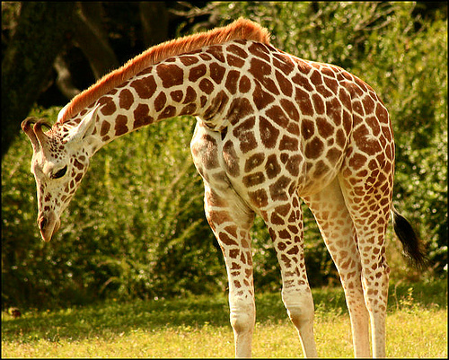
Can Individuals evolve?
No! Within an individual’s lifetime, it cannot evolve a new phenotype by natural selection in response to its environment.
Natural selection acts on the range of phenotypes in a population.

Slide 3
Can Individuals evolve?
Just like all individuals make up a population, all of the genes of the population’s individuals make up the population’s genes
Evolution occurs as a population’s genes and their frequencies change over time

Slide 4
Definitions
Gene Pool = all of the genes in a population’s genes
Allelic Frequency = % of any specific allele in the population
Genetic Equilibrium = when frequency of alleles remains the same over time
*does evolution occur when a population reaches genetic equilibrium??

Slide 5
Mechanisms of Genetic Change
A. Natural Selection – nature favors the organism best suited to thrive in its environment
Three types:
(1) Directional
(2) Stabilizing
(3) Disruptive

Slide 6
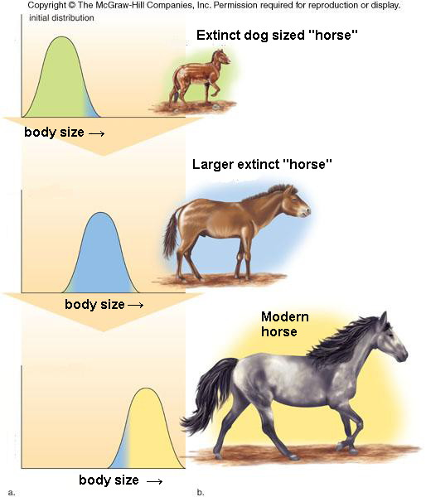
Directional Natural Selection
Directional selection occurs when natural selection favors one extreme of continuous variation. Over time, the favored extreme will become more common and the other extreme will be less common or lost.

Slide 7
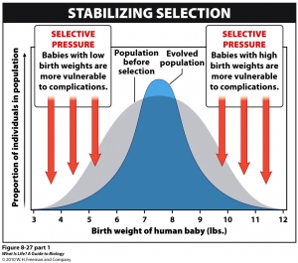
Stabilizing Natural Selection
Stabilizing selection occurs when natural selection favors the intermediate states (average) of continuous variation. Over time, the average states become more common and each extreme variation will become less common or lost.

Slide 8
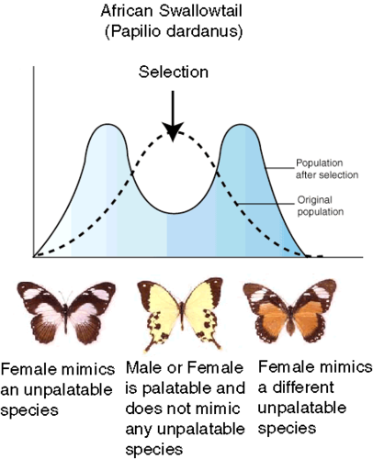
Disruptive Natural Selection
Disruptive selection occurs when natural selection favors both extremes of continuous variation. Over time, the two extreme variations will become more common and the intermediate states will be less common or lost. Disruptive selection can lead to two new species.

Slide 9
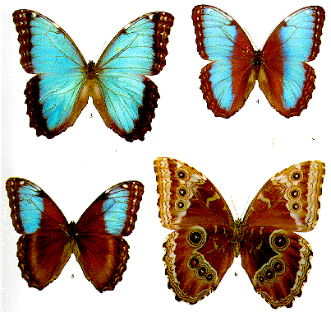
Mechanisms of Genetic Change
B. Mutation:
Most mutations are lethal
Occasionally, mutations result in a useful variation
Example of a useful mutation: different coloration in butterflies

Slide 10
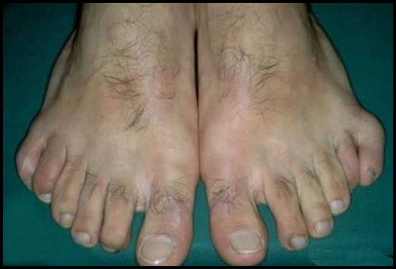
C. Genetic Drift
Changes in allelic frequencies by chance events
Can greatly affect small populations
Genetic drift has been observed in some small human populations that are isolated due to reasons like religious practice.
Example of genetic drift: polydactyl in the Amish community

Slide 11
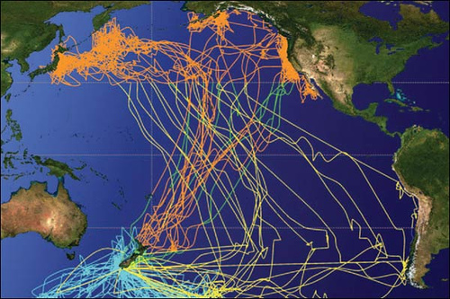
D. Migration
Movement of individuals in and/or out of a population. Transport of genes by migrating individuals is called gene flow.

Slide 12
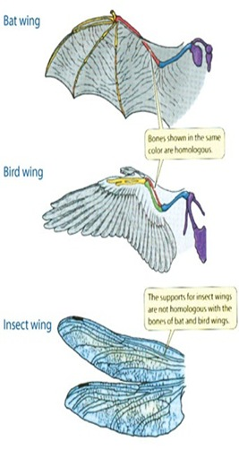
Convergent Evolution
Convergent evolution is the development of similar appearance, structures, or behavior in unrelated species and populations by similar natural selection pressures
EX: Wing structure in bats, birds, and insects

Slide 13
Divergent Evolution/Adaptive Radiation
Divergent evolution occurs when species that were once similar to ancestral species diverge.
Occurs when populations change as they adapt to different environmental conditions
Results in the creation of a new species

Slide 14
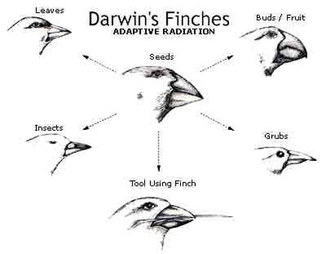
Divergent Evolution/Adaptive Radiation
EX: Darwin’s Finches radiate out into descendent species with similar and different traits
*Finches look
different based on the
types of food they eat

Slide 15
Speciation
How do the changes in the makeup of a gene pool result in the evolution of a new species?
Evolution of a new species is called speciation.
Speciation occurs when members of similar populations no longer interbreed to produce viable offspring

Slide 16
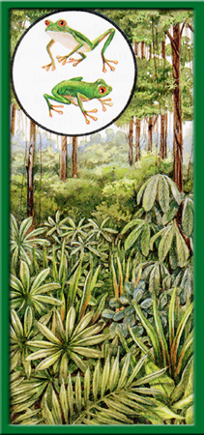
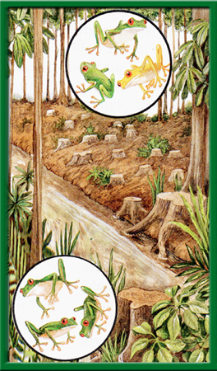
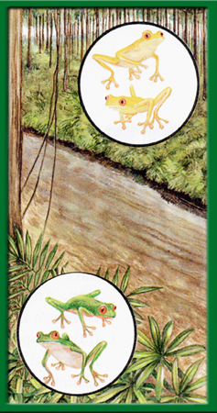
What Prevents Interbreeding?
Geographic Isolation
-Occurs whenever a physical barrier divides a population
Example: Tree Frogs in rain forest separated by a river; new gene pools formed

Slide 17
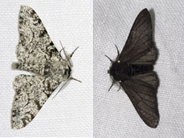
Human Impact on Natural Selection
Humans can affect natural selection if the environment is altered as a result of our activities. This was first seen with the peppered moth during the Industrial Revolution.
*The air pollution created during
The Industrial Revolution that a
layer of soot laid on the trees,
camouflaging the dark moth and allowing traits to be passed on.

Slide 18
Role of Disease Agents in Natural Selection

Slide 19
Physiological Adaptations
Most physiological adaptations can occur very quickly
EX: When penicillin was first used, it was called a wonder drug because it killed many types of disease-causing bacteria. Today penicillin is no longer as effective because some species have evolved physiological adaptations to become resistant to the drug.

Slide 20
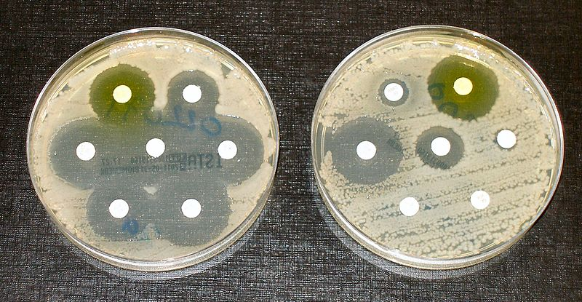
Physiological Adaptations – Drug Resistance
Which drug is resistant to antibiotics?

Slide 21
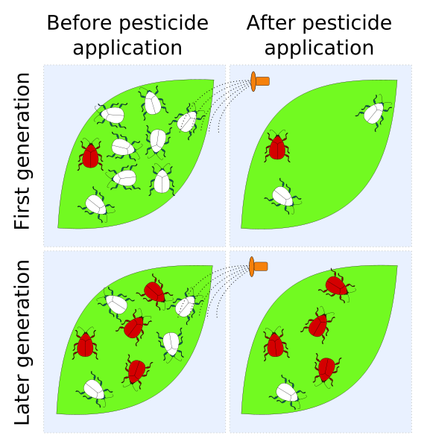
Physiological Adaptations – Pesticide Resistance
In addition to bacteria, scientists have observed physiological adaptations in species of insects and weeds that are pests. After years of exposure to specific pesticides, many species of insects and weeds have become resistant to the chemicals that used to kill them.

Slide 22
Acquired Immunity
Cells of your immune system are constantly on the lookout for foreign invaders. When a pathogen is detected, these cells begin defending your body immediately. At the same time, some white blood cells gradually develop the ability to recognize a specific foreign substance. Defending against a specific pathogen by gradually building up a resistance to it is called acquired immunity.

Slide 23
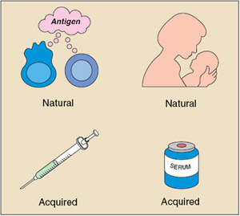
Acquired Immunity
The process of acquiring immunity to a specific disease can take days or weeks.
Acquired immunity to a disease can be either active or passive.

Slide 24
Passive Acquired Immunity
Develops as a result of acquiring antibodies that are generated in another host.
(1) Natural passive immunity – antibodies transferred from mother to unborn child
(2) Artificial passive immunity – injecting antibodies into the body that come from an animal or a human who is already immune to the disease. EX: bit by a snake and injected with antivenom

Slide 25
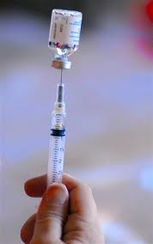
Active Immunity
Active immunity is obtained naturally when a person is exposed to antigens. The body then produces antibodies that correspond directly to the antigens.
Occurs after you get over an infection
Can also induce artificial active immunity by vaccines.

