Slide 1
Human Impact and Improvement

Slide 2
Water Cycle

Slide 3
Water Cycle Processes
Precipitation: water moves from atmosphere to Earth’s surface
Evaporation: water moves from Earth’s surface to atmosphere
Runoff: water moves to lowest point, due to gravity
Infiltration: water seeps through soil to become groundwater
Transpiration: water evaporates from leaves
Condensation: water vapor cools and condenses to form water droplets that make clouds

Slide 4
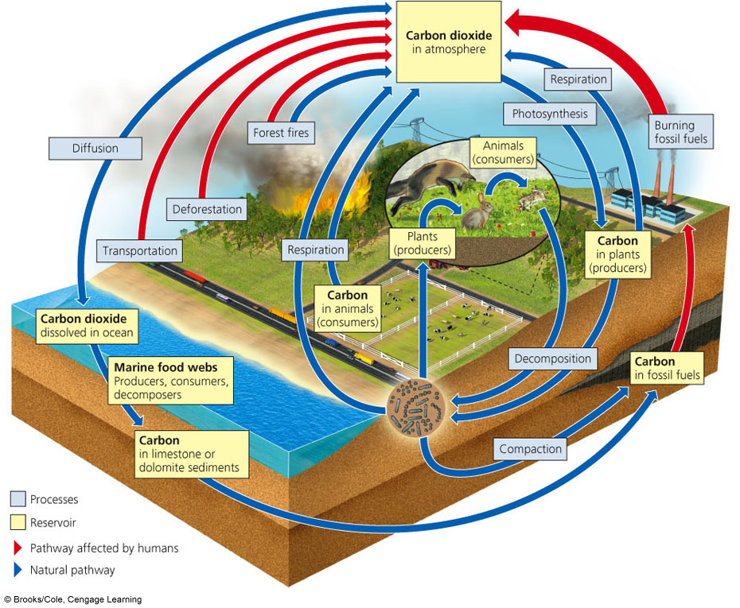
Carbon Cycle

Slide 5
Carbon Cycle Processes
Photosynthesis: removes carbon dioxide from atmosphere
Aerobic and anaerobic respiration: adds carbon dioxide to atmosphere
Burning: adds carbon dioxide to atmosphere
Consumption: when an animal eats another organism, transferring carbon
Decomposition: removes carbon from dead organisms and returns it to the soil
Diffusion: transfers carbon dioxide between atmosphere and water

Slide 6
Nitrogen Cycle

Slide 7
Nitrogen Cycle Processes
Nitrogen fixation: bacteria, algae or lightening convert nitrogen gas into ammonia
Nitrification: bacteria convert ammonia to nitrates
Nitrogen uptake: plants absorb nitrogen (nitrates) from the soil to make DNA and Proteins
Decomposition: removes nitrogen from dead organisms and returns it to the soil
Denitrification: bacteria transfer nitrogen from soil to atmosphere

Slide 8
Human Impact on Carbon Cycle
Burning of fossil fuels leads to increased levels of carbon dioxide in the atmosphere
Carbon dioxide is a greenhouse gas, which effectively retains heat, increasing global temperatures
Therefore, BURNING FOSSIL FUELS contributes to GLOBAL WARMING by increasing levels of carbon dioxide

Slide 9
Human Impact on Carbon Cycle
Recall through photosynthesis that plants take in carbon dioxide and release oxygen
DEFORESTATION (massive removal of trees) leads to an INCREASE in carbon dioxide levels
INCREASING the global warming effect

Slide 10
Human Impact on the Environment
Humans impact the environment in a variety of ways, including:
(1) Through population growth
(2) Habitat destruction (deforestation)
(3) Water and trash pollution
(4) Introduction of invasive species
(5) Global warming/climate change
(6) Ozone Depletion

Slide 11
Human Population Growth
Recall human population growth is exponential
As a result, we need more space to live, which results in deforestation to make homes
We generate more waste (pollution) and consume more resources, outcompeting local flora and fauna for the same limited food and water sources
We generate better quality of life through new technology (mass production, pesticides, gas engines, etc), which leads to burning of fossil fuels and air and water pollution

Slide 12
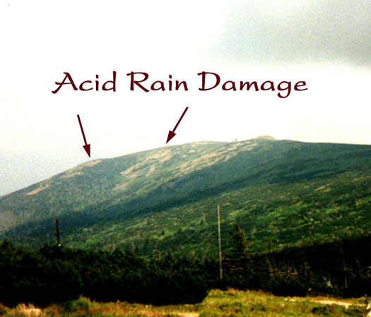
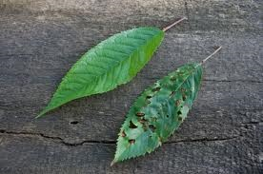
Acid Rain
Acid rain is any precipitation (snow, rain, sleet, and fog) that has a low pH value
Water in atmosphere becomes acidified due to: coal burning factories, car exhaust, etc
Results in damage to plant tissue and can affect aquatic species ability to survive

Slide 13
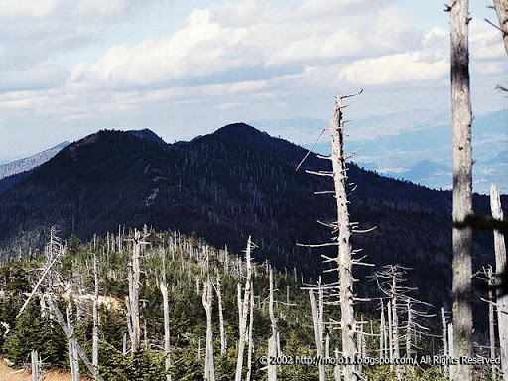
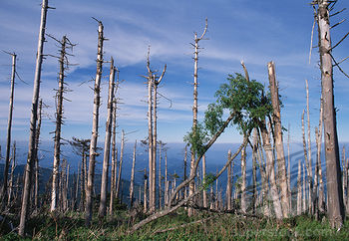
Acid Rain in NC
Mt. Mitchell is the highest point east of the Mississippi River
Acid rain has decimated trees high on mountaintops…why?

Slide 14
Acid Rain

Slide 15
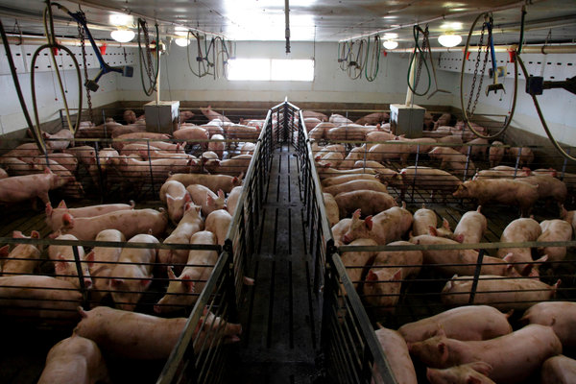
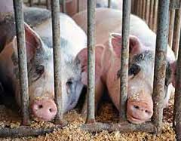
Habitat Degradation – Hog Farms
NC has lots of hog and poultry farms and utilizes concentrated animal feeding operations (CAFO-lots of animals in close quarters) for maximum efficiency in food processing
All of those animals = LOTS of waste….where does it go?

Slide 16
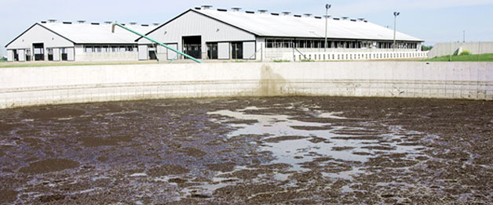
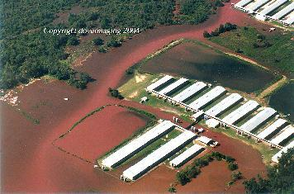
Habitat Degradation – Hog Farms
Waste collects in a lagoon outside hog house; when it rains and the lagoon overflows, water mixed with waste flows into nearby streams

Slide 17
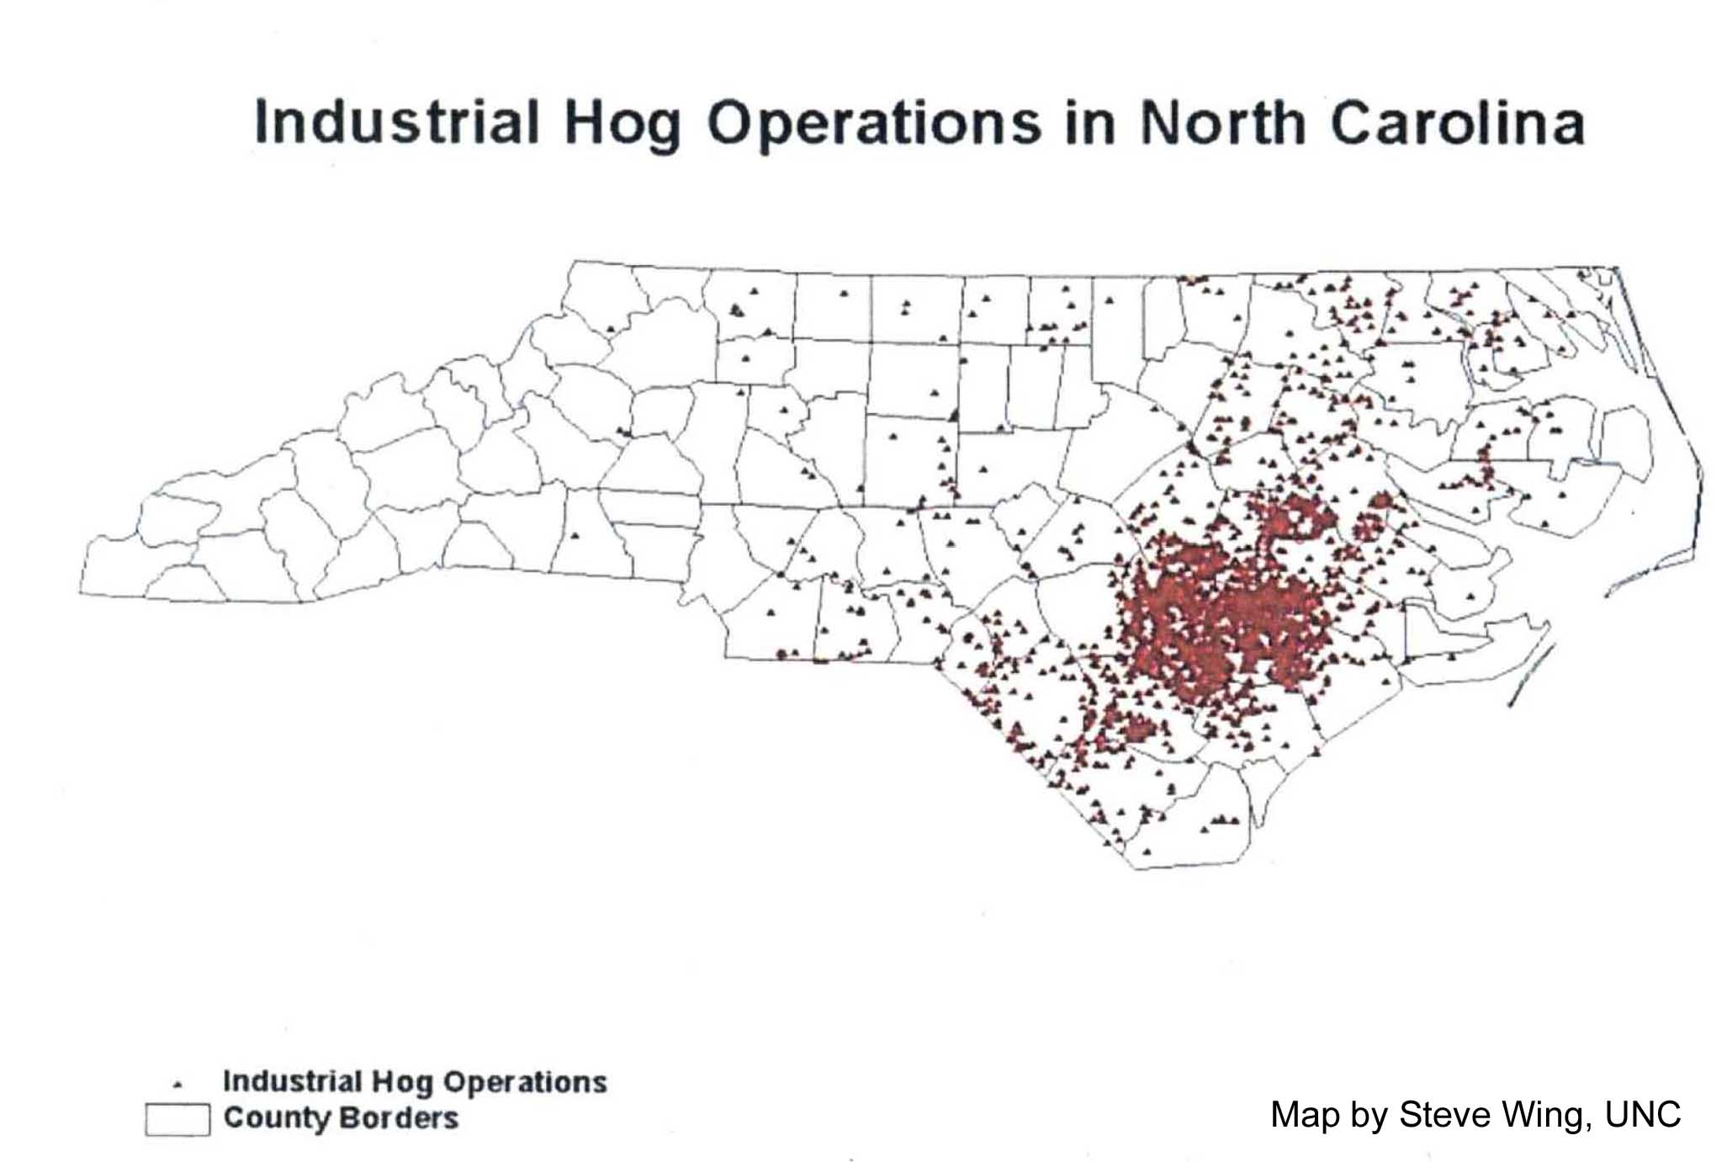
Habitat Degradation – Hog Farms
Harnett County

Slide 18
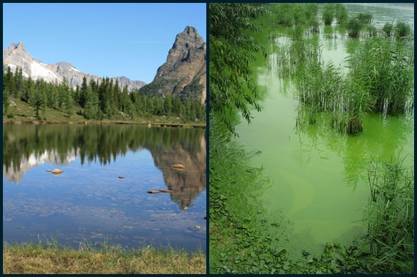
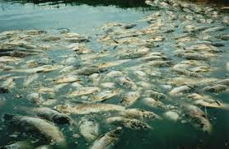
Habitat Degradation - Eutrophication
Excess fertilizer and animal waste runoff are carried into streams, rivers, and lakes. These nutrients allow algal blooms to occur. As the algae dies and decays, it removes oxygen from the water, killing the fish and creating dead zones.

Slide 19
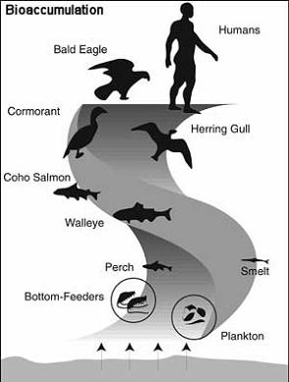
Bioaccumulation
Bioaccumulation is used to describe the increase in concentration of a substance in an organism over time.
Bioaccumulative substances tend to be fat soluble and not to be broken down by the organism.

Slide 20
Bioaccumulation

Slide 21
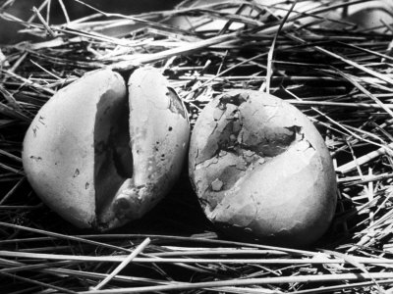
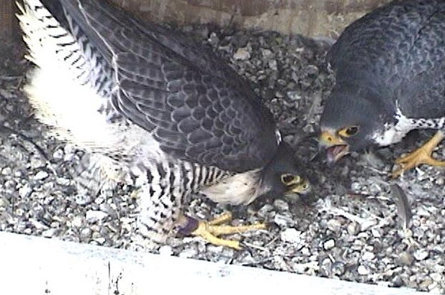
Bioaccumulation - DDT
DDT was used as a very effective pesticide in the 1980s, until it was determined that due to bioaccumulation, bird populations had great quantities of DDT in their bodies
Result of increased DDT levels led to thin eggshells that broke, killing the embryo; saw birds of prey populations decrease – consumed fish

Slide 22
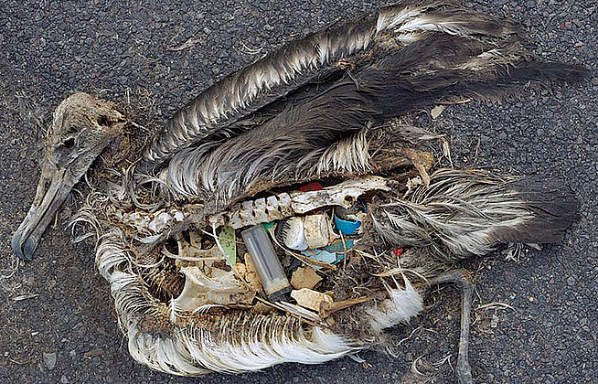
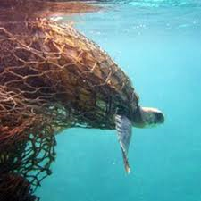
Trash Pollution
In our world driven by convenience, plastic and trash pollution leads to the death of many animals each year

Slide 23
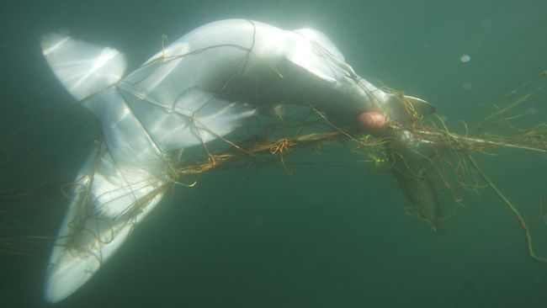
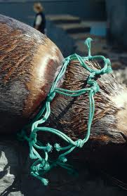
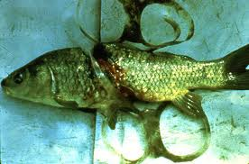
Trash Pollution
Abandoned fishing nets drown marine animals

Slide 24
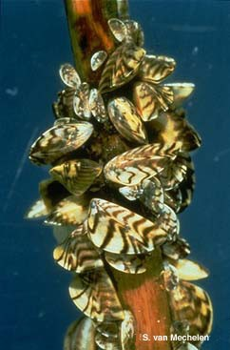
Invasive Species
An invasive species is a nonnative species whose introduction causes or is likely to cause economic, environmental, or harm to human health.
Can be an animal, plant, or microbes
Detrimental to ecosystem…why?

Slide 25
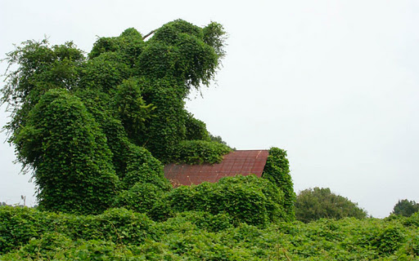
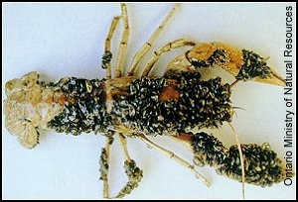
Invasive Species
Kudzu introduced intentionally to US as an ornamental plant and to help reduce soil erosion. However, it grows rapidly, smothering areas of native plants.
Zebra mussels were introduced unintentionally to Great Lakes from ballasts of ships. These fast growing mussels clear the water, but block many food chains.

Slide 26
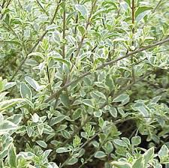
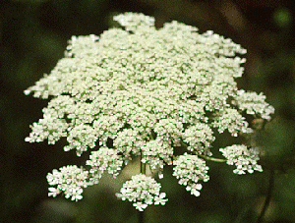
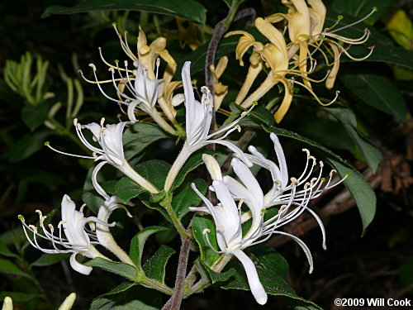
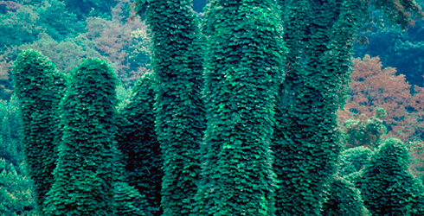
Invasive Species Present in NC
Kudzu, Japanese Honeysuckle, Queen Anne’s Lace, Chinese Privet

Slide 27
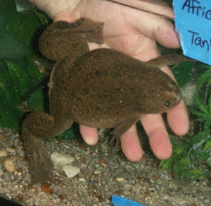
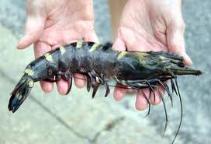
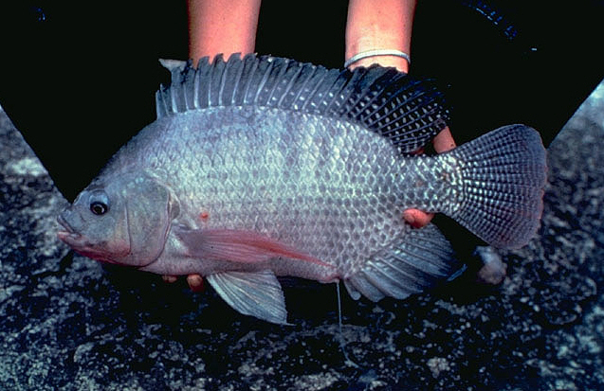
Invasive Species Present in NC
African Clawed Frog
Asian Shore Crab
Asian Tiger Shrimp
Rock bass
Blueback herring
Blue tilapia
Nile tilapia

Slide 28
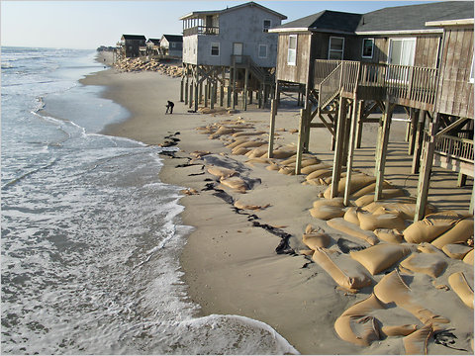
Beach Erosion- NC
More humans = more space to live
Build on beaches, but they constantly erode
Must artificially sustain beaches through beach nourishment projects
Sandbags to prevent loss of sand

Slide 29
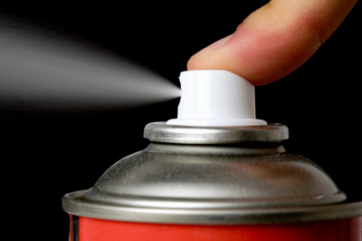
Ozone Depletion
Heavy use of chlorofluorocarbons (CFCs) during the 1900s led to the destruction of the ozone layer
CFC’s are a group of organic compounds commonly used as refrigerants and aerosol propellants

Slide 30
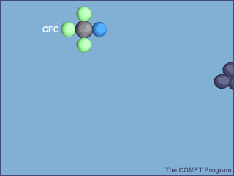
Ozone Depletion
CFCs are inert- they do not participate in chemical reactions. Unfortunately it also means that these compounds persist in the environment for long periods of time. CFCs eventually rise into the upper atmosphere. Here high energy radiation from the sun impacts the atmosphere and causes a variety of chemical reactions to occur. From the point of view of living creatures, one of the most important is the absorption of ultraviolet (UV) light by ozone, and its CFC molecule, a highly reactive halogen atom, such as chlorine, gets released. This chlorine atom then destroys ozone.

Slide 31
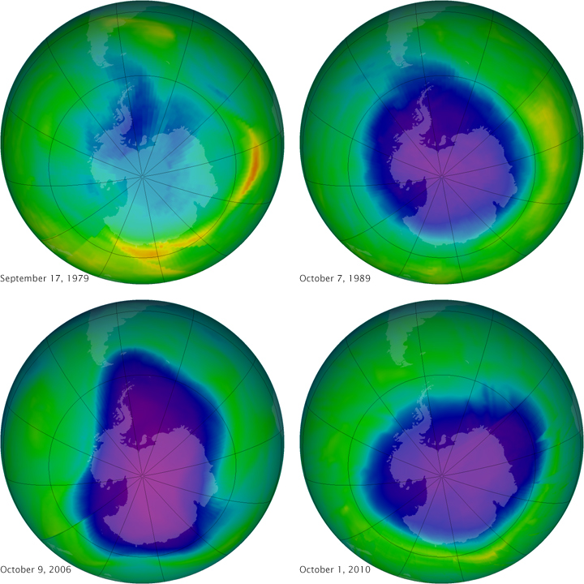
Ozone Depletion

Slide 32
Consequences of Loss of Biodiversity
Extinction – disappearance of a species when the last of its members dies; current rate of extinction has accelerated
Ecosystem collapse – if keystone species is removed, the entire ecosystem could collapse (EX: sea otter in kelp forests)
Possible Medicinal cures for diseases – unknown how many or what types of plants could contribute to medicine
Unknown – many ecosystems are so complex that ecologists cannot begin to predict ramifications of biodiversity loss

Slide 33
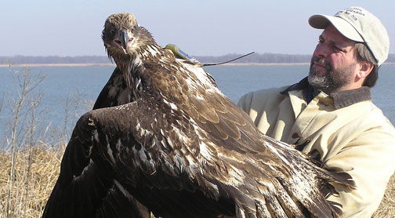
How to Protect Biodiversity?
Conservation biology – the study and implementation of methods to protect biodiversity
Legislation
Preserving Habitats
Reintroduction and Captive Breeding Programs
Reducing “ecological footprint”

