Slide 1
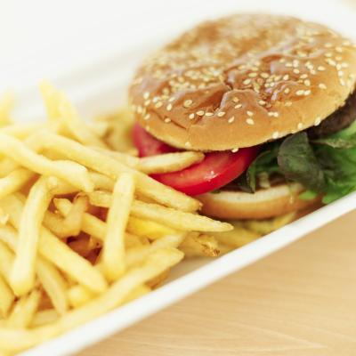
Lipids
Fats, Oils, Steroids, and Waxes

Slide 2
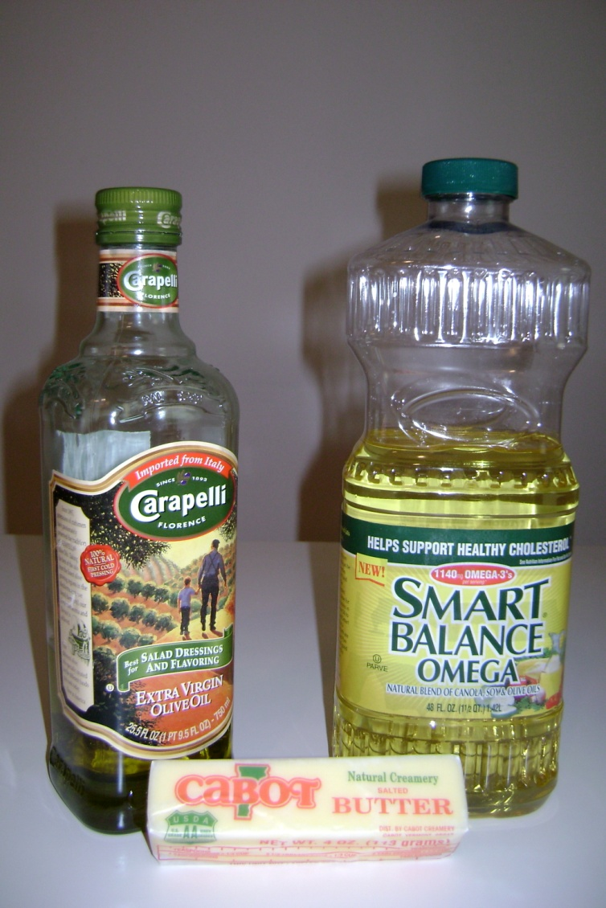
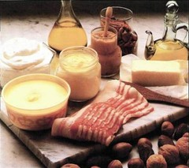
Lipid Basics
Lipids are made mostly from carbon and hydrogen
They are hydrophobic and don’t dissolve in water (insoluble)
Composed of glycerol + fatty acid monomers
Most common lipids are fats, oils, and waxes

Slide 3
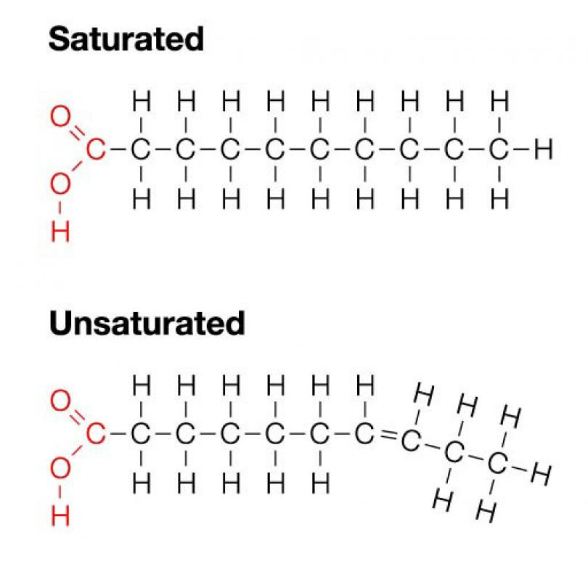
Fatty Acids
2 types – saturated and unsaturated
- What’s the difference?
- saturated fatty acids contain no double bonds between Carbon atoms
- holds the maximum # of H atoms
(saturated with hydrogen)
- unsaturated fatty acids contain double bonds between Carbon atoms

Slide 4
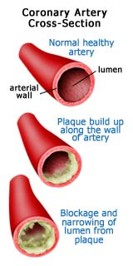
Saturated Fats
Found in animal products like bacon, whole milk, ice creams, fatty meats
They are a solid at room temperature
Tends to increase the amount of cholesterol in your body, which also increases your risk for heart attack and stroke by clogging arteries

Slide 5
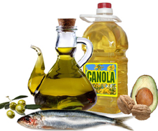
Unsaturated Fats
Found in plant products like canola oil, avocados, and nuts.
Tends to be a liquid at room temperature
Raises levels of good cholesterol in your body

Slide 6
Lipids – Types and Functions
Fats/Oils – long term energy storage, insulation and protection
Phospholipids – cell membranes
Steroids – make hormones (chemical messengers)
Waxes – waterproofing

Slide 7
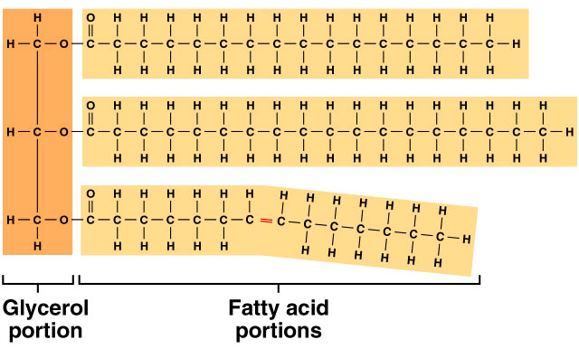
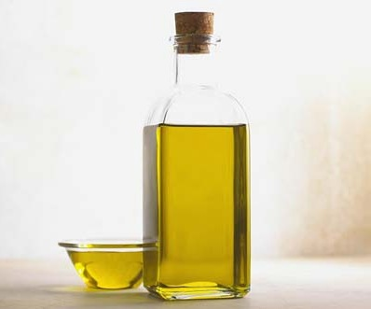
Lipids – Fats and Oils
Fats & Oils (triglycerides)- provide long term energy storage
Fat has twice the calories of carbohydrates.
fat = 9 cal/g sugar= 4 cal/g
The enormous energy is found within the hydrocarbon tails of the fatty acids.

Slide 8
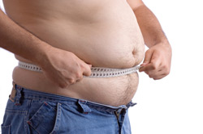
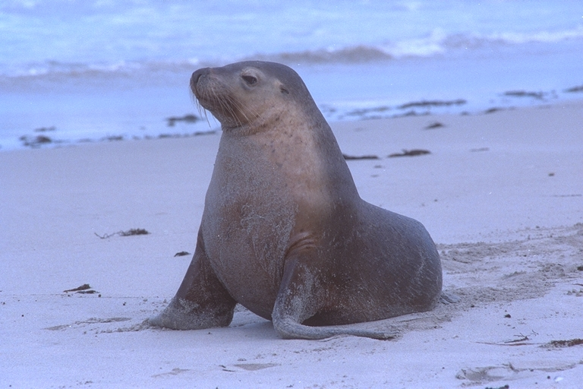
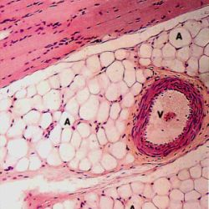
Body Fat – stores energy, insulates and protects the organs
Excess energy not used or burned off is converted to fat
Sea mammals rely on fat to keep them warm

Slide 9
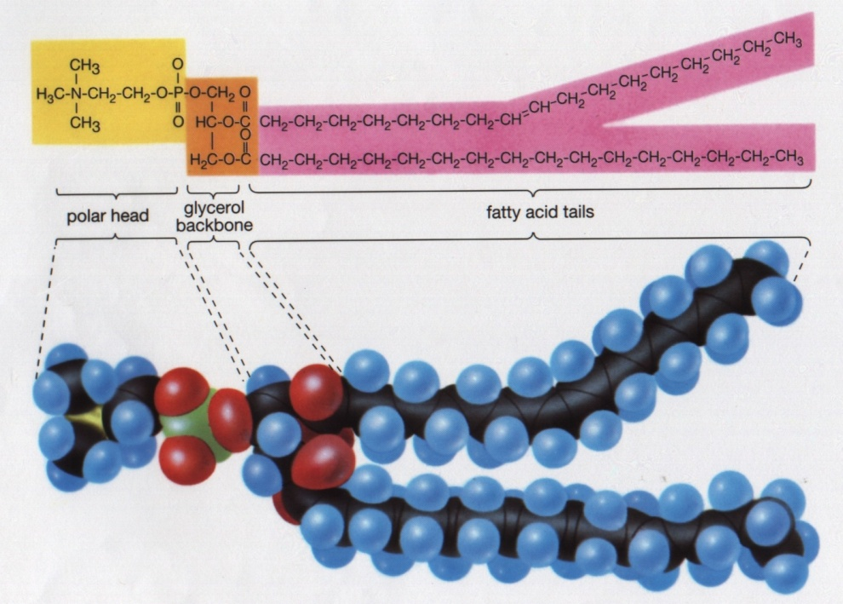
Lipids function to form cell membranes
Glycerol
only 2 fatty acids (not 3 like fats and oils)
3rd fatty acid is replaced by a phosphate molecule
SPONCH

Slide 10
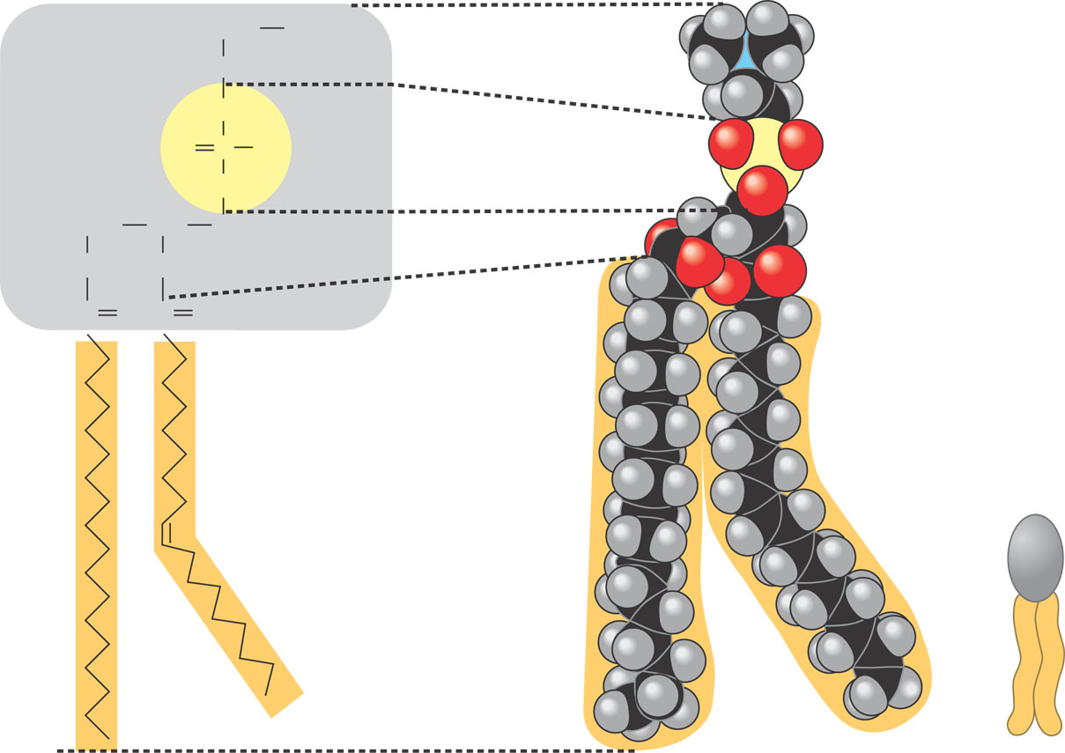
Phospholipid structure
Phosphate molecule forms a hydrophilic (water loving) head
Fatty acid molecules make up hydrophobic tails
CH₂
+
Choline
N(CH₃)₃
CH₂
Hydrophilic head
O
–
Phosphate
O
P
O
O
CH₂
CH
CH₂
Glycerol
O
O
C
C
O
O
Fatty acids
Hydrophobic tails
Hydrophilic
head
Hydrophobic
tails
Figure 5.13
(a) Structural formula
(b) Space-filling model
(c) Phospholipid
symbol
Notes:
10

Slide 11
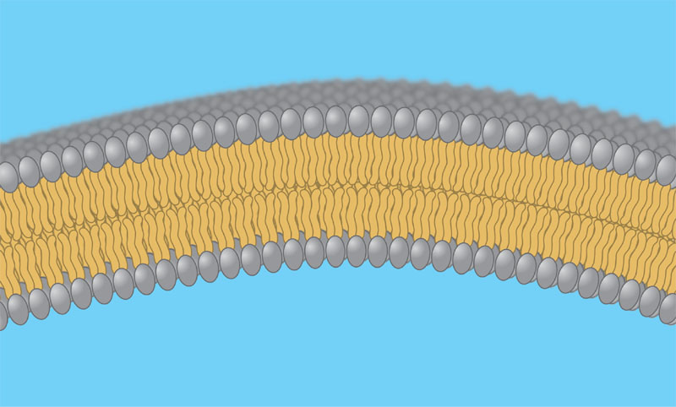
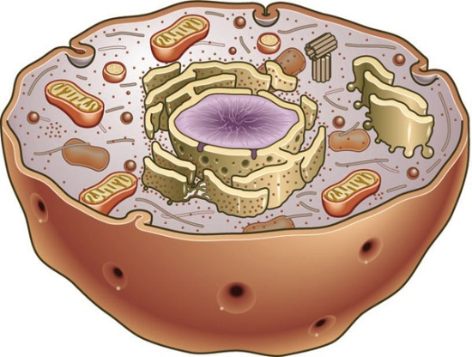
Phospholipids create the structure of cell membranes
2 layers of phospholipids
Phosphates face out – interact with water
Lipid tails make a middle layer that repels
water
Phospholipids separate the contents of the cell from it’s surrounding environment
Hydrophilic
heads
WATER
Hydrophobic
tails
WATER
Hydrophilic
heads
Notes:
11

Slide 12
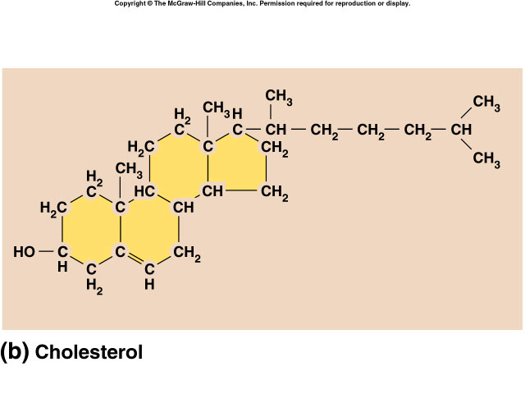
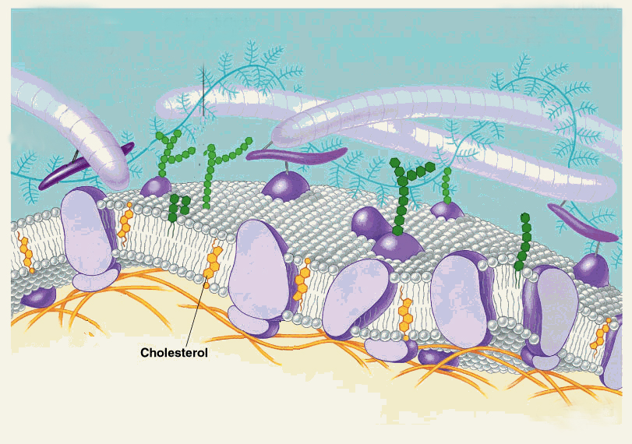
Lipids- Cholesterol
Four fused rings of carbon
Is a component of the cell membrane – adds to the integrity (structure) of the membrane

Slide 13
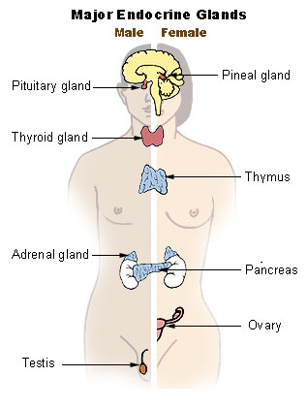
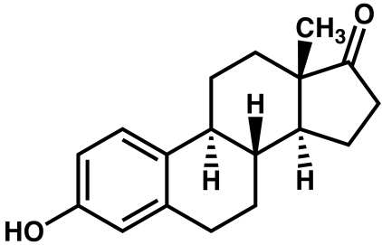
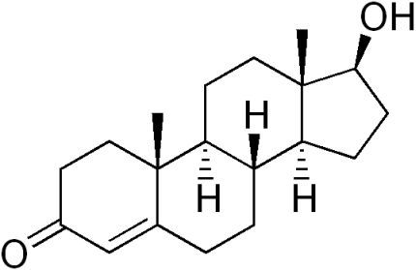
Steroids: Lipids that act as Hormones
Cholesterol used to make steroids
Hormones are chemical messengers
- produced in one part of the body, they travel to and
cause changes in another part of the body
- Hormones control:
growth
development
tissue function
sexual function
the way our bodies use food,
the reaction of our bodies to emergencies,
mood
- examples
estrogen
testosterone
Estrogen Testosterone

Slide 14
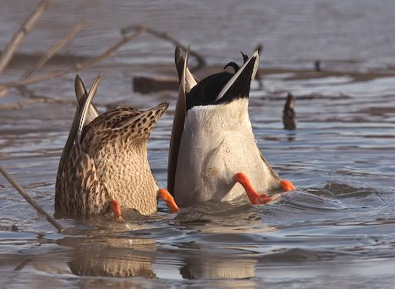
Waxes-Lipids that repel water
- found on the surface of leaves…why?
- found on animal hair to keep it pliable (bendable)
- found on the feathers of water birds to prevent them from becoming waterlogged (waterproofing)

Slide 15
Tests to detect the presence of lipids…
Grease spot test – Place substance on brown paper bag. Allow spots to dry, if lipid is present a translucent spot will be left behind.

Slide 16
Flashcards for Your Learning Pleasure
lipid basics
saturated fatty acids
unsaturated fatty acids
hydrophobic
hydrophilic
fats
oils
phospholipids
myelin
cholesterol
steroids
hormones
waxes

