Slide 1
Nucleic Acids

Slide 2
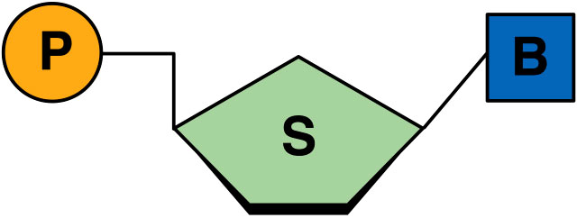
Nucleic Acids
Are composed of carbon, hydrogen, oxygen, nitrogen, and phosphorus (CHONP).
Made up of monomers called nucleotides
P = Phosphate Group
S= 5 Carbon Sugar (ribose or deoxyribose)
B= Nitrogen Base

Slide 3
Nucleic Acid Functions
There are two main functions of nucleic acids:
1. Store genetic information
2. Transfer genetic information

Slide 4
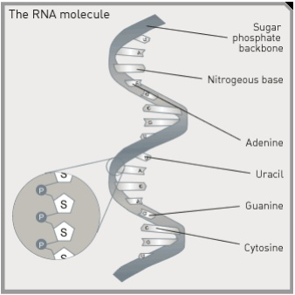
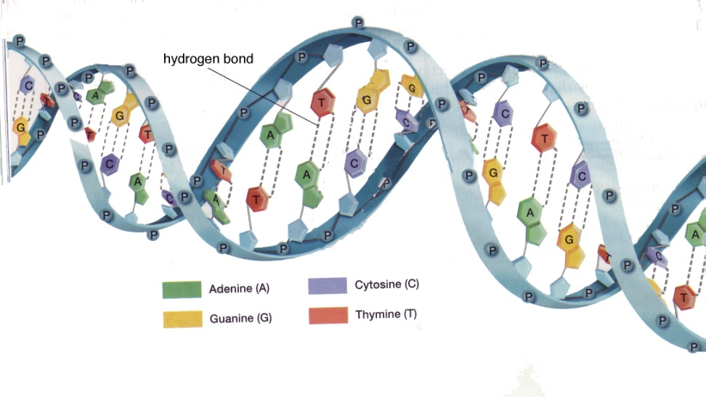
Nucleic Acids
There are two main types of nucleic acids:
(1) ribonucleic acid (RNA)
(2) deoxyribonucleic acid (DNA)

Slide 5
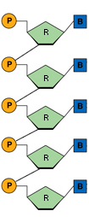
Ribonucleic Acid (RNA)
Contains a different sugar group (ribose)
Single strand of nucleotides that forms a single helix
Functions to transfer information from the DNA to the ribosomes
- carries a protein recipe to the ribosome
-ribosomes are structures in a cell that make protein

Slide 6
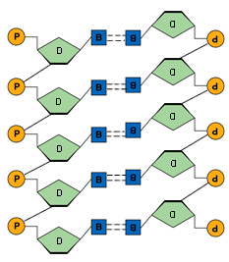
Deoxyribonucleic acid (DNA)
Contains the sugar deoxyribose
2 chains of
nucleotides held
together by weak hydrogen bonds
Forms a double helix
DNA stores hereditary information
- recipes for the proteins
found in the cell’s nucleus

Slide 7
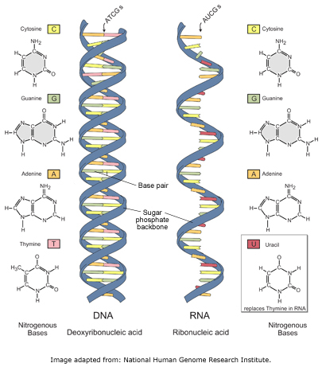
DNA vs. RNA
DNA
RNA
Double stranded
Sugar–Deoxyribose Sugar
Nitrogen Bases-
Adenine
Thymine
Guanine
Cytosine
Single strand
Sugar–
Ribose Sugar
Nitrogen Bases-
Adenine
Uracil
Guanine
Cytosine

