Slide 1
Proteins

Slide 2
Proteins
Some of the most diverse group of macromolecules (polymers)
Contain carbon, hydrogen, oxygen, and nitrogen (CHON)
Examples include:
(1) Antibodies
(2) Contractile Proteins
(3) Hormones (Insulin)
(4) Structural Proteins
(5) Enzymes

Slide 3
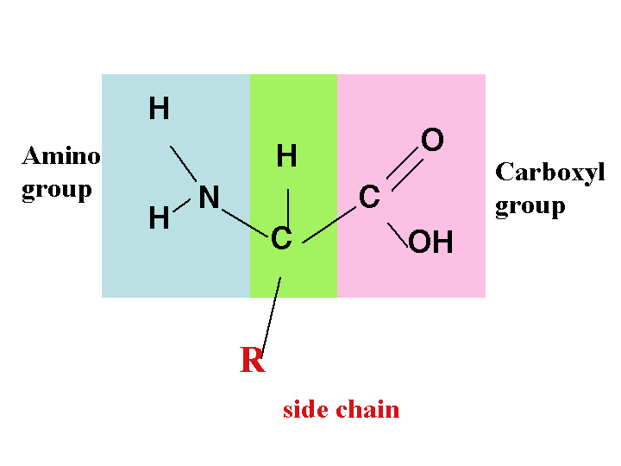
Protein Monomers
Proteins are composed of monomers called amino acids
There are 20 different amino acids that exist in nature!!

Slide 4
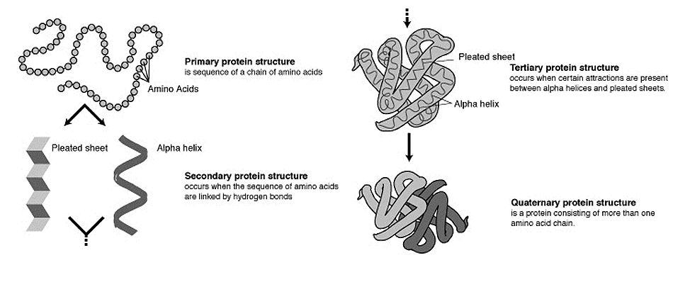
Proteins
Proteins can have up to four different levels of organization, and assume a 3-dimensional shape

Slide 5
Function of Proteins…
Proteins serve many different functions:
1. Muscles provide structural support and motion (actin and myosin)
2. Help fight disease (antibodies)
3. Regulate cell processes (hormones)
4. Transport substances into or out of cells (hemoglobin)
5. Structural proteins provide support (keratin and collagen)
6. Control reaction rates (enzymes)

Slide 6
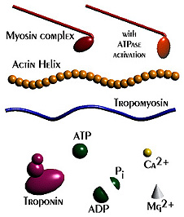
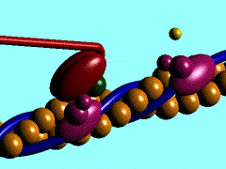
Protein Function - Movement
Contractile proteins are responsible for movement. Examples include actin and myosin. These proteins are involved in muscle contraction and movement.

Slide 7
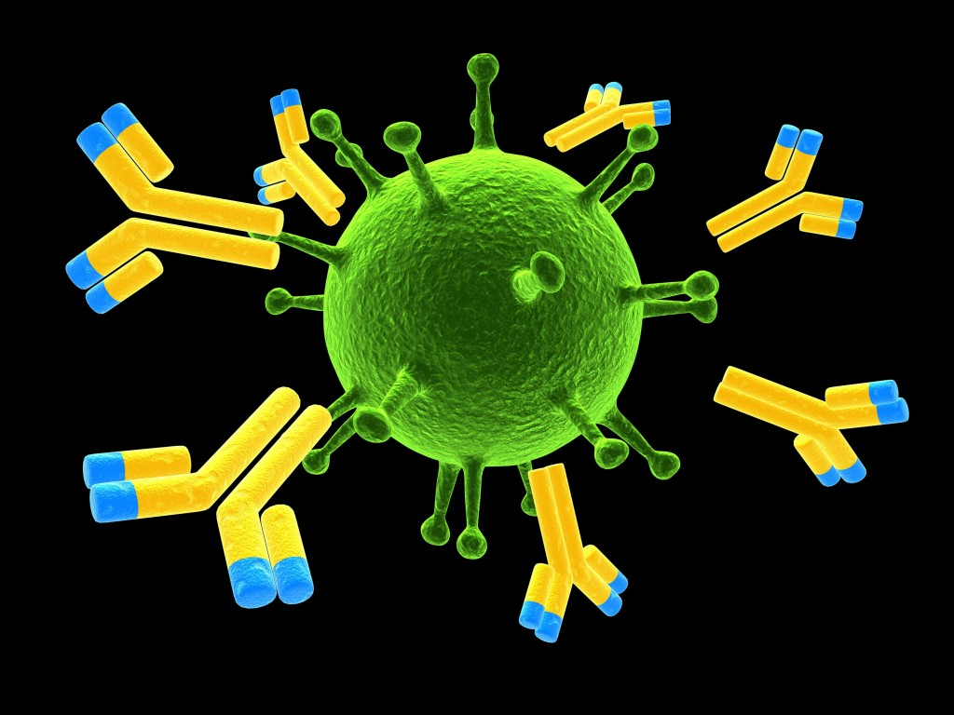
Function of Proteins…Antibodies
Proteins help fight disease. Antibodies are specialized proteins involved in defending the body from antigens (foreign invaders). They can travel through the bloodstream and are utilized by the immune system to identify and defend against bacteria, viruses, and other foreign intruders.

Slide 8
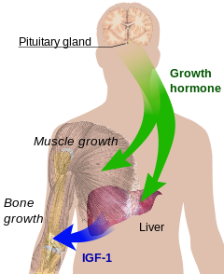
Protein Function - Hormones
Hormones are messenger proteins which help to regulate bodily activities and maintain homeostasis. Insulin regulates glucose metabolism by controlling the blood-sugar concentration.

Slide 9
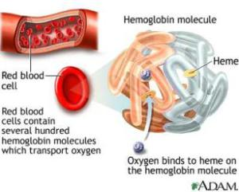
Protein Function – Cell Transport
Transport Proteins are proteins which move molecules from one place to another around the body. Hemoglobin transports oxygen through the blood.

Slide 10
Protein Function - Structure
Structural proteins are fibrous and stringy and provide support. Examples include keratin and collagen. Keratins strengthen protective coverings such as hair, nails, quills, feathers, horns, and beaks. Collagens provide support for connective tissues such as tendons and ligaments.

Slide 11
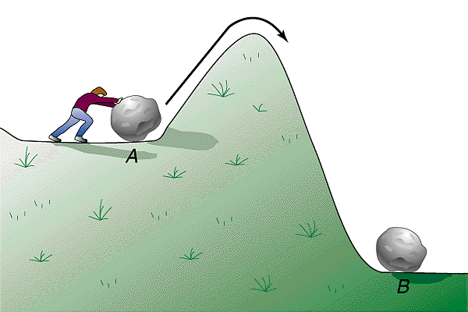
Protein Function - Enzymes
Enzymes are proteins that aid in biochemical reactions. Most chemical reactions require energy to begin
- the energy required to start a chemical reaction is called activation energy.

Slide 12
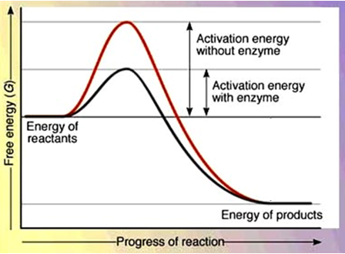
Protein Function - Enzymes
Enzymes are proteins which reduce the activation energy required for a chemical reaction to occur

Slide 13
Protein Function - Enzymes
Enzymes are often referred to as catalysts because they speed up chemical reactions. The catalyst does not change during the reaction!

Slide 14
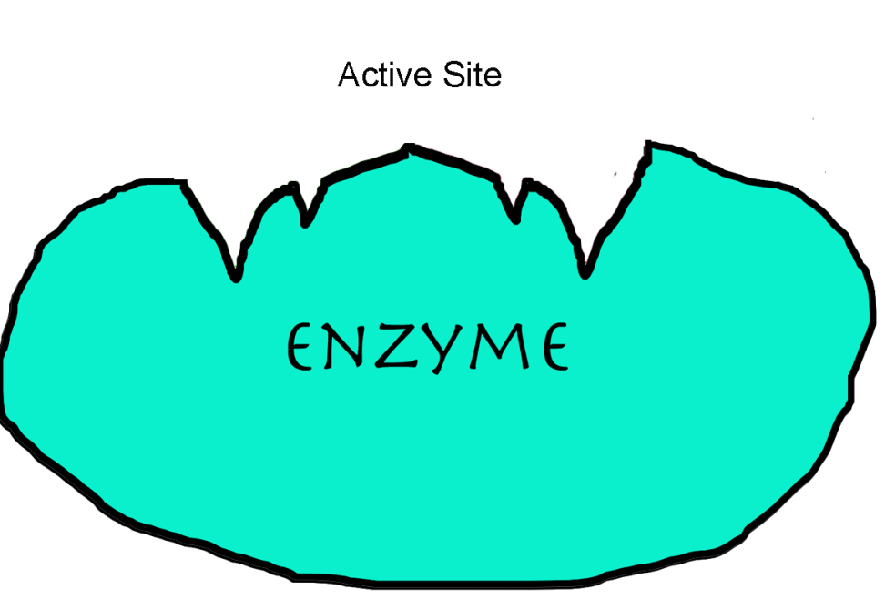
Protein Function - Enzymes
Enzymes have an area called an active site.
- the active site is where the chemical reaction occurs

Slide 15
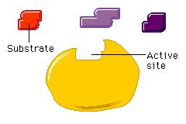
Protein Function - Enzymes
The active site of the enzyme fits with only one type of molecule known as the substrate.
The fact that the active site can only accept one type of substrate is known as enzyme specificity

Slide 16
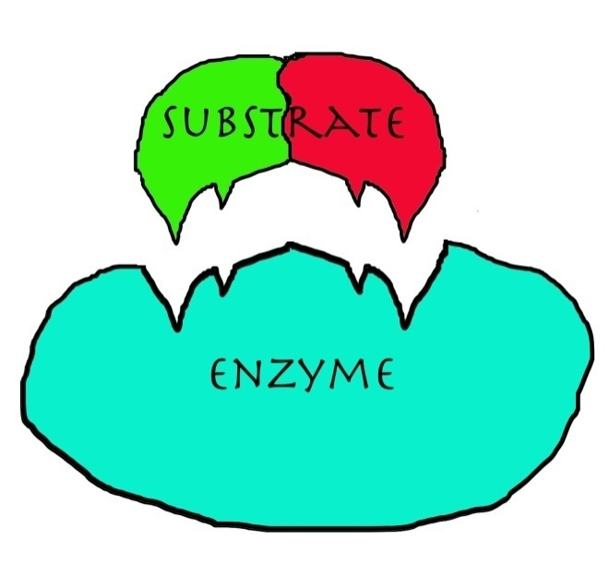
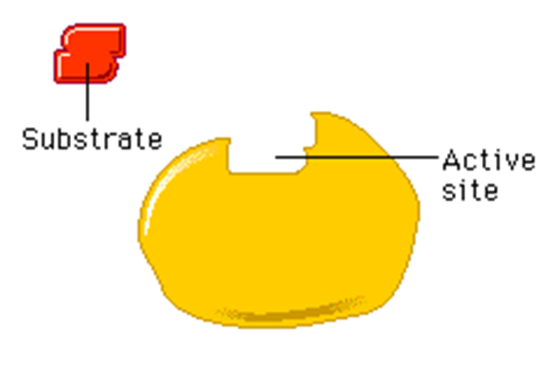
Protein Function - Enzymes
Enzymes work to bind to a substrate

Slide 17
Protein Function - Enzymes
Enzymes are affected by two main factors:
(1) pH
(2) temperature

Slide 18
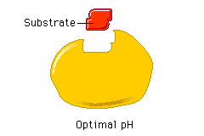
Protein Function - Enzymes
Each enzyme functions best within a certain pH range. For example, the enzyme pepsin, which works in your stomach, functions best in a strongly acidic environment. When the pH changes, the active site distorts and affects enzyme function.

Slide 19
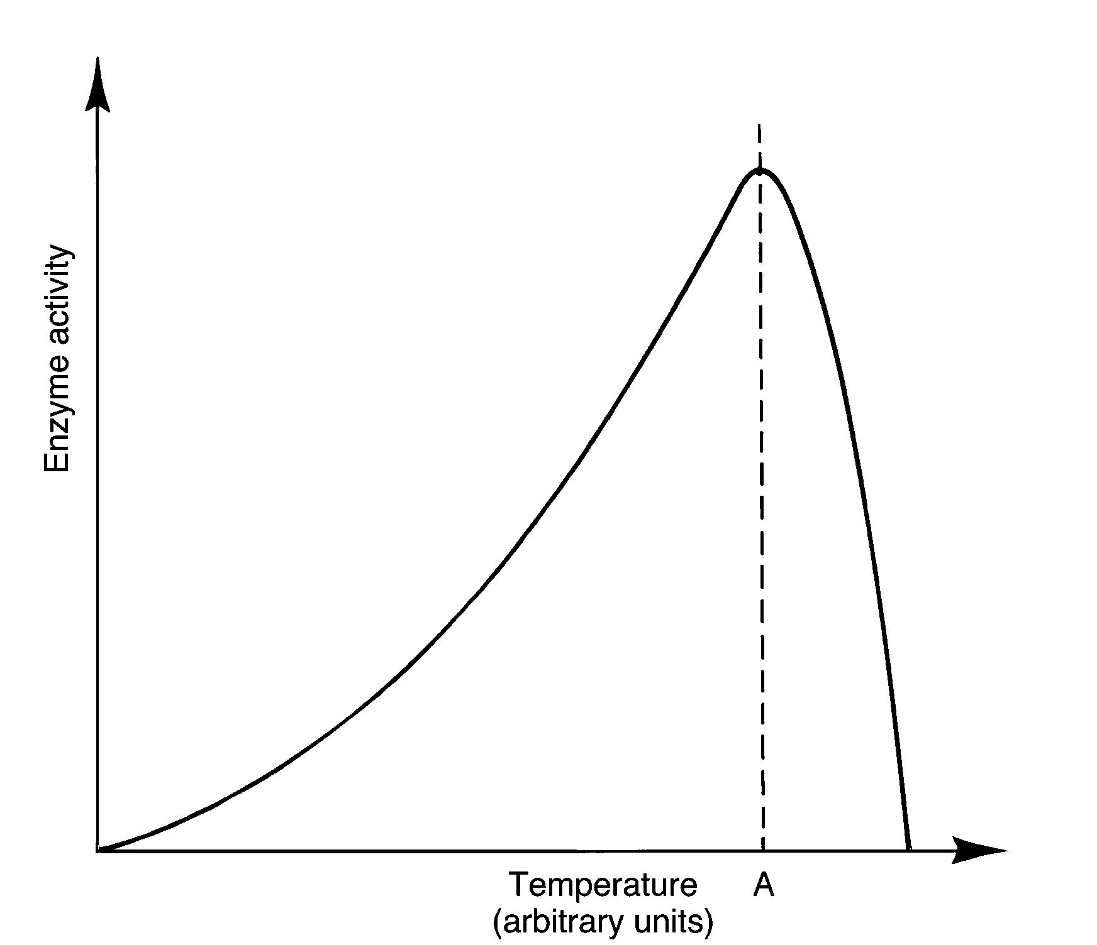
Protein Function - Enzymes
Chemical reactions speed up as temperature is increased, so, in general, reactions will increase at a faster rate at higher temperatures. However, each enzyme has a temperature optimum, and beyond this point the enzyme's functional shape is lost. Boiling temperatures will denature most enzymes.

Slide 20
Protein Function – Common Enzymes
Enzymes often end in the suffix –ase.
Amylase - breaks down starch
Catalase – breaks down H₂O₂
DNA polymerase – joins DNA nucleotides to build DNA
Lipase – break apart fats
Lactase – breaks apart lactose – milk sugar
Protease- breaks apart protein molecules

