Slide 1
Recombinant DNA

Slide 2
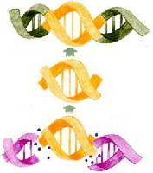
Gene splicing: DNA is cut out of one organism and put into another organism. This creates recombinant DNA – DNA artificially formed by combining genetic material from several different organisms.
A trait will be transferred from one organism to another.
For example: the human insulin gene can be removed from a human cell. It can be put into a bacterial cell. The bacteria will now make human insulin.

Slide 3
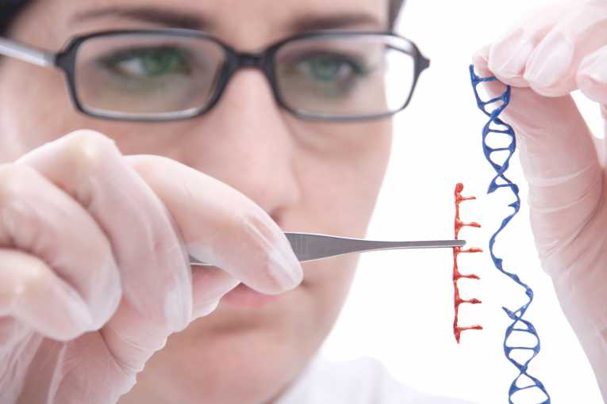
This picture represents gene splicing.
However, DNA is much smaller.
Its done with high tech lab equipment since DNA is too small to hold or see without a microscope.
The red piece the woman is holding is an insulin gene from a human being. It is being combined with DNA from a bacteria.
Creates recombinant DNA, something that has never existed before.

Slide 4
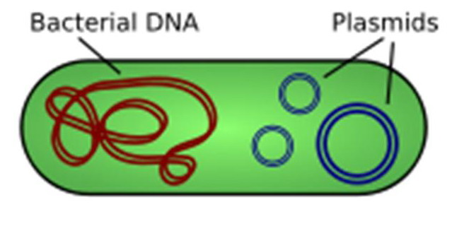
How are genes cut for gene splicing?
A bacterial plasmid is used.
Plasmid: circular DNA in a bacteria cell. It is very simple and easy to manipulate.

Slide 5
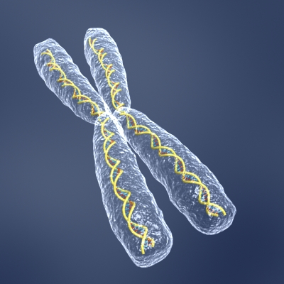
Gene splicing- cutting genes out of DNA
How to splice genes:
A restriction enzyme cuts the insulin gene out of the human DNA.
2. A plasmid is removed from a bacteria and cut with a restriction enzyme

Slide 6
A restriction enzyme: enzyme that cuts the DNA at a specific sequence.
There are thousands of restriction enzymes.
Each cuts DNA at a different sequence.
Some look for GGCC and cut in between the G and C.
Every time GGCC is found in the DNA it is cut by the restriction enzyme
The restriction enzyme cuts the DNA, leaving “sticky ends” which helps the new gene to attach. The ends are then stitched together by another enzyme

Slide 7
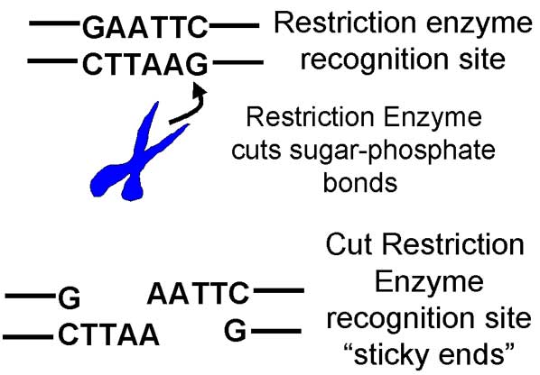
Sticky Ends

Slide 8
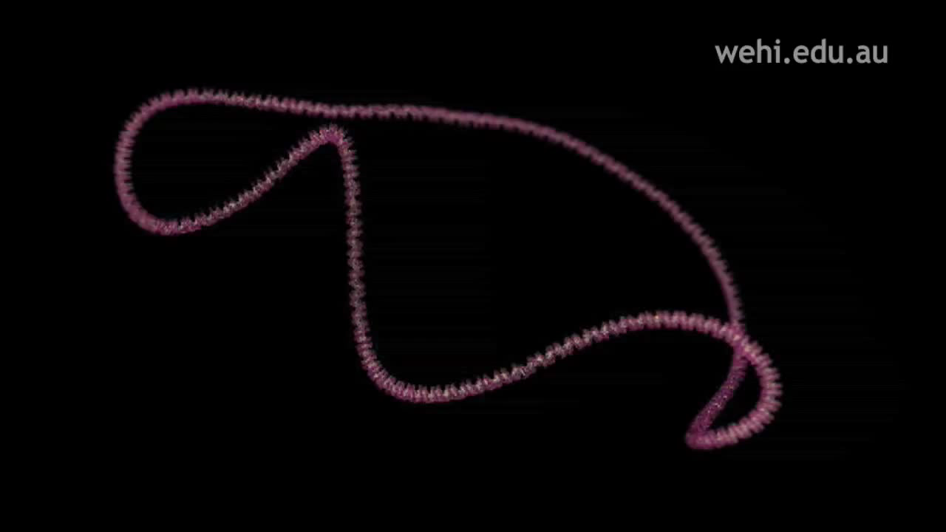
This is how a restriction enzyme works

Slide 9
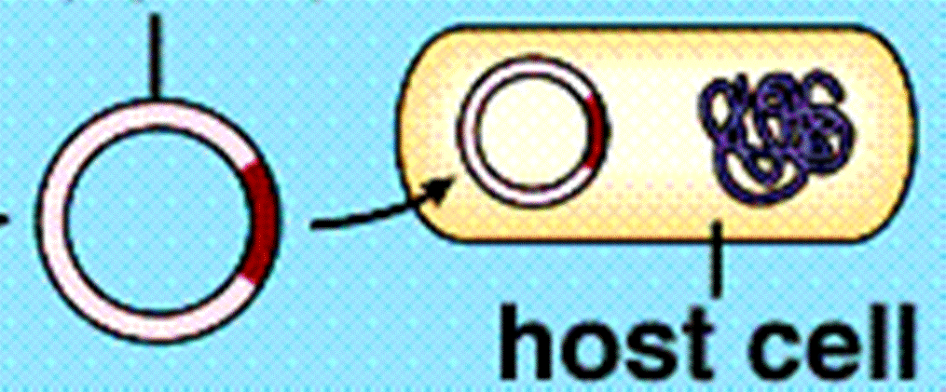
3. The human gene is placed into the bacteria plasmid via a vector (way to get a DNA from one organism into another!). In this case, a plasmid is used!
4. The plasmid is placed back into the bacterial cell. The cell now has directions (DNA) to make insulin. That's exactly what it does. Its human insulin, bacteria do not make insulin on their own.
Plasmid with insulin gene

Slide 10
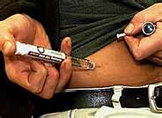
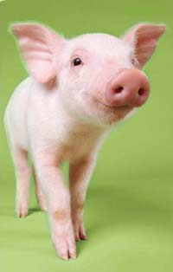
Benefits:
Insulin is cheaper
There are no side effects because it is human insulin.
We once used pig insulin but there are side effects and it is more expensive.

