Slide 1
Simple Dominant Traits
Simple dominant traits need only 1 allele in order to express phenotype – RR or Rr
Examples: Huntington’s disease
Cleft chin, widow’s peak

Slide 2
Simple Dominant Traits
1 homozygous dominant
2 heterozygous
1 homozygous recessive
R r
RR | Rr
Rr | rr
R
r

Slide 3
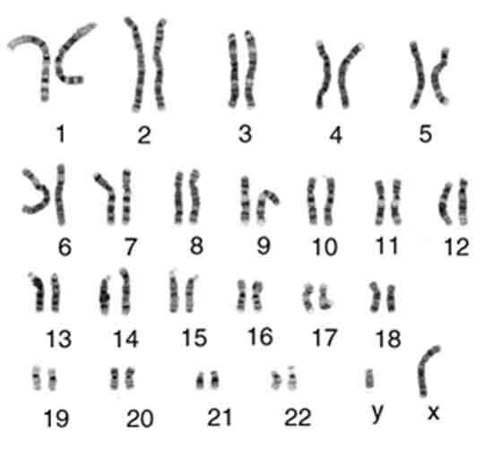
Human Genetics Vocabulary
Autosomes
Karyotype: chart that shows all of one individual’s chromosomes arranged in pairs (one from mom, one from dad)
Autosomes: non-sex chromosomes (chromsomes #1-22)
Sex chromosomes: Chromosomes that determine an individual’s gender (chromosome #23 – X and Y)
Sex chromosomes

Slide 4
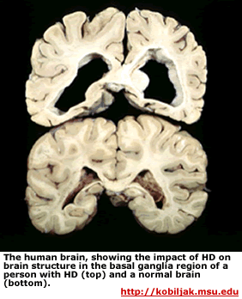
Autosomal Dominant Disorder: Huntington’s
Huntington's disease is an inherited disease that causes the progressive breakdown of nerve cells in the brain. Huntington's disease has a broad impact on a person's functional abilities and usually results in movement, thinking (cognitive) and psychiatric disorders.

Slide 5
Simple Recessive Disorders
Recessive Disorders affect offspring with 2 recessive alleles
(homozygous recessive)
Most genetic disorders are caused by recessive alleles

Slide 6
Recessive Disorders
Cystic Fibrosis
1 in 28 white Americans carry recessive allele
Defective PROTEIN in plasma membrane that results in accumulation of mucus in lungs and digestive tract
Average life expectancy about 30 years

Slide 7
Recessive Disorders
Tay-Sachs
Absence of ENZYME that breaks down LIPIDS
Lipids accumulate in nerve cells that leads to progressive loss of muscular and neural function
Death usually by about 5 years of age

Slide 8
Recessive Disorders
Phenylketonuria (PKU)
Absence of ENZYME to convert phenylalanine to tyrosine
Phenylalanine cannot be broken down
Accumulates in cells, damages Central Nervous System, leading to mental retardation

